Slide 1
KneeBoard
☝️ Click for Update
VER. 24.2.18
by Flyingdeuk
Domestic
Japan
China
S.E Asia(GUM)
Supplement
FUEL Consumption
NO Engine Bleed
GND Air / Cross Bleed
Cold Temp Correction
Cold Wx Operation
ENG ON Deicing | ENG OFFDeicing
Notes:
Kneeboard

Slide 2
Domestic
GMP | CJU
GMP | PUS
CJU | KWJ
CJU | CJJ
CJU | TAE
CJU | PUS
ICN | PUS
ICN | TAE
Welcome PA
Next Page
Home
Notes:
Dometic

Slide 3
WELCOME PA
손님 여러분, 안녕하십니까? 저는 기장 ___입니다. 저희 대한항공을 이용해 주셔서 대단히 감사합니다 ___ (국제)공항까지 비행시간은 ___시간 ___분 으로 예상됩니다. 비행 중에는 항공기가 갑자기 흔들릴 수도 있으니, 자리에 않아 계실 때에는 항상 좌석벨트를 매주시기 바랍니다. 저는 여러분을 안전하게 모시기 위해 최선을 다하겠습니다. 감사합니다.
Good morning (afternoon /evening), ladies and gentlemen. This is captain last name speaking. Welcome aboard Korean Air. This flight is bound for ___(international) airport and our flight time is ___ hours(s) and minutes. For your safety, keep your seatbelts fastened while you are seated. Thank you for choosing Koreanair. Please enjoy the flight.
Domestic
GMP | 서울/김포국제
ICN | 서울/인천국제
CJU | 제주국제
PUS | 부산/김해국제
CJJ | 청주국제
KWJ | 광주
TAE | 대구국제
Home
Domestic
도착 방송 Next Page
Notes:
Domestic PA

Slide 4
도착 방송 (5시간이상, 40분전) 출발지 기준 2200-0800 Quiet Hour
손님 여러분, 저는 기장입니다. 우리 비행기는 앞으로 약 (40)분 후에 ___국제공항에 착륙 예정입니다. 현재 공항의 날씨는 ◐___, 기온은 섭씨 __도 입니다.
◐ 맑으며 ◐ (다소)흐리며 ◐ (이슬)비가 내리며/소나기가 내리며 ◐ 바람이 불고 있으며 |  | ◐ 눈이 오고 있으며 ◐ 안개가 끼어 있으며 ◐ 황사가 있으며
지금 이곳의 시각은 __월 __일 __요일, 오전(오후) __시 __분 입니다. 감사합니다.
Ladies and gentlemen, this is the captain speaking. We expect to land at __ international airport in about (40) minutes. The current temperature at ___ is __ degrees Celsius, or __ degrees Fahrenheit (OPT 참고) and it is ◐___.
◐ (mostly) clear ◐ (partly) cloudy ◐ drizzling / raining ◐ windy | ◐ snowing ◐ foggy ◐ hazy or smoggy
The current time is __ : __ a.m(p.m), on (day-of-the-week), (month)(date). Thank you for flying with us today.
Domestic

Slide 5
Japan
GMP | KIX
PUS | NRT
ICN | KIX
ICN | NRT
ICN | CTS
ICN | HND
ICN | NGO
ICN | FUK
ICN | AOJ
Welcome PA
Next Page
Home

Slide 6
WELCOME PA
손님 여러분, 안녕하십니까? 저는 기장 ___입니다. 저희 대한항공을 이용해 주셔서 대단히 감사합니다 ___ (국제)공항까지 비행시간은 ___시간 ___분 으로 예상됩니다. 비행 중에는 항공기가 갑자기 흔들릴 수도 있으니, 자리에 않아 계실 때에는 항상 좌석벨트를 매주시기 바랍니다. 저는 여러분을 안전하게 모시기 위해 최선을 다하겠습니다. 감사합니다.
Good morning (afternoon /evening), ladies and gentlemen. This is captain last name speaking. Welcome aboard Korean Air. This flight is bound for ___(international) airport and our flight time is ___ hours(s) and minutes. For your safety, keep your seatbelts fastened while you are seated. Thank you for choosing Koreanair. Please enjoy the flight.
Japan
KIX | 오사카/간사이
HND | 도쿄/하네다
NRT | 도쿄/나리타
CTS | 삿포로/신(뉴) 치토세
NGO | 나고야/주부(센트레아)
FUK | 후쿠오카
AOJ | 아오모리
Japan

Slide 7
China
GMP | SHA
GMP | PEK
CJU | PEK
PUS | PVG
ICN | NKG
ICN | TAO
ICN | PEK
ICN | SHE
ICN | PVG
ICN | YNJ
ICN | HGH
ICN | WHE
ICN | XIY
ICN | CSX
ICN | HKG
Welcome PA Next Page
Home

Slide 8
WELCOME PA
손님 여러분, 안녕하십니까? 저는 기장 ___입니다. 저희 대한항공을 이용해 주셔서 대단히 감사합니다 ___ (국제)공항까지 비행시간은 ___시간 ___분 으로 예상됩니다. 비행 중에는 항공기가 갑자기 흔들릴 수도 있으니, 자리에 않아 계실 때에는 항상 좌석벨트를 매주시기 바랍니다. 저는 여러분을 안전하게 모시기 위해 최선을 다하겠습니다. 감사합니다.
Good morning (afternoon /evening), ladies and gentlemen. This is captain last name speaking. Welcome aboard Korean Air. This flight is bound for ___(international) airport and our flight time is ___ hours(s) and minutes. For your safety, keep your seatbelts fastened while you are seated. Thank you for choosing Koreanair. Please enjoy the flight.
China | China
SHA | 상하이/홍차오
NKG | 난징/루커우
TAO | 칭다오/자오동
PEK | 베이징/소우뚜(캐피털)
SHE | 선양/탸오쎈
PVG | 상하이/푸동
YNJ | 옌지
HGH | 황저우/샤오산
WHE | 웨이하이/따쉐이푸오
XIY | 시안/시엔양
CSX | 창사/후앙후아
HKG | 홍콩
China

Slide 9
S.E Asia
ICN | CXR
ICN | SGN
ICN | PNH
ICN | MNL
ICN | TPE
PUS | TPE
ICN | GUM
Welcome PA
Next Page
Home

Slide 10
WELCOME PA
손님 여러분, 안녕하십니까? 저는 기장 ___입니다. 저희 대한항공을 이용해 주셔서 대단히 감사합니다 ___ (국제)공항까지 비행시간은 ___시간 ___분 으로 예상됩니다. 비행 중에는 항공기가 갑자기 흔들릴 수도 있으니, 자리에 않아 계실 때에는 항상 좌석벨트를 매주시기 바랍니다. 저는 여러분을 안전하게 모시기 위해 최선을 다하겠습니다. 감사합니다.
Good morning (afternoon /evening), ladies and gentlemen. This is captain last name speaking. Welcome aboard Korean Air. This flight is bound for ___(international) airport and our flight time is ___ hours(s) and minutes. For your safety, keep your seatbelts fastened while you are seated. Thank you for choosing Koreanair. Please enjoy the flight.
S.E Asia | 상하이/홍차오
CXR | 베트남 나짱/깜라인
SGN | 베트남 호찌민/탄소넛
PNH | 캄보디아 프놈펜
MNL | 필리핀 마닐라/니노이 아키노
TPE | 타이페이/타이완 타오유엔
PGUM | 괌
SE Asia
도착 방송 Next Page

Slide 11
도착 방송 (5시간이상, 40분전) 출발지 기준 2200-0800 Quiet Hour
손님 여러분, 저는 기장입니다. 우리 비행기는 앞으로 약 (40)분 후에 ___국제공항에 착륙 예정입니다. 현재 공항의 날씨는 ◐___, 기온은 섭씨 __도 입니다.
◐ 맑으며 ◐ (다소)흐리며 ◐ (이슬)비가 내리며/소나기가 내리며 ◐ 바람이 불고 있으며 |  | ◐ 눈이 오고 있으며 ◐ 안개가 끼어 있으며 ◐ 황사가 있으며
지금 이곳의 시각은 __월 __일 __요일, 오전(오후) __시 __분 입니다. 감사합니다.
Ladies and gentlemen, this is the captain speaking. We expect to land at __ international airport in about (40) minutes. The current temperature at ___ is __ degrees Celsius, or __ degrees Fahrenheit (OPT 참고) and it is ◐___.
◐ (mostly) clear ◐ (partly) cloudy ◐ drizzling / raining ◐ windy | ◐ snowing ◐ foggy ◐ hazy or smoggy
The current time is __ : __ a.m(p.m), on (day-of-the-week), (month)(date). Thank you for flying with us today.
SE Asia

Slide 12

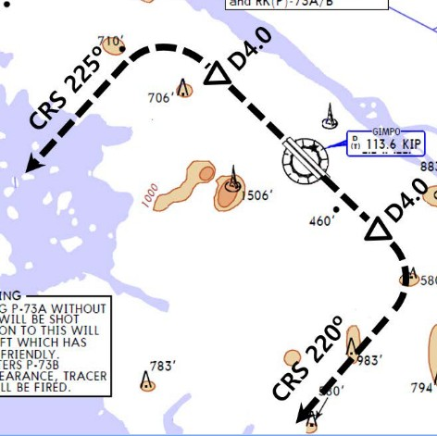
RKSS(GMP) 59ft | RKPC(CJU) 119ft
KE GMP 131.15 DCL -15분 가능 TOBT 5분 차이시 CTC Comm | KE CJU 129.4
PA
Rwy 32R Takeoff
(06:00L~0900L / 12:00L~15:00L /18:00L~21:00L)
GMP : SID (NADP 1)
32L/R | BULTI xT |  | 324 |  | 324 |  | 5000 |  | 324
 | (BULTI xQ) |  | 324 |  | 324 |  | 5000 |  | 324
14L/R | BULTI xU |  | 144 |  | 144 |  | 6000 |  | 144
 | (BULTI xZ) |  | 144 |  | 144 |  | 6000 |  | 144
KIP 113.6 |  | 32L 108.3 | 32R 110.7 |  |  | 14L 109.9 |  | 14R 108.7
32L/R : KIP324/4, R225 YJU R271 |  |  |  | 14L/R : KIP144/4, R220 P73 /2
HUD |  | 32L(41’) |  | 10499’ |  |  | 14R(34’)
 |  | 32R(42’) |  | 11811’ |  |  | 14L(38’)
APRON(130.875) -> GND(121.9) -> TWR (All by ATC)
Domestic
CJU : STAR AFT Merge PT(220kts) DCT IAF(210kts), FAF (160kts)
ILS Z 07 | DOTOL xP |  | YUMIN |  | DOTOL 160
ILS Z 25 | DOTOL xT |  | DUKAL |  | DOTOL/-10 160
HUD |  | 07(87’) |  | 10433’ |  | 25(76’)
07 : P6(5176’), P5(5882’), P4(6840’-ATC HIRO) 25 : P7(5219’), P8(5882’), P10(7524’-ATC HIRO)
Entering Rapid TWY CTC GND 121.675 (STOP x) HST 40KTS

Slide 13

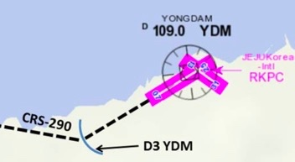
RKPC(CJU) 119ft | RKSS(GMP) 59ft
KE CJU 129.4 DCL -10분 | KE GMP 131.15
PA
Rwy 32L Landing
(06:00L~0900L / 12:00L~15:00L /18:00L~21:00L)
CJU : SID (NADP 1)
07 | KAMIT xE |  |  | 066 |  | 066 |  | 10000 | 066
25 | KAMIT xW |  |  | 246 |  | 246 |  | 10000 | 246
YDM 109.0 |  |  | 07 109.9 |  |  |  | 25 111.3
07 : NONE |  |  |  |  | 25 : YDM246/3, R290
HUD |  | 07(87’) |  |  | 10433’ |  |  | 25(76’)
07 : Passing G4 CTC TWR 25 : 31 Holding PSN on P, E1,2,3 CTC TWR
Domestic
GMP : STAR
ILS 32L/R | OLMEN xT | OLMEN xT | BUMSI | OLMEN 160
ILS 14R | OLMEN xU | OLMEN xU | DOKDO | OLMEN 160
HUD |  | 32L(41’) | 10499’ | 14R(34’)
 |  | 32R(42’) | 11811’ | 14L(38’)
FIX | KIP /8(RWY 32), YJU R271, P73 /2
32L : D3(6532’), E2(9117’), 32R : E1(6614’) 14R : C1(6578’)
32L/R : 8 KIP L/G, 14R : LOC CAPT L/G FAF : Final Flap TWR -> GND -> APRON (All by ATC) Except RWY14R Landing (Until R)

Slide 14
RKSS(GMP) 59ft | RKPK(PUS) 13ft
KE GMP 131.15 DCL -15분 가능 TOBT 5분 차이시 CTC Comm | KE Gimhae 129.2
PA
Rwy 32R Takeoff
(06:00L~0900L / 12:00L~15:00L /18:00L~21:00L)
GMP : SID (NADP 1)
32L/R | OSPOT xT |  | 324 |  | 324 |  | 5000 |  | 324
 | (OSPOT xQ) |  | 324 |  | 324 |  | 5000 |  | 324
14L/R | OSPOT xU |  | 144 |  | 144 |  | 6000 |  | 144
 | (OSPOT xZ) |  | 144 |  | 144 |  | 6000 |  | 144
KIP 113.6 |  | 32L 108.3 | 32R 110.7 |  |  | 14L 109.9 |  | 14R 108.7
32L/R : KIP324/4, R225 YJU R271 |  |  |  | 14L/R : KIP144/4, R220 P73 /2
HUD |  | 32L(41’) |  | 10499’ |  |  | 14R(34’)
 |  | 32R(42’) |  | 11811’ |  |  | 14L(38’)
APRON(130.875) -> GND(121.9) -> TWR (All by ATC)
Domestic
PUS : STAR (Tail Wind 36R 136000lbs F40)
ILS 36 | KEVOX x | MASTA | 9DME LG, 8DME FLAP
VOR 18 | GAYHA x | MASTA | 18 Circling Click!!
HUD | 36L(13’) 10499’ 36R(8’) 8999’ |  | 18R(13’) 8530’ 18L(13’) 8999’
FIX | 36 : IKMA/IKHE /9, /8 |  | 18 : KMH R284, R280
36L : C4 (6299’), C2(7795’) / 36R : E3(5866’), E2(7339’) 18R : C6(5770’), C7 (6824’) / 18L : E4(5882’), E5(8792’)
Vacate C3,C4 by ATC only. Max Taxi SPD 20KTS C2 HOLD SHORT 가까움(Vacate TaxiSPD)

Slide 15
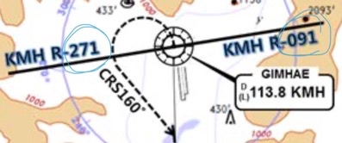
RKPK(PUS) 13ft | RKSS(GMP) 59ft
KE Gimhae 129.2 DCL -5분 | KE GMP 131.15
PA
Rwy 32L Landing
(06:00L~0900L / 12:00L~15:00L /18:00L~21:00L)
PUS : SID (Mod NADP CLB2 1000, 14000 MAX)
36 | SOORO x KALOD tx |  |  | 306 |  | 280 |  | ATC |  | 342
18 | GIMHAE x |  |  | 182 |  | 182 |  | 5000 |  | 182
KMH 113.8 |  |  | PSN 114.0 |  | 36L 108.5 |  |  |  | 36R 109.5
36 : KMH R091, R271, R185
HUD |  | 36L(13’) 10499’ 36R(8’) 8999’ |  |  |  |  | 18R(13’) 8530’ 18L(13’) 8999’
RWY36 400ft Man L/H turn, Max Taxi SPD 20KTS
Domestic
GMP : STAR
ILS 32L/R |  | GUKDO xT | BUMSI | GUKDO 160
ILS 14R |  | GUKDO xU | DOKDO | GUKDO 160
HUD |  | 32L(41’) | 10499’ | 14R(34’)
 |  | 32R(42’) | 11811’ | 14L(38’)
FIX | KIP /8(RWY 32), YJU R271, P73 /2
32L : D3(6532’), E2(9117’), 32R : E1(6614’) 14R : C1(6578’)
32L/R : 8 KIP L/G, 14R : LOC CAPT L/G FAF : Final Flap TWR -> GND -> APRON (All by ATC) Except RWY14R Landing (Until R)

Slide 16

RKPC(CJU) 119ft | RKJJ(KWJ) 48ft
KE CJU 129.4 DCL -10분 | KE KWJ 129.4
PA
CJU : SID (NADP 1)
07 | KAMIT xE |  |  | 066 |  | 066 |  | 10000 | 066
25 | KAMIT xW |  |  | 246 |  | 246 |  | 10000 | 246
YDM 109.0 |  |  | 07 109.9 |  |  |  | 25 111.3
07 : NONE |  |  |  |  | 25 : YDM246/3, R290
HUD |  | 07(87’) |  |  | 10433’ |  |  | 25(76’)
07 : Passing G4 CTC TWR 25 : 31 Holding PSN on P, E1,2,3 CTC TWR
Domestic
KWJ : NO STAR (TL 140확인) – STAR RNP app Only!!
ILS 04R | no KOTTY | SAMUL/-15 | CI04R
RNP 22L | ORUSA x | ORUSA Tx | 3.3도
LOC 22L | SAMUL | D058Q | No PAR 3.3도
VOR 22L/R | SAMUL | D058Q | Offset 3.29도
HUD | 04R(46’) | 9301’ | 22L(48’)
 | 04L(46’) | 9301’ | 22R(48’)
FIX | 04R : SAMUL(CLR Limit)
End of RWY Vacating 9301’
LOC 22L, VOR 22L/R -> LOC/VOR LNAV 지시고도 유지후 Final Establish 이후 강하 (TERR!!) PAR 04L/R, 22R 가능 : 강하각 3도 (6NM, 3도) TAXI MAX 15 kts (Max 30kts by ATC)

Slide 17
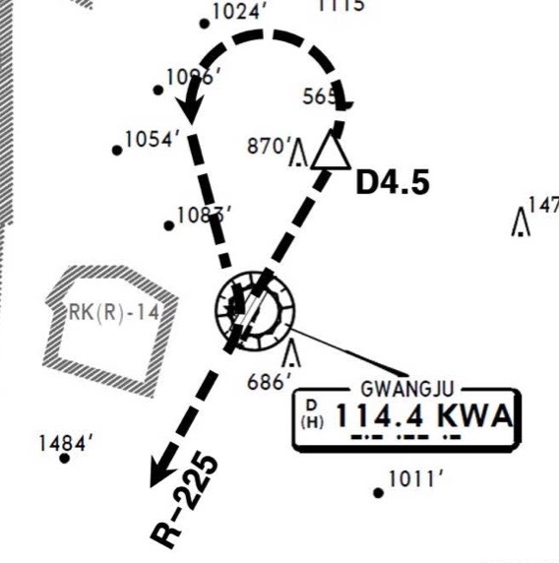
RKJJ(KWJ) 48ft | RKPC(CJU) 119ft
KE KWJ 129.4 NO DCL | KE CJU 129.4
PA
KWJ : SID (NADP 1) DALSU – Y711 – DOTOL Comm RTE(ATC CLR) 확인! (Join Air Way - DCT DOTOL CRS 192- LNAV)
ALL | KWA 5 |  |  |  |  |  |  | 8000
04L | (GWJ 3) |  |  | 038 |  | 038 |  | ATC | 038
22R | (GWJ 4) |  |  | 218 |  | 218 |  | ATC | 218
KWA 114.4 |  |  | 04R 111.1 |  |  |  | 22L 108.5
04 : KWA /4.5, R225 |  |  |  |  | 22 : None
HUD |  | 04L(46’) |  |  | 9301’ |  |  | 22R(48’)
 |  | 04R(46’) |  |  | 9301’ |  |  | 22L(48’)
Taxi SPD MAX 15kts MAX 30kts by ATC
Domestic
CJU : STAR AFT Merge PT(220kts) DCT IAF(210kts), FAF (160kts)
ILS Z 07 | DOTOL xP |  | YUMIN |  | DOTOL 160
ILS Z 25 | DOTOL xT |  | DUKAL |  | DOTOL/-10 160
HUD |  | 07(87’) |  | 10433’ |  | 25(76’)
07 : P6(5176’), P5(5882’), P4(6840’-ATC HIRO) 25 : P7(5219’), P8(5882’), P10(7524’-ATC HIRO)
Entering Rapid TWY CTC GND 121.675 (STOP x) HST 40KTS

Slide 18
RKPC(CJU) 119ft | RKTU(CJJ) 192ft
KE CJU 129.4 DCL -10분 | KE CJJ 129.05 NO DCL, ATIS
PA
CJU : SID (NADP 1)
07 | KAMIT xE |  |  | 066 |  | 066 |  | 10000 | 066
25 | KAMIT xW |  |  | 246 |  | 246 |  | 10000 | 246
YDM 109.0 |  |  | 07 109.9 |  |  |  | 25 111.3
07 : NONE |  |  |  |  | 25 : YDM246/3, R290
HUD |  | 07(87’) |  |  | 10433’ |  |  | 25(76’)
07 : Passing G4 CTC TWR 25 : 31 Holding PSN on P, E1,2,3 CTC TWR
Domestic
CJJ : NO STAR After OSPOT H/D060 – RDR Vector Req ILS Z 24R via HYEIN
ILS Z 06L | NO STAR (MATIZ x) |  | OSPOT (JIKJI tx) | TU761 / BAKJO (STAR 안줌)
ILS Z 24R | NO STAR (MATIZ x) |  | OSPOT (HYEIN tx) | HYEIN (STAR 안줌)
HUD |  | 06L(166’) | 9003’ | 24R(182’)
 |  | 06R(173’) | 9003’ | 24L(191’)
FIX
06L : B3 (6443’), A3 (8786’) 24R : C3 (6230’), D3 (8825’)
GS fluc’ - A/P Dis’ – Back to Normal – A/P Reengage Req full length Landing (Vacate End of RWY) 180 BACK LINE 지나 Taxi Line 있음 Entering TWY A3, B3, B4, C3, D3 change GND freq

Slide 19
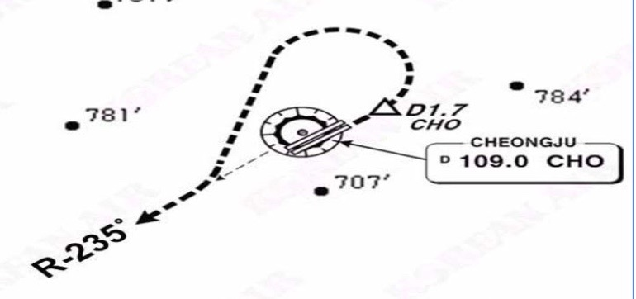
RKTU(CJJ) 192ft | RKPC(CJU) 119ft
KE CJJ 129.05 NO DCL, ATIS | KE CJU 129.4
PA
CJJ : SID (NADP 1)
06L | CJJ xD |  |  | 060 |  | 060 | 6000 | 060
24R | CJJ xD |  |  | 240 |  | 240 | 6000 | 240
(06L : BUKIL 1, 2 RNAV) |  |  |  |  |  | (24R : OLREG 1, UPTIL 1)
CHO 109.0 |  |  | 06L 110.3 |  |  |  | 24R 111.7
06L/R : CHO /1.7, R235 |  |  |  |  | 24L/R : None
HUD |  | 06L(166’) |  |  | 9003’ |  | 24R(182’)
 |  | 06R(173’) |  |  | 9003’ |  | 24L(191’)
Upslope from Apron to RWY Entering TWY A3, B3, B4, C3, D3 change TWR freq
Domestic
CJU : STAR AFT Merge PT(220kts) DCT IAF(210kts), FAF (160kts)
ILS Z 07 | DOTOL xP |  | YUMIN |  | DOTOL 160
ILS Z 25 | DOTOL xT |  | DUKAL |  | DOTOL/-10 160
HUD |  | 07(87’) |  | 10433’ |  | 25(76’)
07 : P6(5176’), P5(5882’), P4(6840’-ATC HIRO) 25 : P7(5219’), P8(5882’), P10(7524’-ATC HIRO)
Entering Rapid TWY CTC GND 121.675 (STOP x) HST 40KTS

Slide 20
RKPC(CJU) 119ft | RKTN(TAE) 120ft
KE CJU 129.4 DCL -10분 | KE TAE 129.2
PA
CJU : SID (NADP 1)
07 | AKPON xE |  |  | 066 |  | 066 |  | 9000 | 066
25 | AKPON xW |  |  | 246 |  | 246 |  | ATC | 246
YDM 109.0 |  |  | 07 109.9 |  |  |  | 25 111.3
07 : NONE |  |  |  |  | 25 : YDM246/3, R290
HUD |  | 07(87’) |  |  | 10433’ |  |  | 25(77’)
07 : Passing G4 CTC TWR 25 : 31 Holding PSN on P, E1,2,3 CTC TWR
Domestic
TAE : NO STAR (TL 140 확인)
ILS 31L | TGU/-10 |  |  | CF31L222/7 |  | CF31L
ILS 13R | TGU/-10 |  |  | YAWAN
HUD |  |  | 31L(118’) | 9039’ | 13R(111’) 3.3
 |  |  | 31R(120’) | 8999’ | 13L(112’)
FIX
31L : D1(8848’), 13R : A1(8772’)
13R ILS 3.3도 PAPI 3.3도 (산악지형 주의) TAXI MAX 20kts (do not req) 최소 2000ft 간격

Slide 21
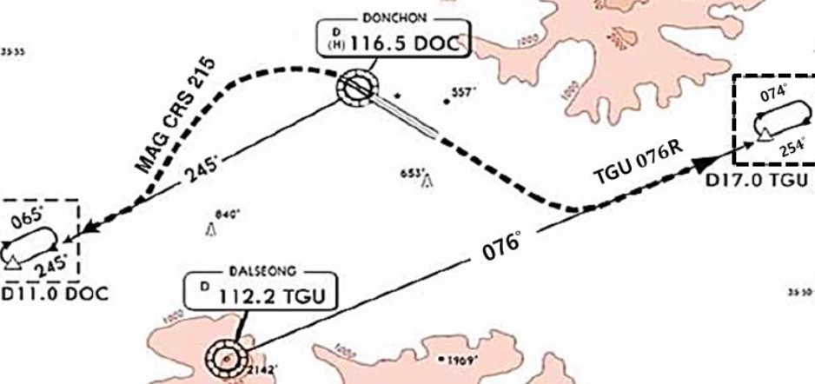
RKTN(TAE) 120ft | RKPC(CJU) 119ft
KE TAE 129.2 NO DCL | KE CJU 129.4
PA
TAE : SID (NADP 1)
31L/R | DAEGU xD |  |  | 312 |  | 312 | 8000 |  | 192
13L/R | DAEGU xD |  |  | 132 |  | 132 | 8000 |  | 192
DOC 116.5 |  |  | TGU 112.2 |  |  | 31L 108.7 |  | 13R 108.7
31 : DOC 245/11 DOC R245 |  |  |  |  | 13 : TGU076/17 TGU R076
HUD |  | 31L(118’) |  |  | 9039’ |  | 13R(112’) 3.3
 |  | 31R(120’) |  |  | 8999’ |  | 13L(112’)
TAXI MAX 20kts (do not req) 최소 2000ft 간격
Domestic
CJU : STAR AFT Merge PT(220kts) DCT IAF(210kts), FAF (160kts)
ILS Z 07 | UPGOS xP | YUMIN
ILS Z 25 | UPGOS xT | DUKAL
HUD | 07(87’) | 10433’ | 25(76’)
07 : P6(5176’), P5(5882’), P4(6840’-ATC HIRO) 25 : P7(5219’), P8(5882’), P10(7524’-ATC HIRO)
Entering Rapid TWY CTC GND 121.675, STOP X HST 40KTS

Slide 22
RKPC(CJU) 119ft | RKPK(PUS) 13ft
KE CJU 129.4 DCL -10분 | KE Gimhae 129.2
PA
CJU : SID (NADP 1)
07 | AKPON xE |  |  | 066 |  | 066 |  | 9000 | 066
25 | AKPON xW |  |  | 246 |  | 246 |  | ATC | 246
YDM 109.0 |  |  | 07 109.9 |  |  |  | 25 111.3
07 : NONE |  |  |  |  | 25 : YDM246/3, R290
HUD |  | 07(87’) |  |  | 10433’ |  |  | 25(76’)
07 : Passing G4 CTC TWR 25 : 31 Holding PSN on P, E1,2,3 CTC TWR
Domestic
PUS : STAR (Tail Wind 36R 136000lbs F40)
ILS 36 | KEVOX x | ANROD | 9DME LG, 8DME FLAP
VOR 18 | GAYHA x | ANROD | 18 Circling Click!!
HUD | 36L(13’) 10499’ 36R(8’) 8999’ |  | 18R(13’) 8530’ 18L(13’) 8999’
FIX | 36 : IKMA/IKHE /9, /8 |  | 18 : KMH R284, R280
36L : C4 (6299’), C2(7795’) / 36R : E3(5866’), E2(7339’) 18R : C6(5770’), C7 (6824’) / 18L : E4(5882’), E5(8792’)
Vacate C3,C4 by ATC only. Max Taxi SPD 20KTS C2 HOLD SHORT 가까움(Vacate TaxiSPD)

Slide 23
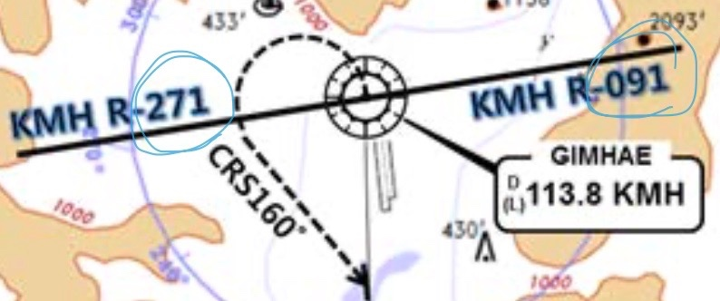
RKPK(PUS) 13ft | RKPC(CJU) 119ft
KE Gimhae 129.2 DCL -5분 | KE CJU 129.4
PA
PUS : SID (Mod NADP CLB2 1000, 14000 MAX)
36 | SOORO x TOPAX tx |  |  | 306 |  | 280 |  | ATC |  | 279
18 | BULIM x ENGOT tx |  |  | 182 |  | 182 |  | 5000 |  | 182
KMH 113.8 |  |  | PSN 114.0 |  | 36L 108.5 |  |  |  | 36R 109.5
36 : KMH R091, R271, R185
HUD |  | 36L(13’) 10499’ 36R(8’) 8999’ |  |  |  |  | 18R(13’) 8530’ 18L(13’) 8999’
RWY36 400ft Man L/H turn, Max Taxi SPD 20KTS
Domestic
CJU : STAR AFT Merge PT(220kts) DCT IAF(210kts), FAF (160kts)
ILS Z 07 | UPGOS xP | YUMIN
ILS Z 25 | UPGOS xT | DUKAL
HUD | 07(87’) | 10433’ | 25(76’)
07 : P6(5176’), P5(5882’), P4(6840’-ATC HIRO) 25 : P7(5219’), P8(5882’), P10(7524’-ATC HIRO)
Entering Rapid TWY CTC GND 121.675, STOP X HST 40KTS

Slide 24
RKSI(ICN) 23ft | RKPK(PUS) 13ft
KE ICN 131.5 DCL -10분 TOBT 5분 차이시 CTC Comm | KE Gimhae 129.2
PA
ICN : SID (33/34 NADP 1, 15/16 NADP 2)
33L/R | OSPOT xE/A |  | 333 |  | 333 |  | 5500/ATC |  | 333
34L/R | OSPOT xY |  | 333 |  | 333 |  | ATC |  | 333
15L/R | OSPOT xC |  | 153 |  | 153 |  | 5000 |  | 153
16L/R | OSPOT xH |  | 153 |  | 153 |  | 5000 |  | 153
NCN 113.8 |  | 33L 109.3 |  | 33R 108.9 |  | 15L 111.9 |  | 15R 109.1
WNG 112.9 |  | 34L 109.95 |  | 34R 108.1 |  | 16L 110.35 |  | 16R 108.55
33L/R : NC05L/R, R242 YJU R271 |  |  |  | 34L/R : WNG333/4.6, R242 YJU R271
HUD | 33L/R 34L(23’) |  |  | 12303’ |  | 15L/R 16R(23’)
 | 34R (23’) |  |  | 13123’ |  | 16L (23’)
Parallel TWY 10KTS 이상(R17 MAX 15kts)
ICN 국제선 이후 TRANSIT GD 필요(팀장님)
–> PUS PASSPORT Immigration 해야함.
Domestic
PUS : STAR (Tail Wind 36R 136000lbs F40)
ILS 36 | KEVOX x | MASTA | 9DME LG, 8DME FLAP
VOR 18 | GAYHA x | MASTA | 18 Circling Click!!
HUD | 36L(13’) 10499’ 36R(8’) 8999’ |  | 18R(13’) 8530’ 18L(13’) 8999’
FIX | 36 : IKMA/IKHE /9, /8 |  | 18 : KMH R284, R280
36L : C4 (6299’), C2(7795’) / 36R : E3(5866’), E2(7339’) 18R : C6(5770’), C7 (6824’) / 18L : E4(5882’), E5(8792’)
Vacate C3,C4 by ATC only, Max Taxi SPD 20KTS C2 HOLD SHORT 가까움(Vacate TaxiSPD)

Slide 25
RKPK(PUS) 13ft | RKSI(ICN) 23ft
KE Gimhae 129.2 DCL -5분 | KE ICN 131.5
PA
PUS : SID (Mod NADP CLB2 1000, 14000 MAX)
36 | SOORO x KALOD tx |  |  | 306 |  | 280 |  | ATC |  | 342
18 | GIMHAE x |  |  | 182 |  | 182 |  | 5000 |  | 182
KMH 113.8 |  |  | PSN 114.0 |  | 36L 108.5 |  |  |  | 36R 109.5
36 : KMH R091, R271, R185
HUD |  | 36L(13’) 10499’ 36R(8’) 8999’ |  |  |  |  | 18R(13’) 8530’ 18L(13’) 8999’
RWY 36 400ft Man L/H turn, Max Taxi SPD 20KTS
Domestic
ICN : STAR
ILS 33/34 | GUKDO xE | ENPIL | GUKDO 180
ILS 15/16 | GUKDO xH | MUNAN | GUKDO 180
HUD | 33L/R 34L(23’) | 12303’ | 15L/R 16R(23’)
 | 34R(23’) | 13123’ | 16L(23’)
FIX | RWY /8, /5 , YJU R271
33R : C4(7529’), C5(8513’), 33L : B4(7463’), B5(8513‘) 15L : C2(7522’), C1(8536’), 15R : B3(7454‘), B2(8641‘)
34L : P7(5600’), P8(6578’), 34R : N4(6876’), N5(8507‘) 16R : P6(5597’), P5(6574’), 16L : N3(7043‘), N2(8444‘)
8NM 180kts, 5NM 160kts, Parr TAXI 10kts이상, HIRO

Slide 26
RKSI(ICN) 23ft | RKTN(TAE)120ft
KE ICN 131.5 DCL -10분 TOBT 5분 차이시 CTC Comm | KE TAE 129.2
PA
ICN : SID (33/34 NADP 1, 15/16 NADP 2)
33L/R | OSPOT xE/A |  | 333 |  | 333 |  | 5500/ATC |  | 333
34L/R | OSPOT xY |  | 333 |  | 333 |  | ATC |  | 333
15L/R | OSPOT xC |  | 153 |  | 153 |  | 5000 |  | 153
16L/R | OSPOT xH |  | 153 |  | 153 |  | 5000 |  | 153
NCN 113.8 |  | 33L 109.3 |  | 33R 108.9 |  | 15L 111.9 |  | 15R 109.1
WNG 112.9 |  | 34L 109.95 |  | 34R 108.1 |  | 16L 110.35 |  | 16R 108.55
33L/R : NC05L/R, R242 YJU R271 |  |  |  | 34L/R : WNG333/4.6, R242 YJU R271
HUD | 33L/R 34L(23’) |  |  | 12303’ |  | 15L/R 16R(23’)
 | 34R (23’) |  |  | 13123’ |  | 16L (23’)
Parallel TWY 10KTS 이상(R17 MAX 15kts)
Domestic
TAE : NO STAR (TL 140 확인)
ILS 31L | TGU/-10 |  |  | CF31L222/7 |  | CF31L
ILS 13R | TGU |  |  | YAWAN
HUD |  |  | 31L(118’) | 9039’ | 13R(111’) 3.3
 |  |  | 31R(120’) | 8999’ | 13L(112’)
FIX
31L : D1(8848’), 13R : A1(8772’)
13R ILS 3.3도 PAPI 3.3도 (산악지형 주의) TAXI MAX 20kts (do not req) 최소 2000ft 간격

Slide 27
RKTN(TAE)120ft | RKSI(ICN) 23ft
KE TAE 129.2 NO DCL | KE ICN 131.5
PA
TAE : SID (NADP 1)
31L/R | DAEGU xD |  |  | 312 |  | 312 | 8000 |  | 192
13L/R | DAEGU xD |  |  | 132 |  | 132 | 8000 |  | 192
DOC 116.5 |  |  | TGU 112.2 |  |  | 31L 108.7 |  | 13R 108.7
31 : DOC 245/11 DOC R245 |  |  |  |  | 13 : TGU076/17 TGU R076
HUD |  | 31L(118’) |  |  | 9039’ |  | 13R(112’) 3.3
 |  | 31R(120’) |  |  | 8999’ |  | 13L(112’)
TAXI MAX 20kts (do not req) 최소 2000ft 간격
Domestic
ICN : STAR
ILS 33/34 | GUKDO xE | ENPIL | GUKDO 180
ILS 15/16 | GUKDO xH | MUNAN | GUKDO 180
HUD | 33L/R 34L(23’) | 12303’ | 15L/R 16R(23’)
 | 34R(23’) | 13123’ | 16L(23’)
FIX | RWY /8, /5 , YJU R271
33R : C4(7529’), C5(8513’), 33L : B4(7463’), B5(8513‘) 15L : C2(7522’), C1(8536’), 15R : B3(7454‘), B2(8641‘)
34L : P7(5600’), P8(6578’), 34R : N4(6876’), N5(8507‘) 16R : P6(5597’), P5(6574’), 16L : N3(7043‘), N2(8444‘)
8NM 180kts, 5NM 160kts, Parr TAXI 10kts이상, HIRO

Slide 28
RKPK(PUS) 13ft | RJAA(NRT) 135ft
KE Gimhae 129.2 DCL -5분 | KE Tokyo 131.7
PA
PUS : SID (Mod NADP CLB2 1000, 14000 MAX)
36 | SOORO x PSN tx |  |  | 306 |  | 280 |  | ATC |  | 162
18 | BULIM x PSN tx |  |  | 182 |  | 182 |  | 5000 |  | 182
KMH 113.8 |  |  | PSN 114.0 |  | 36L 108.5 |  |  |  | 36R 109.5
36 : KMH R091, R271, R185
HUD |  | 36L(13’) 10499’ 36R(8’) 8999’ |  |  |  |  | 18R(13’) 8530’ 18L(13’) 8999’
RWY 36 400ft Man L/H turn, Max Taxi SPD 20KTS
Japan
DEP 125.5 – TGU 125.37
FUK 133.15 – TKO 133.8 – 133.02 – 132.45 -124.1
TKO 128.2 – TKO APP 124.4
NRT HAKKA 330,YAGAN 240,LIVET 210,SWAMP 150 Prepare Holding or RWY CHG
34L/R | SWAMP E (SWAMP T) | ELGAR (TYLER) | ILS 34L/R(Z)
16L/R | SWAMP G (SWAMP N) | GEMIN (NORMA) | ILS Z 16L/R
HUD | 16L(135’) | 8202’ | 34R(141’)
 | 16R(130’) | 13123’ | 34L(139’)
FIX | 16L : ITM 4 / 34R : ITJ 14, 4 (DME) 16R : IKF 4 / 34L : IYQ 12, 4 (DME)
16L : B6(6433’), B7(7017’), 34R : B4(5849’), B2(6778’) 16R : A6(6076’), A7(7624’), 34L : A5(6167’), A4(7641’)
L/D DOWN before 14/12 DME, L/D FLAP 4 DME Arrival Taxi RTE in Jeppesen (No Numbering)

Slide 29
RJAA(NRT) 135ft | RKPK(PUS) 13ft
KE Tokyo 131.70 DCL -15분 | KE Gimhae 129.2
PA
NRT : SID – ENPAR tx (NADP 1)
16L/R | TETRA x ENPAR tx |  | 157 |  | 157 | ATC |  | 157
34L/R |  |  | 337 |  | 337 | 7000/ATC |  | 337
NRE 117.9 |  | 16L 110.7 |  | 16R 111.5 |  | 34L 111.9 | 34R 110.9
HUD | 16L(135’) |  | 8202’ |  |  | 34R(141’)
 | 16R (130’) |  | 13123’ |  |  | 34L (139’)
34R : CLB 220/10000, A4R21/22/23 220KTS 확인 Verity ENPAR tx TETRA 12000A APU Start, TAXI RTE 1, 2, 3, 4 RWY 별 DEP RTE
DEP 124.2
TKO 120.5 – 133.45 – 133.02 – 133.8
FUK 133.15
TGU 125.37
APP 125.5
Japan
PUS : STAR (Tail Wind 36R 136000lbs F40)
ILS 36 | PEDLO x | KALEK | 9DME LG, 8DME FLAP
VOR 18 | GAYHA x | PSN | 18 Circling Click!!
HUD | 36L(13’) 10499’ 36R(8’) 8999’ |  | 18R(13’) 8530’ 18L(13’) 8999’
FIX | 36 : IKMA/IKHE /9, /8 |  | 18 : KMH R284, R280
36L : C4 (6299’), C2(7795’) / 36R : E3(5866’), E2(7339’) 18R : C6(5770’), C7 (6824’) / 18L : E4(5882’), E5(8792’)
Vacate C3,C4 by ATC only. Max Taxi SPD 20KTS C2 HOLD SHORT 가까움(Vacate TaxiSPD)

Slide 30
RKSI(ICN) 23ft | RKPK(PUS) 13ft
KE ICN 131.5 DCL -10분 TOBT 5분 차이시 CTC Comm | KE Gimhae 129.2
PA
ICN : SID (33/34 NADP 1, 15/16 NADP 2)
33L/R | OSPOT xE/A |  | 333 |  | 333 |  | 5500/ATC |  | 333
34L/R | OSPOT xY |  | 333 |  | 333 |  | ATC |  | 333
15L/R | OSPOT xC |  | 153 |  | 153 |  | 5000 |  | 153
16L/R | OSPOT xH |  | 153 |  | 153 |  | 5000 |  | 153
NCN 113.8 |  | 33L 109.3 |  | 33R 108.9 |  | 15L 111.9 |  | 15R 109.1
WNG 112.9 |  | 34L 109.95 |  | 34R 108.1 |  | 16L 110.35 |  | 16R 108.55
33L/R : NC05L/R, R242 YJU R271 |  |  |  | 34L/R : WNG333/4.6, R242 YJU R271
HUD | 33L/R 34L(23’) |  |  | 12303’ |  | 15L/R 16R(23’)
 | 34R (23’) |  |  | 13123’ |  | 16L (23’)
Parallel TWY 10KTS 이상(R17 MAX 15kts)
Domestic
PUS : STAR (Tail Wind 36R 136000lbs F40)
ILS 36 | KEVOX x | MASTA | 9DME LG, 8DME FLAP
VOR 18 | GAYHA x | MASTA | 18 Circling Click!!
HUD | 36L(13’) 10499’ 36R(8’) 8999’ |  | 18R(13’) 8530’ 18L(13’) 8999’
FIX | 36 : IKMA/IKHE /9, /8 |  | 18 : KMH R284, R280
36L : C4 (6299’), C2(7795’) / 36R : E3(5866’), E2(7339’) 18R : C6(5770’), C7 (6824’) / 18L : E4(5882’), E5(8792’)
Vacate C3,C4 by ATC only, Max Taxi SPD 20KTS C2 HOLD SHORT 가까움(Vacate TaxiSPD)

Slide 31
RKPK(PUS) 13ft | RKSI(ICN) 23ft
KE Gimhae 129.2 DCL -5분 | KE ICN 131.5
PA
PUS : SID (Mod NADP CLB2 1000, 14000 MAX)
36 | SOORO x KALOD tx |  |  | 306 |  | 280 |  | ATC |  | 342
18 | GIMHAE x |  |  | 182 |  | 182 |  | 5000 |  | 182
KMH 113.8 |  |  | PSN 114.0 |  | 36L 108.5 |  |  |  | 36R 109.5
36 : KMH R091, R271, R185
HUD |  | 36L(13’) 10499’ 36R(8’) 8999’ |  |  |  |  | 18R(13’) 8530’ 18L(13’) 8999’
RWY 36 400ft Man L/H turn, Max Taxi SPD 20KTS
Domestic
ICN : STAR
ILS 33/34 | GUKDO xE | ENPIL | GUKDO 180
ILS 15/16 | GUKDO xH | MUNAN | GUKDO 180
HUD | 33L/R 34L(23’) | 12303’ | 15L/R 16R(23’)
 | 34R(23’) | 13123’ | 16L(23’)
FIX | RWY /8, /5 , YJU R271
33R : C4(7529’), C5(8513’), 33L : B4(7463’), B5(8513‘) 15L : C2(7522’), C1(8536’), 15R : B3(7454‘), B2(8641‘)
34L : P7(5600’), P8(6578’), 34R : N4(6876’), N5(8507‘) 16R : P6(5597’), P5(6574’), 16L : N3(7043‘), N2(8444‘)
8NM 180kts, 5NM 160kts, Parr TAXI 10kts이상, HIRO

Slide 32
RKSI(ICN) 23ft | RJBB(KIX) 17ft
KE ICN 131.5 DCL -10분 TOBT 5분 차이시 CTC Comm | KE KIX 130.95
PA
ICN : SID (33/34 NADP 1, 15/16 NADP 2)
33L/R | EGOBA xE/A |  | 333 |  | 333 |  | 5500/ATC |  | 333
34L/R | EGOBA xY |  | 333 |  | 333 |  | ATC |  | 333
15L/R | EGOBA xC |  | 153 |  | 153 |  | 5000 |  | 153
16L/R | EGOBA xH |  | 153 |  | 153 |  | 5000 |  | 153
NCN 113.8 |  | 33L 109.3 |  | 33R 108.9 |  | 15L 111.9 |  | 15R 109.1
WNG 112.9 |  | 34L 109.95 |  | 34R 108.1 |  | 16L 110.35 |  | 16R 108.55
33L/R : NC05L/R, R242 YJU R271 |  |  |  | 34L/R : WNG333/4.6, R242 YJU R271
HUD | 33L/R 34L(23’) |  |  | 12303’ |  | 15L/R 16R(23’)
 | 34R (23’) |  |  | 13123’ |  | 16L (23’)
Parallel TWY 10KTS 이상(R17 MAX 15kts)
DEP 125.15 – TGU 134.17 – FUK 124.15 - TKO 133.8
KIX RDR 120.85
KIX APP 120.25
Japan
KIX : STAR (SAEKI 170, RANDY 150)
06L | ALISA B | BERRY | ILS Y 06L
06R | ALISA A | ALLAN | ILS Y 06R
24L/R | ALISA C | MAYAH | ILS Z 24L/R
HUD | 06L(15’) 13123’ 24R(23’)
 | 06R(5’) 11483’ 24L(12’)
06L : B8(5160’), B6(6751’), 24R : B7(5318’), B9(6751’) 06R : A7(5137’), A6(6938’), 24L : A8(5269’), A9(6976’)
RWY06 : After 2500ft L/G DN, After 1500ft L/D FLAP TAXI RTE 1(via J4), 2(via J3)

Slide 33
RJBB(KIX) 17ft | RKSI(ICN) 23ft
KE KIX 130.95 DCL -15분 | KE ICN 131.5
PA
KIX : SID – SOUJA tx (NADP 1)
06L/R | HELEN x - SOUJA tx |  | 059 |  | 059 | ATC (9000) |  | 059
24L/R |  |  | 239 |  | 239 | ATC (9000) |  | 239
KIE 111.6 |  | 06L 108.7 |  | 06R 108.1 |  | 24L 110.7 | 24R 108.5
HUD | 06L(15’) |  | 13123’ |  |  | 24R(23’)
 | 06R (5’) |  | 13123’ |  |  | 24L (12’)
APU Start, TAXI RTE 1(via J4), 2(via J3)
DEP 119.2
TKO 132.7 – 133.8
FUK 124.15
TGU 120.57
APP 119.75
Japan
ICN : STAR
ILS 33/34 | GUKDO xE | ENPIL | GUKDO 180
ILS 15/16 | GUKDO xH | MUNAN | GUKDO 180
HUD | 33L/R 34L(23’) | 12303’ | 15L/R 16R(23’)
 | 34R(23’) | 13123’ | 16L(23’)
FIX | RWY /8, /5 , YJU R271
33R : C4(7529’), C5(8513’), 33L : B4(7563’), B5(8513‘) 15L : C2(7522’), C1(8536’), 15R : B3(7454‘), B2(8641‘)
34L : P7(5600’), P8(6578’), 34R : N4(6876’), N5(8507‘) 16R : P6(5597’), P5(6574’), 16L : N3(7043‘), N2(8444‘)
8NM 180kts, 5NM 160kts, Parr TAXI 10kts이상, HIRO

Slide 34
RKSI(ICN) 23ft | RJAA(NRT) 135ft
KE ICN 131.5 DCL -10분 TOBT 5분 차이시 CTC Comm | KE Tokyo 131.70
PA
ICN : SID (33/34 NADP 1, 15/16 NADP 2)
33L/R | EGOBA xE/A |  | 333 |  | 333 |  | 5500/ATC |  | 333
34L/R | EGOBA xY |  | 333 |  | 333 |  | ATC |  | 333
15L/R | EGOBA xC |  | 153 |  | 153 |  | 5000 |  | 153
16L/R | EGOBA xH |  | 153 |  | 153 |  | 5000 |  | 153
NCN 113.8 |  | 33L 109.3 |  | 33R 108.9 |  | 15L 111.9 |  | 15R 109.1
WNG 112.9 |  | 34L 109.95 |  | 34R 108.1 |  | 16L 110.35 |  | 16R 108.55
33L/R : NC05L/R, R242 YJU R271 |  |  |  | 34L/R : WNG333/4.6, R242 YJU R271
HUD | 33L/R 34L(23’) |  |  | 12303’ |  | 15L/R 16R(23’)
 | 34R (23’) |  |  | 13123’ |  | 16L (23’)
Parallel TWY 10KTS 이상(R17 MAX 15kts)
DEP 125.15 – TGU 134.17 - TKO 124.15 – 132.02
TKO 124.1- 128.2 – TKO APP 124.4 - 120.2
Japan
NRT : HAKKA 330,YAGAN 240,LIVET 210,SWAMP 150
34L/R | SWAMP E (SWAMP T) | ELGAR (TYLER) | ILS 34L/R(Z)
16L/R | SWAMP G (SWAMP N) | GEMIN (NORMA) | ILS Z 16L/R
HUD | 16L(135’) | 8202’ | 34R(141’)
 | 16R(130’) | 13123’ | 34L(139’)
FIX | 16L : ITM 4 / 34R : ITJ 14, 4 (DME) 16R : IKF 4 / 34L : IYQ 12, 4 (DME)
16L : B6(6433’), B7(7017’), 34R : B4(5849’), B2(6778’) 16R : A6(6076’), A7(7624’), 34L : A5(6167’), A4(7641’)
L/D DOWN before 14/12 DME, L/D FLAP 4 DME Arrival Taxi RTE in Jeppesen (No Numbering)

Slide 35
RJAA(NRT) 135ft | RKSI(ICN) 23ft
KE Tokyo 131.70 DCL -15분 | KE ICN 131.5
PA
NRT : SID – ENPAR tx (NADP 1)
16L/R | TETRA x ENPAR tx |  | 157 |  | 157 | ATC |  | 157
34L/R |  |  | 337 |  | 337 | 7000/ATC |  | 337
NRE 117.9 |  | 16L 110.7 |  | 16R 111.5 |  | 34L 111.9 | 34R 110.9
HUD | 16L(135’) |  | 8202’ |  |  | 34R(141’)
 | 16R (130’) |  | 13123’ |  |  | 34L (139’)
34R : CLB 220/10000, A4R21/22/23 220KTS 확인 Verity ENPAR tx TETRA 12000A APU Start, TAXI RTE 1, 2, 3, 4 RWY 별 DEP RTE
DEP 124.2
TKO 120.5 – 133.45 – 133.02 – 133.8
TGU 120.57
APP 119.75
Japan
ICN : STAR
ILS 33/34 | GUKDO xE | ENPIL | GUKDO 180
ILS 15/16 | GUKDO xH | MUNAN | GUKDO 180
HUD | 33L/R 34L(23’) | 12303’ | 15L/R 16R(23’)
 | 34R(23’) | 13123’ | 16L(23’)
FIX | RWY /8, /5 , YJU R271
33R : C4(7529’), C5(8513’), 33L : B4(7563’), B5(8513‘) 15L : C2(7522’), C1(8536’), 15R : B3(7454‘), B2(8641‘)
34L : P7(5600’), P8(6578’), 34R : N4(6876’), N5(8507‘) 16R : P6(5597’), P5(6574’), 16L : N3(7043‘), N2(8444‘)
8NM 180kts, 5NM 160kts, Parr TAXI 10kts이상, HIRO

Slide 36
RKSI(ICN) 23ft | RJCC(CTS) 70ft
KE ICN 131.5 DCL -10분 TOBT 5분 차이시 CTC Comm | Chitose Oper 132.05
PA
ICN : SID (33/34 NADP 1, 15/16 NADP 2)
33L/R | EGOBA xE/A |  | 333 |  | 333 |  | 5500/ATC |  | 333
34L/R | EGOBA xY |  | 333 |  | 333 |  | ATC |  | 333
15L/R | EGOBA xC |  | 153 |  | 153 |  | 5000 |  | 153
16L/R | EGOBA xH |  | 153 |  | 153 |  | 5000 |  | 153
NCN 113.8 |  | 33L 109.3 |  | 33R 108.9 |  | 15L 111.9 |  | 15R 109.1
WNG 112.9 |  | 34L 109.95 |  | 34R 108.1 |  | 16L 110.35 |  | 16R 108.55
33L/R : NC05L/R, R242 YJU R271 |  |  |  | 34L/R : WNG333/4.6, R242 YJU R271
HUD | 33L/R 34L(23’) |  |  | 12303’ |  | 15L/R 16R(23’)
 | 34R (23’) |  |  | 13123’ |  | 16L (23’)
Parallel TWY 10KTS 이상(R17 MAX 15kts)
DEP 125.15 – TGU 134.17 - TKO 124.15 – 133.02 – 132.3
SPR 133.3 -119.3
CTS APP 120.1
Japan
CTS : STAR (19R for CAT III)
01R | YOTEI SOUTH (YUKII WEST) | YOTEI not YOSEI | ILS Y/Z 01R
19L | NAVER(170) YUNEY SOUTH (KAORY A) | KAORY YUNEY (KAORY) | ILS Z 19L
HUD | 01R(57’) 01L(62’) | 9843’ | 19L(77’) 19R(82’)
01R : B4(5278’), B3(7047’), 19L : B8(5177’), B9(7119’) 01L : A5(5538’), A4(6961’), 19R : A7(5390’), A8(6873’)
Do not Cross 01L/19R After L/D (No TWY) TAXI to Gate Via D(J) or G

Slide 37
RJCC(CTS) 70ft | RKSI(ICN) 23ft
Chitose Oper 132.05 NO DCL -5분 | KE ICN 131.5
PA
CTS : SID (NADP 1)
ALL | DALBI x SUVIT x SOSHU x |  | 002 |  | 002 | ATC |  | 002
 |  |  | 182 |  | 182 | ATC |  | 182
CHE 116.9 |  | 01R 110.75 |  | 19L 109.35 |  | 01L 110.9 | 19R 111.5
HUD | 01R(57’) 01L(62’) |  | 9843’ |  |  | 19L(77’) 19R(82’)
APU, Deicing at the Gate R/H turn DCT to HWE -> Confirm R/H Turn ND
DEP 124.7
SPR 119.3 – TKO 132.3 – 132.45 – 133.8
TGU 120.57
APP 119.75
Japan
ICN : STAR
ILS 33/34 | GUKDO xE | ENPIL | GUKDO 180
ILS 15/16 | GUKDO xH | MUNAN | GUKDO 180
HUD | 33L/R 34L(23’) | 12303’ | 15L/R 16R(23’)
 | 34R(23’) | 13123’ | 16L(23’)
FIX | RWY /8, /5 , YJU R271
33R : C4(7529’), C5(8513’), 33L : B4(7563’), B5(8513‘) 15L : C2(7522’), C1(8536’), 15R : B3(7454‘), B2(8641‘)
34L : P7(5600’), P8(6578’), 34R : N4(6876’), N5(8507‘) 16R : P6(5597’), P5(6574’), 16L : N3(7043‘), N2(8444‘)
8NM 180kts, 5NM 160kts, Parr TAXI 10kts이상, HIRO

Slide 38
RKSI(ICN) 23ft | RJTT(HND) 21ft
KE ICN 131.5 DCL -10분 TOBT 5분 차이시 CTC Comm | Delta Oper 132.075
PA
ICN : SID (33/34 NADP 1, 15/16 NADP 2)
33L/R | EGOBA xE/A |  | 333 |  | 333 |  | 5500/ATC |  | 333
34L/R | EGOBA xY |  | 333 |  | 333 |  | ATC |  | 333
15L/R | EGOBA xC |  | 153 |  | 153 |  | 5000 |  | 153
16L/R | EGOBA xH |  | 153 |  | 153 |  | 5000 |  | 153
NCN 113.8 |  | 33L 109.3 |  | 33R 108.9 |  | 15L 111.9 |  | 15R 109.1
WNG 112.9 |  | 34L 109.95 |  | 34R 108.1 |  | 16L 110.35 |  | 16R 108.55
33L/R : NC05L/R, R242 YJU R271 |  |  |  | 34L/R : WNG333/4.6, R242 YJU R271
HUD | 33L/R 34L(23’) |  |  | 12303’ |  | 15L/R 16R(23’)
 | 34R (23’) |  |  | 13123’ |  | 16L (23’)
Parallel TWY 10KTS 이상(R17 MAX 15kts)
DEP 125.15 – TGU 134.17 – FUK 133.02 – TKO 120.5
TKO 133.35
TKO APP 119.1 – 119.65
Japan
HND : STAR XAC Night– APP xxx Y 1400z~ SPENS 220
34L/R | XAC xK/H | KAIHO/CACAO | ILS X / VIS
22 | XAC xB | BACON | LDA W(RNVW 22)
16R/L | XAC R | NATTY/SANDY | RNP(R16RT/R16LT)
23 | - | DANON | LDA W(RNVW 23)
HUD | 34L(18’) 9843’ |  | 16R(77’) 8268’ DIS
 | 34R(21’) 9843’ DIS TH |  | 16L(19’) 9744’ DIS
 | 22(35’) 8202’ |  | 23(55’) 8202’
34L : L12(6515’), L13(7165’), 22 : B4(6207’), B3(6830’) 16R : L5(5147’), L3(6361’), 23 : D5(5072’), D3(6391’)
xxx Z : 180kts, 160kts limit APP Chart, xxx Y After 1400z

Slide 39
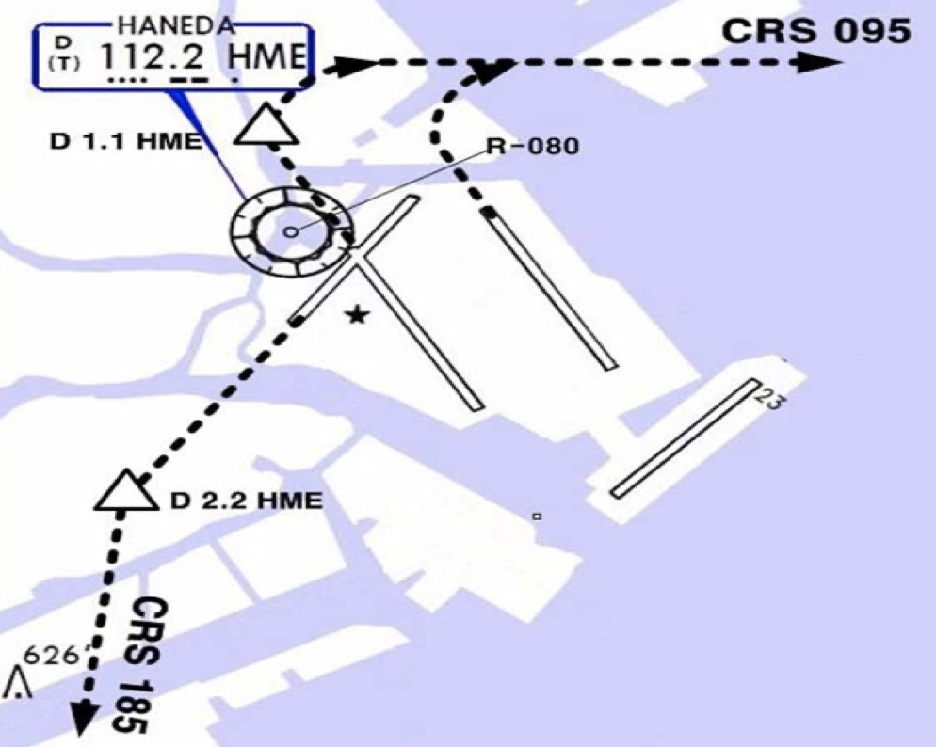
RJTT(HND) 21ft | RKSI(ICN) 23ft
Delta Oper 132.075 DCL -15분 | KE ICN 131.5
PA
HND : SID (xx B/C 2200-0230z 0600-1000z) NADP 1
ALL | BEKLA x OPPAR x |  | RWY H/D | RWY CRS | ATC | RWY H/D
HME 112.2 | 34L 111.7 | 16R 111.55 | 34R 108.9 | 16L 111.95 | 22 108.1 | 23 110.5
HUD |  | 34L(18’) 9843’ 16R(77’)
 |  | 34R(21’) 11024’ 16L(19’)
 |  | 04(19’) 8202’ 05(46’)
34L : HME 351/1.1, R095, 34R : HME R080, R095, 22 : HME /2.2 R185
34R BEKLA : KAIJI 230kts, TORAM Flap5 SPD 16L : BEKLA : PLUTO 230kts RWY05 RTE5 TAXI Chart
DEP ATIS
TKO 120.5 – FUK 133.02
TGU 120.57
APP 119.75
Japan
ICN : STAR
ILS 33/34 | GUKDO xE | ENPIL | GUKDO 180
ILS 15/16 | GUKDO xH | MUNAN | GUKDO 180
HUD | 33L/R 34L(23’) | 12303’ | 15L/R 16R(23’)
 | 34R(23’) | 13123’ | 16L(23’)
FIX | RWY /8, /5 , YJU R271
33R : C4(7529’), C5(8513’), 33L : B4(7563’), B5(8513‘) 15L : C2(7522’), C1(8536’), 15R : B3(7454‘), B2(8641‘)
34L : P7(5600’), P8(6578’), 34R : N4(6876’), N5(8507‘) 16R : P6(5597’), P5(6574’), 16L : N3(7043‘), N2(8444‘)
8NM 180kts, 5NM 160kts, Parr TAXI 10kts이상, HIRO

Slide 40
RKSI(ICN) 23ft | RJGG(NGO) 12ft
KE ICN 131.5 DCL -10분 TOBT 5분 차이시 CTC Comm | SWISSPORT OPERATION 132.05
PA
ICN : SID (33/34 NADP 1, 15/16 NADP 2)
33L/R | EGOBA xE/A |  | 333 |  | 333 |  | 5500/ATC |  | 333
34L/R | EGOBA xY |  | 333 |  | 333 |  | ATC |  | 333
15L/R | EGOBA xC |  | 153 |  | 153 |  | 5000 |  | 153
16L/R | EGOBA xH |  | 153 |  | 153 |  | 5000 |  | 153
NCN 113.8 |  | 33L 109.3 |  | 33R 108.9 |  | 15L 111.9 |  | 15R 109.1
WNG 112.9 |  | 34L 109.95 |  | 34R 108.1 |  | 16L 110.35 |  | 16R 108.55
33L/R : NC05L/R, R242 YJU R271 |  |  |  | 34L/R : WNG333/4.6, R242 YJU R271
HUD | 33L/R 34L(23’) |  |  | 12303’ |  | 15L/R 16R(23’)
 | 34R (23’) |  |  | 13123’ |  | 16L (23’)
Parallel TWY 10KTS 이상(R17 MAX 15kts)
DEP 125.15
TGU 134.17 – TKO 133.8 – 133.02
센트레아 APP – 121.05
Japan
NGO : STAR (SAMON 290, MARIA 130)
36 | CHESS(CARDS) SOUTH | PROBE | ILS Z 36
18 | CHESS(CARDS) NORTH | QUEST | ILS Z 18
HUD | 36(15’) 11483’ 18(15’)
36 : A6(5213’), A7(6525’), A8(7837’) 18 : A5(5393’), A4(6528’), A3(7841’)
RWY36 : After 1500ft L/D FLAP RWY 18 : After 3000ft L/G DN & L/D FLAP Caution Stop line, Yellow Ramp line, VDGS!!!

Slide 41
RJGG(NGO) 12ft | RKSI(ICN) 23ft
SWISSPORT OPERATION 132.05 DCL -15분 | KE ICN 131.5
PA
NGO : SID – TANGO tx (NADP 1)
36 | OUMI x - TANGO tx |  | 356 | 356 | ATC (7000) | 356
18 |  |  | 176 | 176 | ATC (7000) | 176
CBE 117.8 |  | 18 109.7 |  |  | 36 111.9
HUD | 36(15’) |  | 11483’ |  | 18(15’)
APU Start 30min, Prepare Intersection T/O
DEP 120.0
TKO 133.55 – 133.8 – TGU 120.52
APP – 119.75
Japan
ICN : STAR
ILS 33/34 | GUKDO xE | ENPIL | GUKDO 180
ILS 15/16 | GUKDO xH | MUNAN | GUKDO 180
HUD | 33L/R 34L(23’) | 12303’ | 15L/R 16R(23’)
 | 34R(23’) | 13123’ | 16L(23’)
FIX | RWY /8, /5 , YJU R271
33R : C4(7529’), C5(8513’), 33L : B4(7563’), B5(8513‘) 15L : C2(7522’), C1(8536’), 15R : B3(7454‘), B2(8641‘)
34L : P7(5600’), P8(6578’), 34R : N4(6876’), N5(8507‘) 16R : P6(5597’), P5(6574’), 16L : N3(7043‘), N2(8444‘)
8NM 180kts, 5NM 160kts, Parr TAXI 10kts이상, HIRO

Slide 42
RKSI(ICN) 23ft | RJFF(FUK) 30ft
KE ICN 131.5 DCL -10분 TOBT 5분 차이시 CTC Comm | KE FUK 132.05
PA
ICN : SID (33/34 NADP 1, 15/16 NADP 2)
33L/R | OSPOT xE/A |  | 333 |  | 333 |  | 5500/ATC |  | 333
34L/R | OSPOT xY |  | 333 |  | 333 |  | ATC |  | 333
15L/R | OSPOT xC |  | 153 |  | 153 |  | 5000 |  | 153
16L/R | OSPOT xH |  | 153 |  | 153 |  | 5000 |  | 153
NCN 113.8 |  | 33L 109.3 |  | 33R 108.9 |  | 15L 111.9 |  | 15R 109.1
WNG 112.9 |  | 34L 109.95 |  | 34R 108.1 |  | 16L 110.35 |  | 16R 108.55
33L/R : NC05L/R, R242 YJU R271 |  |  |  | 34L/R : WNG333/4.6, R242 YJU R271
HUD | 33L/R 34L(23’) |  |  | 12303’ |  | 15L/R 16R(23’)
 | 34R (23’) |  |  | 13123’ |  | 16L (23’)
Parallel TWY 10KTS 이상(R17 MAX 15kts)
TGU 125.37
Kobe 118.9 - FUK APP 119.65
FUK RDR – 121.125
Japan
FUK : RNAV STAR, RDR Vectoring from IKE (PAVGA 13000ft) Hold W of IKE published
16 | SARUP | ENTIX | RNP, LOC 16
34 | V34 HAWKS WEST | RWY34 HAWKS | VIS 34 RNP, LOC 34
HUD | 16(15’) 9186’ 34(32’) |  | 24R(305’) 12014’ 24L(293’) 8710’ DIS TH
16 : C6(5505’), C7(6407’), 34 : C4(5193’), C3(6354’)
DGC VOR out of 6NM A/P VIS 34 : After IKE – RDR Vector Downwind – 1800ft – RWY Insight 1500ft – Before L/D CHK Complete before base (Do not Extend Downwind due Terrain)

Slide 43
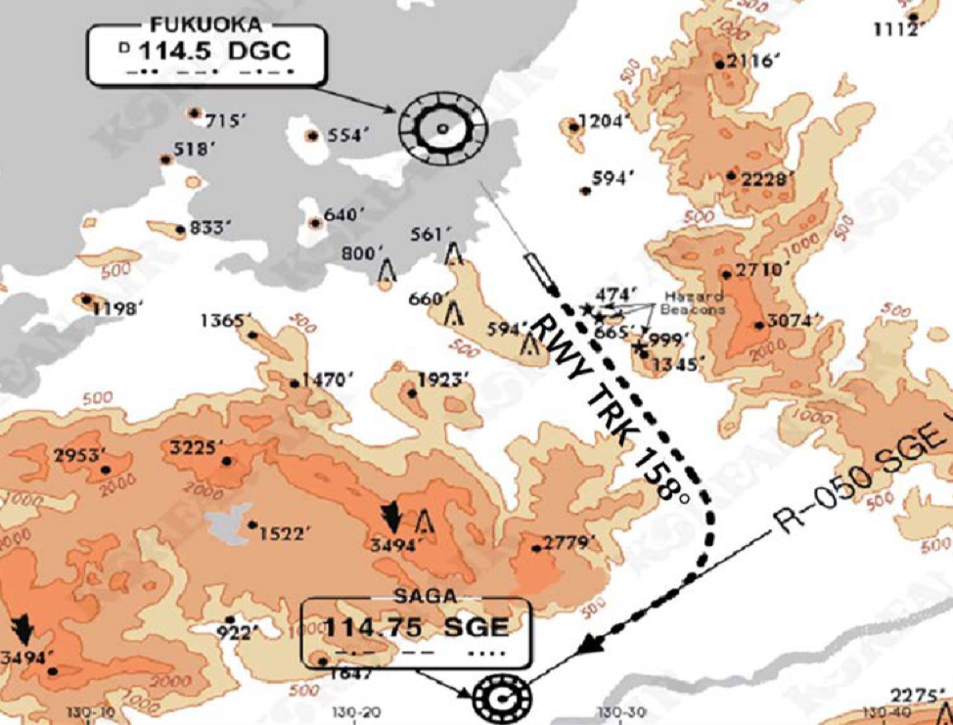
RJFF(FUK) 30ft | RKSI(ICN) 23ft
KE FUK 132.05 DCL -15min, Voice -5min | KE ICN 131.5
PA
FUK : SID (Consider C2, C8 Intersection T/O)
16 | HAKATA xx |  | 158 | 158 | ATC (10000) |  | 158
34 |  |  | 338 | 338 | ATC (10000) |  | 338
DGC 114.5 |  |  |  | 16 111.7 |  | 34 108.9
34 : SGE R050 (DGC VOR out of 6NM A/P)
HUD |  | 16(15’) 9186’ 34(32’) |  |  | 24R(305’) 8530’ 24L(293’) 8999’
Caution GP HOLD LINE Initial CTC TWR, “Ready for departure” RWSL(Runway Status Lights) in operation
DEP 127.9
Kobe 118.9
TGU 125.37
Japan
ICN : STAR
ILS 33/34 | GUKDO xE | ENPIL | GUKDO 180
ILS 15/16 | GUKDO xH | MUNAN | GUKDO 180
HUD | 33L/R 34L(23’) | 12303’ | 15L/R 16R(23’)
 | 34R(23’) | 13123’ | 16L(23’)
FIX | RWY /8, /5 , YJU R271
33R : C4(7529’), C5(8513’), 33L : B4(7463’), B5(8513‘) 15L : C2(7522’), C1(8536’), 15R : B3(7454‘), B2(8641‘)
34L : P7(5600’), P8(6578’), 34R : N4(6876’), N5(8507‘) 16R : P6(5597’), P5(6574’), 16L : N3(7043‘), N2(8444‘)
8NM 180kts, 5NM 160kts, Parr TAXI 10kts이상, HIRO

Slide 44
RKSI(ICN) 23ft | RJSA(AOJ) 650ft
KE ICN 131.5 DCL -10분 TOBT 5분 차이시 CTC Comm | JPN AIR AOJ 130.17 NO ATIS
PA
ICN : SID (33/34 NADP 1, 15/16 NADP 2)
33L/R | EGOBA xE/A |  | 333 |  | 333 |  | 5500/ATC |  | 333
34L/R | EGOBA xY |  | 333 |  | 333 |  | ATC |  | 333
15L/R | EGOBA xC |  | 153 |  | 153 |  | 5000 |  | 153
16L/R | EGOBA xH |  | 153 |  | 153 |  | 5000 |  | 153
NCN 113.8 |  | 33L 109.3 |  | 33R 108.9 |  | 15L 111.9 |  | 15R 109.1
WNG 112.9 |  | 34L 109.95 |  | 34R 108.1 |  | 16L 110.35 |  | 16R 108.55
33L/R : NC05L/R, R242 YJU R271 |  |  |  | 34L/R : WNG333/4.6, R242 YJU R271
HUD | 33L/R 34L(23’) |  |  | 12303’ |  | 15L/R 16R(23’)
 | 34R (23’) |  |  | 13123’ |  | 16L (23’)
Parallel TWY 10KTS 이상(R17 MAX 15kts)
DEP 125.15 – TGU 134.17 - FUK 124.15
FUK 125.15 - 133.02 – 132.3
SPR 133.3 -127.57 - AOJ TWR 118.3
Japan
AOJ : Obstacle Around Airport (High FE, Cold Temp) Hold over MRE, MELOS, YACHI Confirm CRS, EFC CAT II,III Request Before 15min By Com
24 | NONE | MRE YACHI | ILS Y/Z 24 RNP Z 24 (AR)
06 | MELOS SOUTH | YACHI MELOS | RNP Z 06 (AR) VOR Z 06(5도)
HUD | 24(664’) | 9843’ | 06(647’)
24 : T2(5043’),T1(7043’), 06 : T3(5043’), T4(7043’)
ILS Y 24 Turn SPD : Max 200kts, CHK MRE D12 Turn 시작 (선회 반경으로 선회 늦어짐 주의!, SPD Modify) RWY, TWY color Yellow, GND by TWR

Slide 45
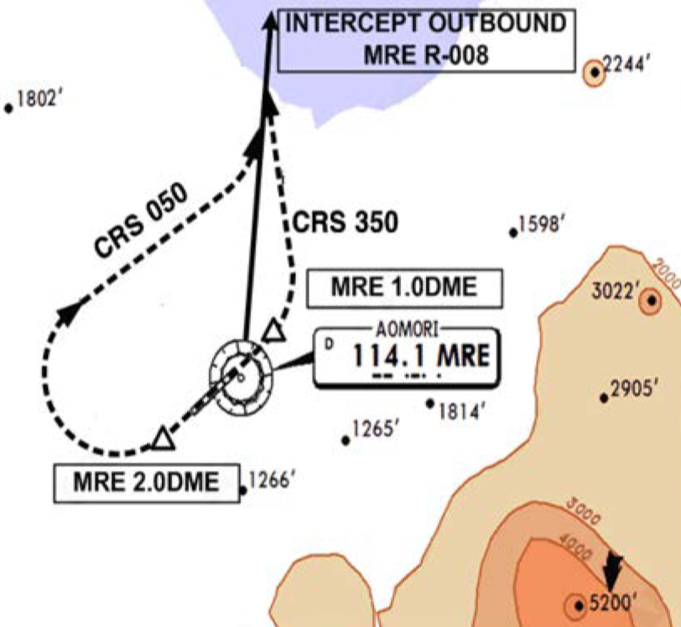
RJSA(AOJ) 650ft | RKSI(ICN) 23ft
JPN AIR AOJ 130.17 NO ATIS, TWR 118.3 Voice | KE ICN 131.5
PA
AOJ : SID (NADP 1)
24 | IWAKI xx | 241 | 241 | ATC | 241
06 |  | 061 | 061 | ATC | 061
MRE 114.1 |  |  | 24 111.9
HUD | 24(664’) | 9843’ |  | 06(647’)
EO | 24 : MRE 241/2, MRE R008 06 : MRE 061/1, R350, MRE R008
ATC 순서 특이함. Deicing at the Gate
TWR 118.3
SPR 127.57 – 133.3
TKO 132.3 – 132.45 – 133.02
TKO 133.8
TGU 120.57
APP 119.75
Japan
ICN : STAR
ILS 33/34 | GUKDO xE | ENPIL | GUKDO 180
ILS 15/16 | GUKDO xH | MUNAN | GUKDO 180
HUD | 33L/R 34L(23’) | 12303’ | 15L/R 16R(23’)
 | 34R(23’) | 13123’ | 16L(23’)
FIX | RWY /8, /5 , YJU R271
33R : C4(7529’), C5(8513’), 33L : B4(7563’), B5(8513‘) 15L : C2(7522’), C1(8536’), 15R : B3(7454‘), B2(8641‘)
34L : P7(5600’), P8(6578’), 34R : N4(6876’), N5(8507‘) 16R : P6(5597’), P5(6574’), 16L : N3(7043‘), N2(8444‘)
8NM 180kts, 5NM 160kts, Parr TAXI 10kts이상, HIRO

Slide 46
RKSS(GMP) 59ft | ZSSS(SHA) 10ft
KE GMP 131.15 DCL -15분 가능 TOBT 5분 차이시 CTC Comm | China Eastern 131.5
PA
Rwy 32R Takeoff
(06:00L~0900L / 12:00L~15:00L /18:00L~21:00L)
GMP : SID (NADP 1)
32L/R | BULTI xT |  | 324 |  | 324 |  | 5000 |  | 324
 | (BULTI xQ) |  | 324 |  | 324 |  | 5000 |  | 324
14L/R | BULTI xU |  | 144 |  | 144 |  | 6000 |  | 144
 | (BULTI xZ) |  | 144 |  | 144 |  | 6000 |  | 144
KIP 113.6 |  | 32L 108.3 | 32R 110.7 |  |  | 14L 109.9 |  | 14R 108.7
32L/R : KIP324/4, R225 YJU R271 |  |  |  | 14L/R : KIP144/4, R220 P73 /2
HUD |  | 32L(41’) |  | 10499’ |  |  | 14R(34’)
 |  | 32R(42’) |  | 11811’ |  |  | 14L(38’)
APRON(130.875) -> GND(121.9) -> TWR (All by ATC)
CJU 124.52
SHA 120.95
SHA APP – 125.625 - 125.4 – 126.65
China
SHA : STAR SPD Rest From IAF(210kts), 180kts, 160kts
ILS Z 18L | PUD 61A |  | SS204 |  | above 2960ft PUD QRH Below 2960ft SHA QRH
ILS Z 36R | PUD 71A |  | SS405 |  | Below 2960ft SHA QRH
HUD |  | 18L(6’) |  | 10499’ |  | 36R(9’)
18L: A3(6555’), A4(7578’) 36R: A2(5738’), A1(7089’)
Traffic PTN West of RWY, Landing East RWY Normally Des 550m (1800ft) ”five five zero meters” L08, L09 not available B737 Shall CTC Apron Before Entering

Slide 47
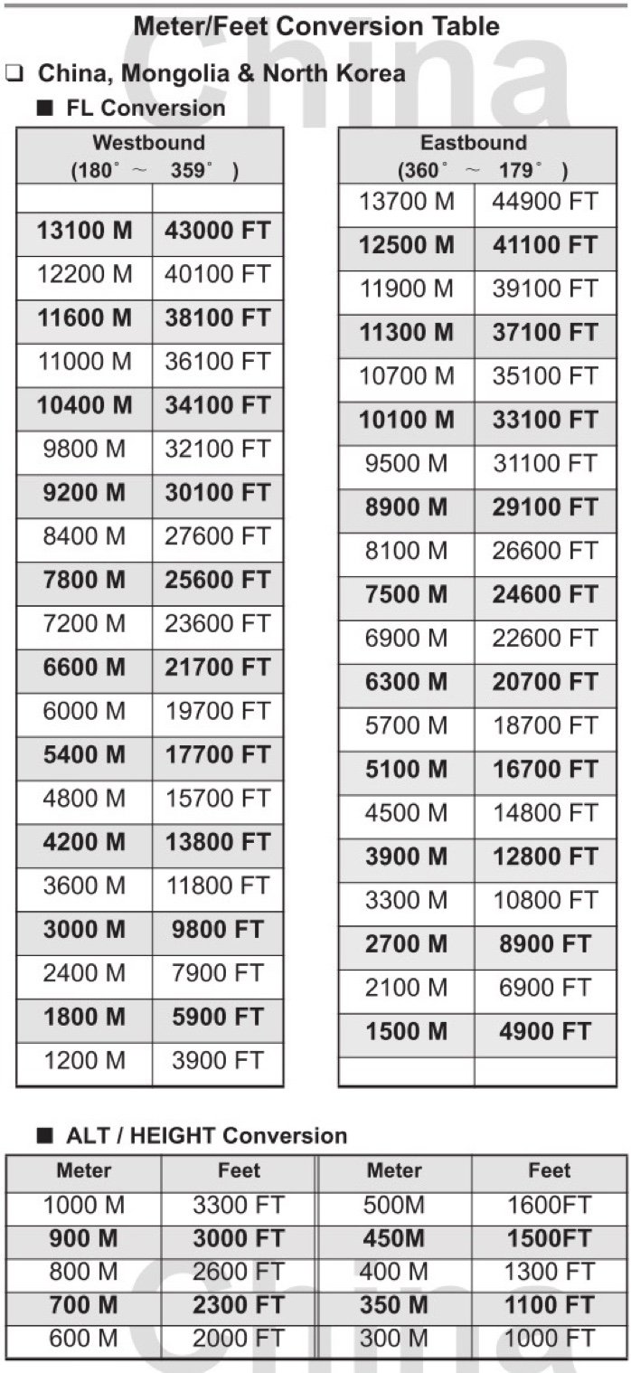
TL
TA
550M 1800ft
China

Slide 48
ZSSS(SHA) 10ft | RKSS(GMP) 59ft
China Eastern 131.5 DCL -20분, No READBACK | KE GMP 131.15
PA
Rwy 32L Landing
(06:00L~0900L / 12:00L~15:00L /18:00L~21:00L)
SHA : SID (NADP 1) N DEP Freq : 126.65 South DEP : 121.10 (넘겨줌)
18R | LAMEN 61D |  |  | 183 |  | 183 | 3000 (900m) | 3000 900m | 183
36L | LAMEN 73D |  |  | 003 |  | 003 | 3000 (900m) | 3000 900m | 003
 | LAMEN 71D |  |  | 003 |  | 003 | 3000 or 4900 | 3000 4900 | 003
SHA 117.2 |  |  | 18L 111.3 |  |  |  | 36R 110.3
HUD |  | 18R (9’) |  |  | 10827’ |  |  | 36L (76’)
RWY 36L LAMEN 71D : L/H Turn Below 200m(660ft) in DCL
DEP 126.65(121.1)
SHA APP 125.4 – 125.625 – SHA 120.95
ICN 125.725 – 124.52
APP – 119.75
China
GMP : STAR
ILS 32L/R | OLMEN xT |  |  | BUMSI | OLMEN 160
ILS 14R | OLMEN xU |  |  | DOKDO | OLMEN 160
HUD |  |  | 32L(41’) | 10499’ | 14R(34’)
 |  |  | 32R(42’) | 11811’ | 14L(38’)
FIX |  | KIP /8(RWY 32), YJU R271, P73 /2
32L : D3(6532’), E2(9117’), 32R : E1(6614’) 14R : C1(6578’)
32L/R : 8 KIP L/G, 14R : LOC CAPT L/G FAF : Final Flap TWR -> GND -> APRON (All by ATC) Except RWY14R Landing (Until R)

Slide 49
RKSS(GMP) 59ft | ZBAA(PEK) 116ft
KE GMP 131.15 DCL -15분 가능 TOBT 5분 차이시 CTC Comm | Air China Beijing 131.5
PA
Rwy 32R Takeoff
(06:00L~0900L / 12:00L~15:00L /18:00L~21:00L)
GMP : SID (NADP 1)
32L/R | NOPIK xT |  | 324 |  | 324 |  | 5000 |  | 324
 | (NOPIK xQ) |  | 324 |  | 324 |  | 5000 |  | 324
14L/R | NOPIK xU |  | 144 |  | 144 |  | 6000 |  | 144
KIP 113.6 |  | 32L 108.3 | 32R 110.7 |  |  | 14L 109.9 |  | 14R 108.7
32L/R : KIP324/4, R225 YJU R271 |  |  |  | 14L/R : KIP144/4, R220 P73 /2
HUD |  | 32L(41’) |  | 10499’ |  |  | 14R(34’)
 |  | 32R(42’) |  | 11811’ |  |  | 14L(38’)
APRON(130.875) -> GND(121.9) -> TWR (All by ATC)
DEP 125.15 – TGU 132.8 – DLC 132.95
TAO 133.72 – 128.15 – PEK 125.6
PEK APP 120.6 – Final 119.0
China
PEK : STAR (RW01/19 main (RW36L/18R))
01(36L) | DUMAP xZA | AA421 | ILS Z 01(Y 36L)
19(18R)) | DUMAP xZA | AA521 | ILS Z 19(Y 18R)
HUD | 01(84’) 12467’ 19(94’) 3.2도
 | 36L(107’) 10499’ 18R(115’)
FIX : RWxx /8(180kts), /6(160kts) TMA Max 280kts
01 : Q5(5223’), Q6(7024’), 19 :Q4(5298’), Q3(7103’) 36L : P6(6276’), P7(7719’), 18R : P3(6223’), P2(7552’)
APU off Procedure (GND Air Cond’ & GPU) Standard TAXI RTE in Jeppesen Chart

Slide 50
TL
TA
550M 1800ft
China

Slide 51
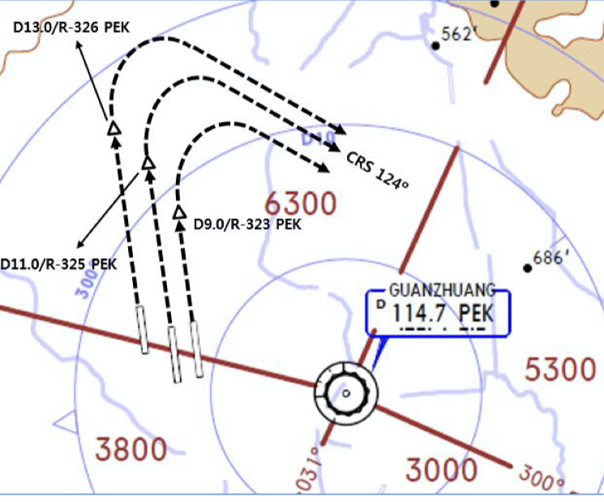
ZBAA(PEK) 116ft | RKSS(GMP) 59ft
Air China Beijing 131.5 DCL -30분, Voice -10분 (COBT/STD 15분 차이 CTC Comm) | KE GMP 131.15
PA
Rwy 32L Landing
(06:00L~0900L / 12:00L~15:00L /18:00L~21:00L)
PEK : SID (NADP 1) RW36R/18L Intersec T/O W2, W7
36R (01) | MUGLO xWD(xYD) |  |  | 359 |  |  | 359 | ATIS/DCL | 3000 900m | 359
18L (19) | MUGLO xZD(xYD) |  |  | 179 |  |  | 179 | ATIS/DCL | 3000 900m | 179
PEK 114.7 |  |  | 36R 111.55 |  | 18L 109.3 |  |  | 01 108.5 |  | 19 108.9
36R : PEK 325/11, 36L : PEK 326/13, 01 : PEK 323/9 R124
HUD |  | 36R(98’) 01(84’) |  |  |  | 12467’ |  |  | 18L(110’) 19(94’)
COBT from ATIS “Enroute”, Bad Wx DOTRA SID
DEP 124.4
PEK APP 120.6 – PEK 125.6
DLC 123.2 – 132.95
ICN 132.8 – APP 119.75
China
GMP : STAR
ILS 32L/R | REBIT xT(xQ) |  |  | BUMSI | REBIT 170
ILS 14R | REBIT xU |  |  | DOKDO
HUD |  |  | 32L(41’) | 10499’ | 14R(34’)
 |  |  | 32R(42’) | 11811’ | 14L(38’)
FIX |  | KIP /8(RWY 32), YJU R271, P73 /2
32L : D3(6532’), E2(9117’), 32R : E1(6614’) 14R : C1(6578’)
32L/R : 8 KIP L/G, 14R : LOC CAPT L/G FAF : Final Flap TWR -> GND -> APRON (All by ATC) Except RWY14R Landing (Until R)

Slide 52
RKSS(GMP) 59ft | RJBB(KIX) 17ft
KE GMP 131.15 DCL -15분 가능 TOBT 5분 차이시 CTC Comm | KE KIX 130.95
PA
Rwy 32R Takeoff
(06:00L~0900L / 12:00L~15:00L /18:00L~21:00L)
GMP : SID (NADP 1)
32L/R | EGOBA xT |  | 324 |  | 324 |  | 5000 |  | 324
 | (EGOBA xQ) |  | 324 |  | 324 |  | 5000 |  | 324
14L/R | EGOBA xU |  | 144 |  | 144 |  | 6000 |  | 144
KIP 113.6 |  | 32L 108.3 | 32R 110.7 |  |  | 14L 109.9 |  | 14R 108.7
32L/R : KIP324/4, R225 YJU R271 |  |  |  | 14L/R : KIP144/4, R220 P73 /2
HUD |  | 32L(41’) |  | 10499’ |  |  | 14R(34’)
 |  | 32R(42’) |  | 11811’ |  |  | 14L(38’)
APRON(130.875) -> GND(121.9) -> TWR (All by ATC)
DEP 125.15 – TGU 134.17 - TKO 133.8
KIX RDR 120.85
KIX APP 120.25
Japan
KIX : STAR (SAEKI 170, RANDY 150)
06L | ALISA B | BERRY | ILS Y 06L
06R | ALISA A | ALLAN | ILS Y 06R
24L/R | ALISA C | MAYAH | ILS Z 24L/R
HUD | 06L(15’) 13123’ 24R(23’)
 | 06R(5’) 11483’ 24L(12’)
06L : B8(5160’), B6(6751’), 24R : B7(5318’), B9(6751’) 06R : A7(5137’), A6(6938’), 24L : A8(5269’), A9(6976’)
RWY06 : After 2500ft L/G DN, After 1500ft L/D FLAP TAXI RTE 1, 2

Slide 53
RJBB(KIX) 17ft | RKSS(GMP) 59ft
KE KIX 130.95 DCL -15분 | KE GMP 131.15
PA
Rwy 32L Landing
(06:00L~0900L / 12:00L~15:00L /18:00L~21:00L)
KIX : SID – SOUJA tx (NADP 1)
06L/R | HELEN x - SOUJA tx |  | 059 |  | 059 | ATC (9000) |  | 059
24L/R |  |  | 239 |  | 239 | ATC (9000) |  | 239
KIE 111.6 |  | 06L 108.7 |  | 06R 108.1 |  | 24L 110.7 | 24R 108.5
HUD | 06L(15’) |  | 13123’ |  |  | 24R(23’)
 | 06R (5’) |  | 13123’ |  |  | 24L (12’)
APU Start, TAXI RTE 1, 2
DEP 119.2
TKO 132.7 – 133.8
TGU 120.57
APP 119.75
Japan
GMP : STAR
ILS 32L/R | GUKDO xT |  |  | BUMSI | OLMEN 160
ILS 14R | GUKDO xU |  |  | DOKDO | OLMEN 160
HUD |  |  | 32L(41’) | 10499’ | 14R(34’)
 |  |  | 32R(42’) | 11811’ | 14L(38’)
FIX |  | KIP /8(RWY 32), YJU R271, P73 /2
32L : D3(6532’), E2(9117’), 32R : E1(6614’) 14R : C1(6578’)
32L/R : 8 KIP L/G, 14R : LOC CAPT L/G FAF : Final Flap TWR -> GND -> APRON (All by ATC) Except RWY14R Landing (Until R)

Slide 54
RKPC(CJU) 119ft | ZBAA(PEK) 116ft
KE CJU 129.4 DCL -10분 | Air China Beijing 132.0
PA
CJU : SID (NADP 1)
07 | LIMDI xE |  |  | 066 |  | 066 |  | 9000 | 066
25 | KAMIT xW |  |  | 246 |  | 246 |  | ATC | 246
YDM 109.0 |  |  | 07 109.9 |  |  |  | 25 111.3
07 : NONE |  |  |  |  | 25 : YDM246/3, R290
HUD |  | 07(87’) |  |  | 10433’ |  |  | 25(76’)
07 : Passing G4 CTC TWR 25 : 31 Holding PSN on P, E1,2,3 CTC TWR
China
DEP 121.2 – TGU 124.52 – 120.72 – 126.17 – 132.8
DLC 132.95 - TAO 133.72 – 128.15 – PEK 125.6
PEK APP 120.6 – Final 119.0
PEK : STAR (RW01/19 main (RW36L/18R))
01(36L) | DUMAP xZA | AA421 | ILS Z 01(Y 36L)
19(18R)) | DUMAP xZA | AA521 | ILS Z 19(Y 18R)
HUD | 01(84’) 12467’ 19(94’) 3.2도
 | 36L(107’) 10499’ 18R(115’)
FIX : RWxx /8(180kts), /6(160kts) TMA Max 280kts
01 : Q5(5223’), Q6(7024’), 19 :Q4(5298’), Q3(7103’) 36L : P6(6276’), P7(7719’), 18R : P3(6223’), P2(7552’)
APU off Procedure (GND Air Cond’ & GPU) Standard TAXI RTE in Jeppesen Chart

Slide 55
TL
TA
550M 1800ft
China

Slide 56
ZBAA(PEK) 116ft | RKPC(CJU) 119ft
Air China Beijing 132.0 DCL 30분전, Voice 10분전 (COBT/STD 15분 차이 CTC Comm) | KE CJU 129.4
PA
PEK : SID (NADP 1) RW36R/18L Intersec T/O W2, W7
36R (01) | MUGLO xWD(xYD) |  |  | 359 |  |  | 359 | ATIS/DCL | 3000 900m | 359
18L (19) | MUGLO xZD(xYD) |  |  | 179 |  |  | 179 | ATIS/DCL | 3000 900m | 179
PEK 114.7 |  |  | 36R 111.55 |  | 18L 109.3 |  |  | 01 108.5 |  | 19 108.9
36R : PEK 325/11, 36L : PEK 326/13, 01 : PEK 323/9 R124
HUD |  | 36R(98’) 01(84’) |  |  |  | 12467’ |  |  | 18L(110’) 19(94’)
COBT from ATIS “Enroute”, Bad Wx DOTRA SID
DEP 124.4
PEK APP 120.6 – PEK 125.6
DLC 123.2 – 132.95
ICN 132.8 – 126.17 – 120.72
124.52 - APP 119.75
China
CJU : STAR AFT Merge PT(220kts) DCT IAF(210kts), FAF (160kts)
ILS Z 07 | LIMDI xP |  | YUMIN
ILS Z 25 | LIMDI xT |  | DUKAL
HUD |  | 07(87’) |  | 10433’ |  | 25(76’)
07 : P6(5176’), P5(5882’), P4(6840’-ATC HIRO) 25 : P7(5219’), P8(5882’), P10(7524’-ATC HIRO)
Entering Rapid TWY CTC GND 121.675 (STOP x) HST 40KTS

Slide 57
RKPK(PUS) 13ft | ZSPD(PVG) 13ft
KE Gimhae 129.2 DCL -5분 | China Eastern 130.5
PA
PUS : SID (Mod NADP CLB2 1000, 14000 MAX)
36 | SOORO x TOPAX tx |  |  | 306 |  | 280 |  | ATC |  | 279
18 | BULIM x ENGOT tx |  |  | 182 |  | 182 |  | 5000 |  | 182
KMH 113.8 |  |  | PSN 114.0 |  | 36L 108.5 |  |  |  | 36R 109.5
36 : KMH R091, R271, R185
HUD |  | 36L(13’) 10499’ 36R(8’) 8999’ |  |  |  |  | 18R(13’) 8530’ 18L(13’) 8999’
RWY36 400ft Man L/H turn, Max Taxi SPD 20KTS
DEP 125.5 – TGU 128.17 – 124.52(125.72)
SHA 120.95
SHA APP 125.62(119.975) – 125.4
China
PVG : STAR (North of ‘PVGNB’, R-276 Prohibited)
34R(L)/35L(R) | DUM 91A/92A | MP2 | ILS Z xx
16L(R)/17R(L) | DUM 81A/82A | MP1 | ILS Z xx
HUD | 34R/L(11’/12’) 12467’ 16L/R(12’/11’)
 | 35R(10’) 13123’ 17L10’)
 | 35L(12’) 11155’ 17R(12’)
34R : G4(5603’), G5(6896’), 16L : G3(5577’), G2(6909’) 35L : D4(5636’), D5(6932’), 17R : D3(5626’), D2(6942’)
Normally DUMET 6000m Follow Me Car Insight – TAXI L/T off,APU off Procedure

Slide 58
TL
TA
550M 1800ft
China

Slide 59
ZSPD(PVG) 13ft | RKPK(PUS) 13ft
China Eastern 130.5 DCL 20분전, No READ BACK! | KE Gimhae 129.2
PA
PVG : SID (NADP 1) (ATC Hold Expected Fuel Add!!)
34L/R 35R/L | LAM 92D (LAM 91D) |  |  | 348 |  |  | 348 | ATC (900m) | 348
16R/L 17L/R | LAM 82D (LAM 81D) |  |  | 168 |  |  | 168 | ATC (900m) | 168
PUD 116.9 |  |  | 34R 108.9 |  | 35L 108.1 |  |  | 34L 108.3 | 35R 111.9
 |  |  | 16L 111.5 |  | 17R 111.1 |  |  | 16R 108.7 | 17L 110.7
HUD |  | 34R/L(11’/12’) 35R(10’) 35L(12’) |  |  |  | 12467’ 13123’ 11155’ |  | 16L/R(12’/11’) 17L(10’) 17R(12’)
APU Start, TUG Connect After Beacon L/T ON Ready for Intersection T/O
SHA APP 125.4 (Without Instruction)
SHA APP 125.62(119.975)
SHA 120.95
ICN 125.725(124.52) – 128.17
APP – 125.5
China
PUS : STAR (Tail Wind 36R 136000lbs F40)
ILS 36 | KEVOX x | ANROD | 9DME LG, 8DME FLAP
VOR 18 | GAYHA x | ANROD | 18 Circling Click!!
HUD | 36L(13’) 10499’ 36R(8’) 8999’ |  | 18R(13’) 8530’ 18L(13’) 8999’
FIX | 36 : IKMA/IKHE /9, /8 |  | 18 : KMH R284, R280
36L : C4 (6299’), C2(7795’) / 36R : E3(5866’), E2(7339’) 18R : C6(5770’), C7 (6824’) / 18L : E4(5882’), E5(8792’)
Vacate C3,C4 by ATC only. Max Taxi SPD 20KTS C2 HOLD SHORT 가까움(Vacate TaxiSPD)

Slide 60
RKSI(ICN) 23ft | ZSNJ(NKG) 49ft
KE ICN 131.5 DCL -10분 TOBT 5분 차이시 CTC Comm | None
PA
ICN : SID (33/34 NADP 1, 15/16 NADP 2)
33L/R | BOPTA xA |  | 333 |  | 333 |  | ATC |  | 333
34L/R | BOPTA xY |  | 333 |  | 333 |  | ATC |  | 333
15L/R | BOPTA xC |  | 153 |  | 153 |  | 5000 |  | 153
16L/R | BOPTA xH |  | 153 |  | 153 |  | 5000 |  | 153
NCN 113.8 |  | 33L 109.3 |  | 33R 108.9 |  | 15L 111.9 |  | 15R 109.1
WNG 112.9 |  | 34L 109.95 |  | 34R 108.1 |  | 16L 110.35 |  | 16R 108.55
33L/R : NC05L/R, R242 YJU R271 |  |  |  | 34L/R : WNG333/4.6, R242 YJU R271
HUD | 33L/R 34L(23’) |  |  | 12303’ |  | 15L/R 16R(23’)
 | 34R (23’) |  |  | 13123’ |  | 16L (23’)
Parallel TWY 10KTS 이상(R17 MAX 15kts)
DEP 125.15 – TGU 126.17 – 120.72 – 124.52(125.72)
SHA 120.95 – 120.55 – 125.95 – 119.075
NKG APP 126.55 – 119.25
China
NKG : STAR (‘D’ N31 34.0 E118 42.1 – R101, R289)
07 (06) | ESB 71F/21A (ESB 61F/11A) | SNQ | ILS Z 07 (ILS Z 06)
25 (24) | ESB 52F/22A (ESB 42F/12A) | NJ210 | ILS Z 25 (ILS Z 24)
HUD | 07(41’) 11811’ 25(39’)
 | 06(43’) 11811’ 24(38’)
07 : D5(6499’), D6(7582’), 25 : D2(6505’), D1(7582’) 06 : A5(6614’), A6(7860’), 24 : A3(6637’), A9(7864’)
IAF, Missed App SPD APP : 210kts or 205kts Follow Me Car on C 13, APU off Procedure

Slide 61
TL
TA
550M 1800ft
China

Slide 62
ZSNJ(NKG) 49ft | RKSI(ICN) 23ft
None DCL 가능, READ BACK! | KE ICN 131.5
PA
NKG : SID (NADP 1) (ATC Hold Expected Fuel Add!!)
06 (07) | ESB 61X/11D (ESB 71X/21D) |  |  | 064 |  |  | 064 | 3000 (900m) | 3000 900m | 064
24 (25) | ESB 42X/12D (ESB 52X/22D) |  |  | 244 |  |  | 244 | 3000 (900m) | 3000 900m | 244
NJL 113.6 |  |  | 07 108.7 |  | 25 111.3 |  |  | 06 110.3 |  | 24 110.9
HUD |  | 06(43’) 07(41’) |  |  |  | 11811’ |  |  | 24(38’) 25(39’)
APU Start, TUG Connect After Beacon L/T ON
DEP 119.25
NKG APP 126.55
SHA 119.075 – 125.95 - 120.55 - 120.95
ICN 125.725(124.52) – 120.72 – 126.17
APP – 119.75
China
ICN : STAR
ILS 33/34 | OLMEN xE | ENPIL | OLMEN 180
ILS 15/16 | OLMEN xH | MUNAN | OLMEN 180
HUD | 33L/R 34L(23’) | 12303’ | 15L/R 16R(23’)
 | 34R(23’) | 13123’ | 16L(23’)
FIX | RWY /8, /5 , YJU R271
33R : C4(7529’), C5(8513’), 33L : B4(7563’), B5(8513‘) 15L : C2(7522’), C1(8536’), 15R : B3(7454‘), B2(8641‘)
34L : P7(5600’), P8(6578’), 34R : N4(6876’), N5(8507‘) 16R : P6(5597’), P5(6574’), 16L : N3(7043‘), N2(8444‘)
8NM 180kts, 5NM 160kts, Parr TAXI 10kts이상, HIRO

Slide 63
RKSI(ICN) 23ft | ZSQD(TAO) 30ft
KE ICN 131.5 DCL -10분 TOBT 5분 차이시 CTC Comm | None
PA
ICN : SID (33/34 NADP 1, 15/16 NADP 2)
33L/R | NOPIK xA |  | 333 |  | 333 |  | ATC |  | 333
34L/R | NOPIK xY |  | 333 |  | 333 |  | ATC |  | 333
15L/R | BINIL xC |  | 153 |  | 153 |  | 5000 |  | 153
16L/R | BINIL xH |  | 153 |  | 153 |  | 5000 |  | 153
NCN 113.8 |  | 33L 109.3 |  | 33R 108.9 |  | 15L 111.9 |  | 15R 109.1
WNG 112.9 |  | 34L 109.95 |  | 34R 108.1 |  | 16L 110.35 |  | 16R 108.55
33L/R : NC05L/R, R242 P518 R068, R278 |  |  |  | 34L/R : WNG333/4.6, R242 P518 R068, R278
HUD | 33L/R 34L(23’) |  |  | 12303’ |  | 15L/R 16R(23’)
 | 34R (23’) |  |  | 13123’ |  | 16L (23’)
Parallel TWY 10KTS 이상(R17 MAX 15kts)
DEP 125.15 – TGU 132.8 – DLC 132.95
TAO 134.85 – 133.72 – 134.85
TAO APP 124.6 – 119.4
China
TAO : STAR (AVBIK R014 - LAROP R159 동쪽 금지)
35(34) | LAT 91A/01A | JD405 | ILS Z 35(34)
17(16) | LAT 81A/11A | JD305 | ILS Z 17(16)
HUD | 35(27’) 11811’ 17(29’)
 | 34(27’) 11811’ 16(27’)
FIX : AVBIK R014, LAROP R159 (두점 연결)
35 : S2(5255’), S4(6624’), 17 : S1(5282’), S3(6604’) 34 : R2(5278’), R4(6650’), 16 : R1(5318’), R3(6706’)
위 Vacate Point 불가시 TWR 보고 Follow Me Car on Lxx, APU off Procedure

Slide 64
TL
TA
550M 1800ft
China

Slide 65
ZSQD(TAO) 30ft | RKSI(ICN) 23ft
None DCL 가능, READ BACK! (Voice 10분전 부터) | KE ICN 131.5
PA
TAO : SID (NADP 1)
34 (35) | LAT 91D/01D |  |  | 350 |  |  | 350 | ATC 3000 (900m) | 3000 900m | 350
16 (17) | LAT 81D/11D |  |  | 170 |  |  | 170 | ATC 3000 (900m) | 3000 900m | 170
JDG 114.45 |  |  | 17 110.15 |  | 35 109.75 |  |  | 16 111.9 |  | 34 108.55
HUD |  | 34(27’) 35(27’) |  |  |  | 11811’ |  |  | 16(27’) 17(29’)
Heading 190, Join W209 -> DCT LATUX CRS 147
APP 119.4
TAO APP 124.6
TAO 134.85 – 133.72 – DLC 132.95
ICN 132.8 – APP 119.75
China
ICN : STAR
ILS 33/34 | REBIT xA | PAMBI | REBIT 170
ILS 15/16 | REBIT xH | MUNAN | REBIT 170
HUD | 33L/R 34L(23’) | 12303’ | 15L/R 16R(23’)
 | 34R(23’) | 13123’ | 16L(23’)
FIX | RWY /8, /5 , P518 R068, R278
33R : C4(7529’), C5(8513’), 33L : B4(7563’), B5(8513‘) 15L : C2(7522’), C1(8536’), 15R : B3(7454‘), B2(8641‘)
34L : P7(5600’), P8(6578’), 34R : N4(6876’), N5(8507‘) 16R : P6(5597’), P5(6574’), 16L : N3(7043‘), N2(8444‘)
8NM 180kts, 5NM 160kts, Parr TAXI 10kts이상, HIRO

Slide 66
RKSI(ICN) 23ft | ZBAA(PEK) 116ft
KE ICN 131.5 DCL -10분 TOBT 5분 차이시 CTC Comm | Air China Beijing 132.0
PA
ICN : SID (33/34 NADP 1, 15/16 NADP 2)
33L/R | NOPIK xA |  | 333 |  | 333 |  | ATC |  | 333
34L/R | NOPIK xY |  | 333 |  | 333 |  | ATC |  | 333
15L/R | BINIL xC |  | 153 |  | 153 |  | 5000 |  | 153
16L/R | BINIL xH |  | 153 |  | 153 |  | 5000 |  | 153
NCN 113.8 |  | 33L 109.3 |  | 33R 108.9 |  | 15L 111.9 |  | 15R 109.1
WNG 112.9 |  | 34L 109.95 |  | 34R 108.1 |  | 16L 110.35 |  | 16R 108.55
33L/R : NC05L/R, R242 P518 R068, R278 |  |  |  | 34L/R : WNG333/4.6, R242 P518 R068, R278
HUD | 33L/R 34L(23’) |  |  | 12303’ |  | 15L/R 16R(23’)
 | 34R (23’) |  |  | 13123’ |  | 16L (23’)
Parallel TWY 10KTS 이상(R17 MAX 15kts)
DEP 125.15 – TGU 132.8 – DLC 132.95
TAO 133.72 – 128.15 – PEK 125.6
PEK APP 120.6 – Final 119.0
China
PEK : STAR (RW01/19 main (RW36L/18R))
01(36L) | DUMAP xZA | AA421 | ILS Z 01(Y 36L)
19(18R)) | DUMAP xZA | AA521 | ILS Z 19(Y 18R)
HUD | 01(84’) 12467’ 19(94’) 3.2도
 | 36L(107’) 10499’ 18R(115’)
FIX : RWxx /8(180kts), /6(160kts) TMA Max 280kts
01 : Q5(5223’), Q6(7024’), 19 :Q4(5298’), Q3(7103’) 36L : P6(6276’), P7(7719’), 18R : P3(6223’), P2(7552’)
APU off Procedure (GND Air Cond’ & GPU) Standard TAXI RTE in Jeppesen Chart

Slide 67
TL
TA
550M 1800ft
China

Slide 68
ZBAA(PEK) 116ft | RKSI(ICN) 23ft
Air China Beijing 132.0 DCL 30분전, Voice 10분전 (COBT/STD 15분 차이 CTC Comm) | KE ICN 131.5
PA
PEK : SID (NADP 1) RW36R/18L Intersec T/O W2, W7
36R (01) | MUGLO xWD(xYD) |  |  | 359 |  |  | 359 | ATIS/DCL | 3000 900m | 359
18L (19) | MUGLO xZD(xYD) |  |  | 179 |  |  | 179 | ATIS/DCL | 3000 900m | 179
PEK 114.7 |  |  | 36R 111.55 |  | 18L 109.3 |  |  | 01 108.5 |  | 19 108.9
36R : PEK 325/11, 36L : PEK 326/13, 01 : PEK 323/9 R124
HUD |  | 36R(98’) 01(84’) |  |  |  | 12467’ |  |  | 18L(110’) 19(94’)
COBT from ATIS “Enroute”, Bad Wx DOTRA SID
DEP 124.4
PEK APP 120.6 – PEK 125.6
DLC 123.2 – 132.95
ICN 132.8 – APP 119.75
China
ICN : STAR
ILS 33/34 | REBIT xA | PAMBI | REBIT 170
ILS 15/16 | REBIT xH | MUNAN | REBIT 170
HUD | 33L/R 34L(23’) | 12303’ | 15L/R 16R(23’)
 | 34R(23’) | 13123’ | 16L(23’)
FIX | RWY /8, /5 , P518 R068, R278
33R : C4(7529’), C5(8513’), 33L : B4(7563’), B5(8513‘) 15L : C2(7522’), C1(8536’), 15R : B3(7454‘), B2(8641‘)
34L : P7(5600’), P8(6578’), 34R : N4(6876’), N5(8507‘) 16R : P6(5597’), P5(6574’), 16L : N3(7043‘), N2(8444‘)
8NM 180kts, 5NM 160kts, Parr TAXI 10kts이상, HIRO

Slide 69
RKSI(ICN) 23ft | ZYTX(SHE) 198ft
KE ICN 131.5 DCL -10분 TOBT 5분 차이시 CTC Comm | China Southern Dispatch 131.5
PA
ICN : SID (33/34 NADP 1, 15/16 NADP 2)
33L/R | NOPIK xA |  | 333 |  | 333 |  | ATC |  | 333
34L/R | NOPIK xY |  | 333 |  | 333 |  | ATC |  | 333
15L/R | BINIL xC |  | 153 |  | 153 |  | 5000 |  | 153
16L/R | BINIL xH |  | 153 |  | 153 |  | 5000 |  | 153
NCN 113.8 |  | 33L 109.3 |  | 33R 108.9 |  | 15L 111.9 |  | 15R 109.1
WNG 112.9 |  | 34L 109.95 |  | 34R 108.1 |  | 16L 110.35 |  | 16R 108.55
33L/R : NC05L/R, R242 P518 R068, R278 |  |  |  | 34L/R : WNG333/4.6, R242 P518 R068, R278
HUD | 33L/R 34L(23’) |  |  | 12303’ |  | 15L/R 16R(23’)
 | 34R (23’) |  |  | 13123’ |  | 16L (23’)
Parallel TWY 10KTS 이상(R17 MAX 15kts)
DEP 125.15 – TGU 132.8 – DLC 132.95 – 135.65
DLC 134.325(128.775)
SHE APP 125.55 – 119.825
TWR 118.1
China
SHE : STAR (CLR Limit TOSID Late Handoff to SHE)
06 | TOSID 62A, 61A | TX504 | ILS Z 06
24 | TOSID 72A, 11A | TX662 | ILS Z 24
HUD | 06(170’) 10499’ 24(198’)
Around TOSID – Present TRK or HDG – CTC SHE CTL
06 : D(6210’), C(7854’), 24 : J(6227’), K(7864’) - ATC
06 : HP06(03), 24 : HP06(03) Follow Me Car Normally Remain Parking Brake SET!! APU off Procedure (GND Air Cond’ & GPU)

Slide 70
TL
TA
550M 1800ft
China

Slide 71
ZYTX(SHE) 198ft | RKSI(ICN) 23ft
China Southern Dispatch 131.5 DCL 가능, 5분전 READ BACK! (Voice 10분전) | KE ICN 131.5
PA
SHE : SID (NADP 1) A2, A8 Intersec T/O by ATC
06 | TOSID 61,62D |  |  | 056 |  | 056 | ATC/DCL | 3000 900m | 056
24 | TOSID 71,72D |  |  | 236 |  | 236 | ATIS/DCL | 3000 900m | 236
SEY 114.1 |  |  | 06 110.5 |  |  |  | 24 110.3 |  | 19 108.9
HUD |  | 06(170’) |  |  | 10499’ |  |  | 24(198’)
Follow FollowMe Car Until HPxx Be Careful “Hold short CAT I Hold line” Maintain Present TRK/HDG Join A588(CRS 217) Offset R3 → Active Fix DCT and EXE again!!
CTC APP without TWR Instruction
APP 119.825 – 125.55
DLC 134.325 – 135.65
DLC 132.95
ICN 132.8 – APP 119.75
China
ICN : STAR
ILS 33/34 | REBIT xA | PAMBI | REBIT 170
ILS 15/16 | REBIT xH | MUNAN | REBIT 170
HUD | 33L/R 34L(23’) | 12303’ | 15L/R 16R(23’)
 | 34R(23’) | 13123’ | 16L(23’)
FIX | RWY /8, /5 , P518 R068, R278
33R : C4(7529’), C5(8513’), 33L : B4(7563’), B5(8513‘) 15L : C2(7522’), C1(8536’), 15R : B3(7454‘), B2(8641‘)
34L : P7(5600’), P8(6578’), 34R : N4(6876’), N5(8507‘) 16R : P6(5597’), P5(6574’), 16L : N3(7043‘), N2(8444‘)
8NM 180kts, 5NM 160kts, Parr TAXI 10kts이상, HIRO

Slide 72
RKSI(ICN) 23ft | ZSPD(PVG) 13ft
KE ICN 131.5 DCL -10분 TOBT 5분 차이시 CTC Comm | China Eastern 130.5
PA
ICN : SID (33/34 NADP 1, 15/16 NADP 2)
33L/R | BOPTA xA |  | 333 |  | 333 |  | ATC |  | 333
34L/R | BOPTA xY |  | 333 |  | 333 |  | ATC |  | 333
15L/R | BOPTA xC |  | 153 |  | 153 |  | 5000 |  | 153
16L/R | BOPTA xH |  | 153 |  | 153 |  | 5000 |  | 153
NCN 113.8 |  | 33L 109.3 |  | 33R 108.9 |  | 15L 111.9 |  | 15R 109.1
WNG 112.9 |  | 34L 109.95 |  | 34R 108.1 |  | 16L 110.35 |  | 16R 108.55
33L/R : NC05L/R, R242 YJU R271 |  |  |  | 34L/R : WNG333/4.6, R242 YJU R271
HUD | 33L/R 34L(23’) |  |  | 12303’ |  | 15L/R 16R(23’)
 | 34R (23’) |  |  | 13123’ |  | 16L (23’)
Parallel TWY 10KTS 이상(R17 MAX 15kts)
DEP 125.15 – TGU 126.17 – 120.72 – 124.52(125.72)
SHA 120.95
SHA APP 125.62(119.975) – 125.4
China
PVG : STAR (North of ‘PVGNB’, R-276 Prohibited)
34R(L)/35L(R) | DUM 91A/92A | MP2 | ILS Z xx
16L(R)/17R(L) | DUM 81A/82A | MP1 | ILS Z xx
HUD | 34R/L(11’/12’) 12467’ 16L/R(12’/11’)
 | 35R(10’) 13123’ 17L(10’)
 | 35L(12’) 11155’ 17R(12’)
34R : G4(5603’), G5(6896’), 16L : G3(5577’), G2(6909’) 35L : D4(5636’), D5(6932’), 17R : D3(5626’), D2(6942’)
Normally DUMET 6000m Follow Me Car Insight – TAXI L/T off,APU off Procedure

Slide 73
TL
TA
550M 1800ft
China

Slide 74
ZSPD(PVG) 13ft | RKSI(ICN) 23ft
China Eastern 130.5 DCL 20분전, No READ BACK! | KE ICN 131.5
PA
PVG : SID (NADP 1) (ATC Hold Expected Fuel Add!!)
34L/R 35R/L | LAM 92D (LAM 91D) |  |  | 348 |  |  | 348 | ATC (900m) | 348
16R/L 17L/R | LAM 82D (LAM 81D) |  |  | 168 |  |  | 168 | ATC (900m) | 168
PUD 116.9 |  |  | 34R 108.9 |  | 35L 108.1 |  |  | 34L 108.3 | 35R 111.9
 |  |  | 16L 111.5 |  | 17R 111.1 |  |  | 16R 108.7 | 17L 110.7
HUD |  | 34R/L(11’/12’) 35R(10’) 35L(12’) |  |  |  | 12467’ 13123’ 11155’ |  | 16L/R(12’/11’) 17L(10’) 17R(12’)
APU Start, TUG Connect After Beacon L/T ON Ready for Intersection T/O
SHA APP 125.4 (Without Instruction)
SHA APP 125.62(119.975)
SHA 120.95
ICN 125.725(124.52) – 120.72 – 126.17
APP – 119.75
China
ICN : STAR
ILS 33/34 | OLMEN xE | ENPIL | OLMEN 180
ILS 15/16 | OLMEN xH | MUNAN | OLMEN 180
HUD | 33L/R 34L(23’) | 12303’ | 15L/R 16R(23’)
 | 34R(23’) | 13123’ | 16L(23’)
FIX | RWY /8, /5 , YJU R271
33R : C4(7529’), C5(8513’), 33L : B4(7563’), B5(8513‘) 15L : C2(7522’), C1(8536’), 15R : B3(7454‘), B2(8641‘)
34L : P7(5600’), P8(6578’), 34R : N4(6876’), N5(8507‘) 16R : P6(5597’), P5(6574’), 16L : N3(7043‘), N2(8444‘)
8NM 180kts, 5NM 160kts, Parr TAXI 10kts이상, HIRO

Slide 75
RKSI(ICN) 23ft | ZYYJ(YNJ) 624ft
KE ICN 131.5 DCL -10분 TOBT 5분 차이시 CTC Comm | None No D-ATIS
PA
ICN : SID (33/34 NADP 1, 15/16 NADP 2)
33L/R | NOPIK xA |  | 333 |  | 333 |  | ATC |  | 333
34L/R | NOPIK xY |  | 333 |  | 333 |  | ATC |  | 333
15L/R | BINIL xC |  | 153 |  | 153 |  | 5000 |  | 153
16L/R | BINIL xH |  | 153 |  | 153 |  | 5000 |  | 153
NCN 113.8 |  | 33L 109.3 |  | 33R 108.9 |  | 15L 111.9 |  | 15R 109.1
WNG 112.9 |  | 34L 109.95 |  | 34R 108.1 |  | 16L 110.35 |  | 16R 108.55
33L/R : NC05L/R, R242 P518 R068, R278 |  |  |  | 34L/R : WNG333/4.6, R242 P518 R068, R278
HUD | 33L/R 34L(23’) |  |  | 12303’ |  | 15L/R 16R(23’)
 | 34R (23’) |  |  | 13123’ |  | 16L (23’)
Parallel TWY 10KTS 이상(R17 MAX 15kts)
DEP 125.15 – TGU 132.8 – DLC 132.95 – 135.65
128.77 – SHE 119.3 – 118.9
YNJ TWR 118.75
China
YNJ : RNP STAR (RW09 main for L/D) CHK NAV DATA for Holding Area(Expect Hold Mil Train)
09 | KAN/OMB 09A (KAN/OMB 04(02)A) | YJ504 (D267T) | ILS Z 09 (VOR 4도 off)
27 | KAN/OMB 19(18)A (KAN/OMB 11(12)A) | YJ604 (D341N) | ILS Z 27 (VOR 4도 off)
HUD | 09(621’) 8530’ 27(597’) 3.3도
FIX | DPRKK(N43 01.6/E129 52.0) R100, R200 RWY27 /12 (Do not overshoot 12DME ARC)
09 : C(5330’),180 BACK(8530’), 27 : B(7400’),A (8350’)
Expect Hold Due to MIL Train(ADD FUEL 30min) PAX Window must closed Between APP and DEP. Parking Brake Remain SET (Winter)

Slide 76
TL
TA
550M 1800ft
QFE Next Page
China

Slide 77
YNJ Altitude / Height Conversion Table
xxxx meters on STD 이후 적용 xxxx meters on QFE xxxx -> REQ QNH -> QNH xxx SET후 Conversion Table 사용 YNJ A/P Elevation : 623ft = 22.5hPa
Height based on QFE (instructed by ATC) | Altitude base on QNH (Set Altitude : QFE + Elev SET)
xxx m on QFE | xxx m plus Elevation Set
3000 m | 10500 ft
2700 m | 9500 ft
2400 m | 8500 ft
2100 m | 7500 ft
1800 m | 6500 ft
1500 m | 5600 ft
1200 m | 4600 ft
1100 m | 4200 ft
1000 m | 3900 ft
850 m | 3400 ft
800 m | 3200 ft
750 m | 3100 ft
550 m | 2400 ft
515 m | 2300 ft
500 m | 2300 ft
425 m | 2000 ft
355 m | 1800 ft
200 m | 1300 ft
100 m | 1000 ft
0 m | 623 ft

Slide 78
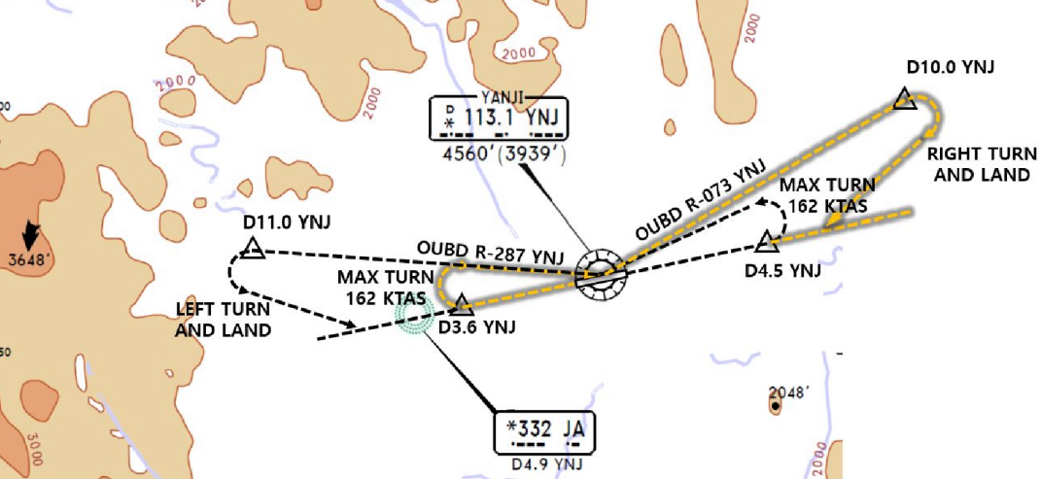
ZYYJ(YNJ) 624ft | RKSI(ICN) 23ft
None TWR 118.75 By Voice | KE ICN 131.5
PA
YNJ : RNP SID (NADP 1) RW27 Main CTOT from GND Staff due to Mil Train (ADD Fuel) Consider Improve C/B & NO Bleed T/O (in Summer)
27 | KANVU 19D (11D) |  |  | 271 |  | 271 | ATC/6500ft (1800mQFE) | 3000 900m | 271
09 | KANVU 09D (01D) |  |  | 091 |  | 091 | ATC/6500ft SPD 200kts | 3000 900m | 091
YNJ 113.1 |  |  | 09 108.7 |  |  |  | 27 109.3 |  | 19 108.9
FIX |  | 27 : YNJ 271/3.6, YNJ 073/10 (MAX 162kts) 09 : YNJ 091/4.5, YNJ 287/11 (MAX 162kts)
HUD |  | 27(597’) 3.3도 |  |  | 8530’ |  |  | 09(621’)
Must Check MTOW RWY 27 180 Back(Clockwise)
YNJ 118.75
SHE 132.35 – 119.3
DLC 128.77 – 135.65
132.95 - ICN 132.8
China
ICN : STAR
ILS 33/34 | REBIT xA | PAMBI | REBIT 170
ILS 15/16 | REBIT xH | MUNAN | REBIT 170
HUD | 33L/R 34L(23’) | 12303’ | 15L/R 16R(23’)
 | 34R(23’) | 13123’ | 16L(23’)
FIX | RWY /8, /5 , P518 R068, R278
33R : C4(7529’), C5(8513’), 33L : B4(7563’), B5(8513‘) 15L : C2(7522’), C1(8536’), 15R : B3(7454‘), B2(8641‘)
34L : P7(5600’), P8(6578’), 34R : N4(6876’), N5(8507‘) 16R : P6(5597’), P5(6574’), 16L : N3(7043‘), N2(8444‘)
8NM 180kts, 5NM 160kts, Parr TAXI 10kts이상, HIRO

Slide 79
RKSI(ICN) 23ft | ZSHC(HGH) 22ft
KE ICN 131.5 DCL -10분 TOBT 5분 차이시 CTC Comm | Hangzhou Reporting Office 130.65
PA
ICN : SID (33/34 NADP 1, 15/16 NADP 2)
33L/R | BOPTA xA |  | 333 |  | 333 |  | ATC |  | 333
34L/R | BOPTA xY |  | 333 |  | 333 |  | ATC |  | 333
15L/R | BOPTA xC |  | 153 |  | 153 |  | 5000 |  | 153
16L/R | BOPTA xH |  | 153 |  | 153 |  | 5000 |  | 153
NCN 113.8 |  | 33L 109.3 |  | 33R 108.9 |  | 15L 111.9 |  | 15R 109.1
WNG 112.9 |  | 34L 109.95 |  | 34R 108.1 |  | 16L 110.35 |  | 16R 108.55
33L/R : NC05L/R, R242 YJU R271 |  |  |  | 34L/R : WNG333/4.6, R242 YJU R271
HUD | 33L/R 34L(23’) |  |  | 12303’ |  | 15L/R 16R(23’)
 | 34R (23’) |  |  | 13123’ |  | 16L (23’)
Parallel TWY 10KTS 이상(R17 MAX 15kts)
DEP 125.15 – TGU 126.17 – 120.72 – 124.52(125.72)
SHA 120.95 – 120.55 - SHA APP 125.62 – 119.7
HGH APP 119.82 – 120.4 – 125.55
China
HGH : STAR - STAR, APP, Missed APP Keep Track Cauton Military Traffic (Missed APP ALT In ATIS)
06/07 | OKT, SUP 91A | HC410 | ILS Z xx
24/25 | OKT, SUP 81A | HC305 | ILS Z xx
HUD | 06(22’) 11155’ 24(22’)
 | 07(22’) 11811’ 25(22’)
FIX | APP SPD REST in APP Chart
06 : C5(5613’), C6(6899’), 24 : C4(5613’), C3(6981’) 07 : A5(6266’), A6(7565’), 25 : A4(6250’), A3(7555’) TWR Permisson Report RWY Vacated
TAXI RTE In Jeppesen Chart, Follow Me Car, APU off

Slide 80
TL
TA
550M 1800ft
China

Slide 81
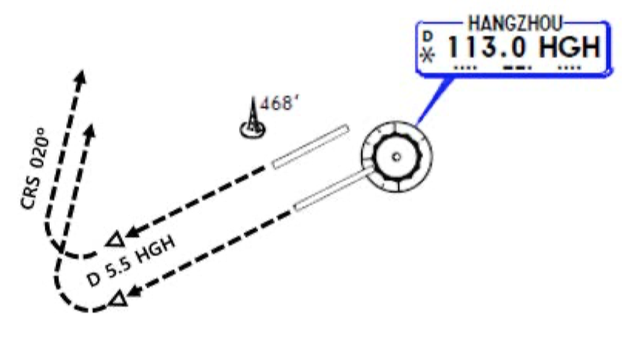
ZSHC(HGH) 22ft | RKSI(ICN) 23ft
Hangzhou Reporting Office 130.65 DCL(NO Readback) Voice 10min전 | KE ICN 131.5
PA
HGH: SID (NADP 1)
06/07 | OKT, SUP 91D |  |  | 069 |  | 069 | 3000 (900m) | 069
24/25 | SUP 81D |  |  | 249 |  | 249 | 3000 (900m) | 249
HGH 113.0 |  |  | 06 110.5 |  | 07 110.35 |  | 24 111.5 | 25 108.5
FIX |  | 24/25 : HGH 249/5.5, R020
HUD |  | 06(22’) 11155’ 24(22’) |  |  |  |  | 16L/R(12’/11’) 17L(10’)
 |  | 07(22’) 11811’ 25(22’)
APU Start, TUG Connect After Beacon L/T ON Red/Blue PushBack, Verify RWY & Direction After T/O, Report T/O RWY
HGH APP 120.4 – 119.82
SHA APP 119.975
SHA 120.55 - 120.95
ICN 125.725(124.52) – 120.72 – 126.17
APP – 119.75
China
ICN : STAR
ILS 33/34 | OLMEN xE | ENPIL | OLMEN 180
ILS 15/16 | OLMEN xH | MUNAN | OLMEN 180
HUD | 33L/R 34L(23’) | 12303’ | 15L/R 16R(23’)
 | 34R(23’) | 13123’ | 16L(23’)
FIX | RWY /8, /5 , YJU R271
33R : C4(7529’), C5(8513’), 33L : B4(7563’), B5(8513‘) 15L : C2(7522’), C1(8536’), 15R : B3(7454‘), B2(8641‘)
34L : P7(5600’), P8(6578’), 34R : N4(6876’), N5(8507‘) 16R : P6(5597’), P5(6574’), 16L : N3(7043‘), N2(8444‘)
8NM 180kts, 5NM 160kts, Parr TAXI 10kts이상, HIRO

Slide 82
RKSI(ICN) 23ft | ZSWH(WEH)146ft
KE ICN 131.5 DCL -10분 TOBT 5분 차이시 CTC Comm | None No D-ATIS
PA
ICN : SID (33/34 NADP 1, 15/16 NADP 2)
33L/R | NOPIK xA |  | 333 |  | 333 |  | ATC |  | 333
34L/R | NOPIK xY |  | 333 |  | 333 |  | ATC |  | 333
15L/R | BINIL xC |  | 153 |  | 153 |  | 5000 |  | 153
16L/R | BINIL xH |  | 153 |  | 153 |  | 5000 |  | 153
NCN 113.8 |  | 33L 109.3 |  | 33R 108.9 |  | 15L 111.9 |  | 15R 109.1
WNG 112.9 |  | 34L 109.95 |  | 34R 108.1 |  | 16L 110.35 |  | 16R 108.55
33L/R : NC05L/R, R242 P518 R068, R278 |  |  |  | 34L/R : WNG333/4.6, R242 P518 R068, R278
HUD | 33L/R 34L(23’) |  |  | 12303’ |  | 15L/R 16R(23’)
 | 34R (23’) |  |  | 13123’ |  | 16L (23’)
Parallel TWY 10KTS 이상(R17 MAX 15kts)
DEP 125.15 – TGU 132.8 – DLC 132.95
TAO 133.725
WHE TWR 118.65 (130.0)
China
WEH (TL 69) : RNAV STAR (QFE but QNH Operation) Around AGAVO ATIS 126.25 get RWY, APP info
03 | IKE xx F | WH106 | RNP ILS Z 03
21 | IKE xx F | WH206 | RNP ILS Z 21
HUD | 03(113’) 8530’ 21(146’)
03 : B(6500’), C(5300’), 21 : D(7300’) 90 Turn Vacate 180 Back No Terminal Side Turn
RWY 21 Short Track Miles -> Req one Orbit WH113 Watch MLDW Due to RWY 21 ShortCut Descend Published Report Published = CLR APP PAX Window must closed Between APP and DEP

Slide 83
TL
TA
550M 1800ft
QFE Next Page
China

Slide 84
WEH Altitude / Height Conversion Table
xxxx meters on STD 이후 적용 xxxx meters on QFE xxxx -> REQ QNH -> QNH xxx SET후 Conversion Table 사용 03 Elev : 113ft = 4.0hPa, 21 Elev : 146ft = 5.2hPa
Height based on QFE (instructed by ATC) | Altitude base on QNH (Set Altitude : QFE + Elev SET)
xxx m on QFE | xxx m plus Elevation Set
2400 m | 8000 ft
2100 m | 7000 ft
1800 m | 6000 ft
1500 m | 5100 ft
1200 m | 4100 ft
1100 m | 3700 ft
1000 m | 3400 ft
900 m | 3100 ft
800 m | 2700 ft
700 m | 2400 ft
600 m | 2100 ft
550 m | 1900 ft
500 m | 1800 ft
400 m | 1400 ft
350 m | 1300 ft
300 m | 1100 ft
280 m | 1000 ft
200 m | 800 ft
100 m | 400 ft
0 m | 03 : 113 ft | 21 : 146 ft

Slide 85
ZSWH(WEH)146ft | RKSI(ICN) 23ft
None -5 Min, TWR 118.65 By Voice | KE ICN 131.5
PA
WEH (TA 4930’) : RNP SID (NADP 1)
03 | IKE xx X |  |  | 026 |  | 026 | ATC 4500m(14800’) | 3000 900m | 026
21 | IKE xx X |  |  | 206 |  | 206 | ATC 4500m(14800’) | 3000 900m | 206
WHE 115.8 |  |  | 03 110.1 |  |  |  | 21 110.7 |  | 19 108.9
HUD |  | 03(113’) |  |  | 8530’ |  |  | 21(146’)
RWY03/21 Expect C – Taxi down on RWY – 180 Back Taxi to RWY21 via B -> Confirm 180 Back!!! 180 Back No Terminal Side Turn PAX Window must closed Between APP and DEP
TWR 118.65
TAO 133.725
DLC 132.95
TGU 132.8
China
ICN : STAR
ILS 33/34 | REBIT xA | PAMBI | REBIT 170
ILS 15/16 | REBIT xH | MUNAN | REBIT 170
HUD | 33L/R 34L(23’) | 12303’ | 15L/R 16R(23’)
 | 34R(23’) | 13123’ | 16L(23’)
FIX | RWY /8, /5 , P518 R068, R278
33R : C4(7529’), C5(8513’), 33L : B4(7563’), B5(8513‘) 15L : C2(7522’), C1(8536’), 15R : B3(7454‘), B2(8641‘)
34L : P7(5600’), P8(6578’), 34R : N4(6876’), N5(8507‘) 16R : P6(5597’), P5(6574’), 16L : N3(7043‘), N2(8444‘)
8NM 180kts, 5NM 160kts, Parr TAXI 10kts이상, HIRO

Slide 86
RKSI(ICN) 23ft | ZLXY(XIY)1572ft
KE ICN 131.5 DCL -10분 TOBT 5분 차이시 CTC Comm | Airport Operation Center 132.0
PA
ICN : SID (33/34 NADP 1, 15/16 NADP 2)
33L/R | NOPIK xA |  | 333 |  | 333 |  | ATC |  | 333
34L/R | NOPIK xY |  | 333 |  | 333 |  | ATC |  | 333
15L/R | BINIL xC |  | 153 |  | 153 |  | 5000 |  | 153
16L/R | BINIL xH |  | 153 |  | 153 |  | 5000 |  | 153
NCN 113.8 |  | 33L 109.3 |  | 33R 108.9 |  | 15L 111.9 |  | 15R 109.1
WNG 112.9 |  | 34L 109.95 |  | 34R 108.1 |  | 16L 110.35 |  | 16R 108.55
33L/R : NC05L/R, R242 P518 R068, R278 |  |  |  | 34L/R : WNG333/4.6, R242 P518 R068, R278
HUD | 33L/R 34L(23’) |  |  | 12303’ |  | 15L/R 16R(23’)
 | 34R (23’) |  |  | 13123’ |  | 16L (23’)
Parallel TWY 10KTS 이상(R17 MAX 15kts)
DEP 125.15 – TGU 132.8 – DLC 132.95
TAO 133.725 – 128.15
PEK 125.6 – 120.35 – 133.65 – 134.15 - 126.7
XIY 125.3 – 120.95
XIY APP 119.05 – 120.2 – 125.1
China
XIY (TL 118) : RNAV STAR Req ILS APP instead of Visual APP (Speed Restriction)
05L/R | LOVRA xx W | XY906 | RNAV ILS Z 05L/R
23R/L | LOVRA xx Y | XY801 | RNAV ILS Z 23R/L
HUD | 05L(1562’) 9843’ 23R(1569’)
 | 05R(1556’) 12467’ 23L(1538’)
05L : A3(6778’), A2(9032’), 23R : A6(5544’), A7(6512’) 05R : D4(5613’), D3(7322’), 23L : D5(5646’), D6(7408’)
Follow Me Car, CTC Apron before Gate in “Closing to xx TWY, apply to change to xx Freq” Taxi RTE in Jeppesen Chart.

Slide 87
TL
TA
550M 1800ft
China

Slide 88
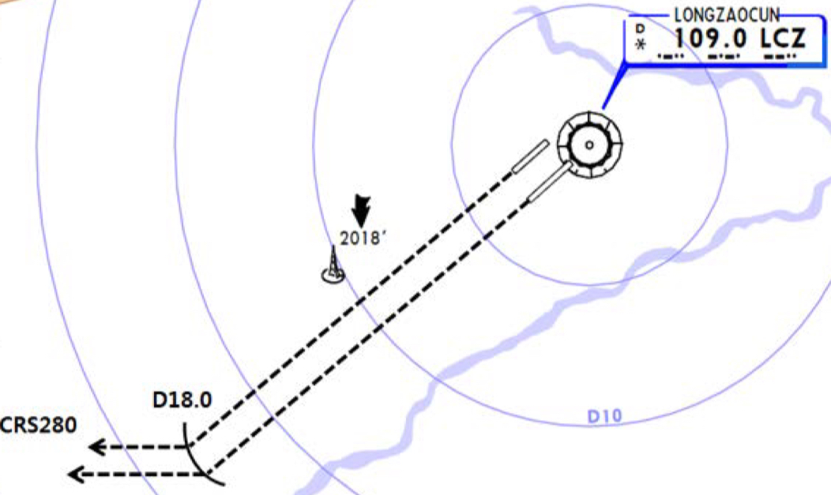
ZLXY(XIY)1572ft | RKSI(ICN) 23ft
Airport Operation Center 132.0 DCL -20 Min, Read Back | KE ICN 131.5
PA
XIY (TA 9850’) : RNAV SID (NADP 1)
05L/R | WJC xx W/Z |  |  | 052 |  | 052 | ATC 1500m(4900’) |  |  | 052
23R/L | WJC xx X/Y |  |  | 232 |  | 232 | ATC 1500m(4900’) |  |  | 232
LCZ 109.0 |  |  | 05L 109.9 |  | 23R 110.3 |  | 21 110.7 | 05R 109.3 | 23L 111.1 | 19 108.9
FIX |  | 23R/L : LCZ /18
HUD |  | 05L(1562’) 9843’ 23R(1569’)
 |  | 05R(1556’) 12467’ 23L(1538’)
Req Full length to Delivery
DEP 119.9- XIY 120.95 – 124.1
PEK 126.7 – 134.15 – 128.3 – 120.35
DLC 123.2 - 132.95
TAE 132.8
China
ICN : STAR
ILS 33/34 | REBIT xA | PAMBI | REBIT 170
ILS 15/16 | REBIT xH | MUNAN | REBIT 170
HUD | 33L/R 34L(23’) | 12303’ | 15L/R 16R(23’)
 | 34R(23’) | 13123’ | 16L(23’)
FIX | RWY /8, /5 , P518 R068, R278
33R : C4(7529’), C5(8513’), 33L : B4(7563’), B5(8513‘) 15L : C2(7522’), C1(8536’), 15R : B3(7454‘), B2(8641‘)
34L : P7(5600’), P8(6578’), 34R : N4(6876’), N5(8507‘) 16R : P6(5597’), P5(6574’), 16L : N3(7043‘), N2(8444‘)
8NM 180kts, 5NM 160kts, Parr TAXI 10kts이상, HIRO

Slide 89
RKSI(ICN) 23ft | ZGHA(CSX)220ft
KE ICN 131.5 DCL -10분 TOBT 5분 차이시 CTC Comm | Changsha Reporting Office 131.15
PA
ICN : SID (33/34 NADP 1, 15/16 NADP 2)
33L/R | NOPIK xA |  | 333 |  | 333 |  | ATC |  | 333
34L/R | NOPIK xY |  | 333 |  | 333 |  | ATC |  | 333
15L/R | BINIL xC |  | 153 |  | 153 |  | 5000 |  | 153
16L/R | BINIL xH |  | 153 |  | 153 |  | 5000 |  | 153
NCN 113.8 |  | 33L 109.3 |  | 33R 108.9 |  | 15L 111.9 |  | 15R 109.1
WNG 112.9 |  | 34L 109.95 |  | 34R 108.1 |  | 16L 110.35 |  | 16R 108.55
33L/R : NC05L/R, R242 P518 R068, R278 |  |  |  | 34L/R : WNG333/4.6, R242 P518 R068, R278
HUD | 33L/R 34L(23’) |  |  | 12303’ |  | 15L/R 16R(23’)
 | 34R (23’) |  |  | 13123’ |  | 16L (23’)
Parallel TWY 10KTS 이상(R17 MAX 15kts)
DEP 125.15 – TGU 132.8 – DLC 132.95
TAO 133.725 – 128.15 – PEK 127.35 – 127.5
PEK 132.2 – SHA 118.9 – WUH 119.7 - 134.35
CSX 132.55 – 125.6 – 119.65
HUH TWR 118.55(118.175)
China
CSX (TL 118) : RNAV STAR After OLMIB 6600M, STAR or RDR Vec before GUSIV
18L/R | PEX xx W | HA366 | RNAV ILS Z 18L/R
36R/L | PEX xx X | HA383 | RNAV ILS Z 36R/L
HUD | 18L(212’) 12467’ 36R(188’)
 | 18R(219’) 10499’ 36L(198’)
18L : C9(5629’),C7(6948’),36R : C11(5675’),C13(6961’) 18R : B4(5167’), B3(6427’), 36L : B5(5206’), B6(6443’)
Position Report to GND first CTC TWY T9 less 29.2m , Follow Me Car APU Procedure but APU available cabin 26도 이하시

Slide 90
TL
TA
550M 1800ft
China

Slide 91
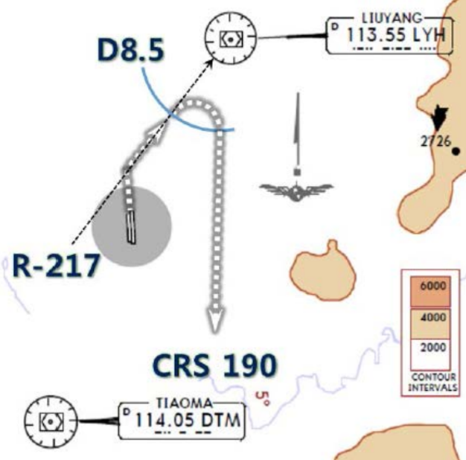
ZGHA(CSX)220ft | RKSI(ICN) 23ft
Changsha Reporting Office 132.0 DCL -20m, Read Back | KE ICN 131.15
PA
XIY (TA 9850’) : RNAV SID (NADP 1)
18R/L | OPO xx W | OPO xx W |  | 181 |  | 181 | ATC(900m) |  | 181
36L/R | OPO xx X | OPO xx X |  | 001 |  | 001 | ATC(900m) |  | 001
18R 110.3 |  |  | 36L 109.9 | 18R 110.3 | 18L 109.3 | 36L 109.9 | 18L 109.3 | 36R 111.1 | 19 108.9
FIX | 36L/R : LYH217/8.5, R190 (LYH 113.55 for EO)
HUD | 18R(219’) 10499’ 36L(198’)
 | 18L(212’) 12467’ 36R(188’)
CTC DEP 119.65 without TWR Instruction
DEP 119.65- CSX 132.55
WUH 134.35 – 120.975 – 135.65
125.775
SHA 132.4 - 125.325 - 120.55
120.95
China
ICN : STAR
ILS 33/34 | REBIT xA | PAMBI | REBIT 170
ILS 15/16 | REBIT xH | MUNAN | REBIT 170
HUD | 33L/R 34L(23’) | 12303’ | 15L/R 16R(23’)
 | 34R(23’) | 13123’ | 16L(23’)
FIX | RWY /8, /5 , P518 R068, R278
33R : C4(7529’), C5(8513’), 33L : B4(7563’), B5(8513‘) 15L : C2(7522’), C1(8536’), 15R : B3(7454‘), B2(8641‘)
34L : P7(5600’), P8(6578’), 34R : N4(6876’), N5(8507‘) 16R : P6(5597’), P5(6574’), 16L : N3(7043‘), N2(8444‘)
8NM 180kts, 5NM 160kts, Parr TAXI 10kts이상, HIRO

Slide 92
RKSI(ICN) 23ft | VHHH(HKG) 28ft
KE ICN 131.5 DCL -10분 TOBT 5분 차이시 CTC Comm | HAS FLT Dispatch 131.6
PA
ICN : SID (33/34 NADP 1, 15/16 NADP 2)
33L/R | BOPTA xA |  | 333 |  | 333 |  | ATC |  | 333
34L/R | BOPTA xY |  | 333 |  | 333 |  | ATC |  | 333
15L/R | BOPTA xC |  | 153 |  | 153 |  | 5000 |  | 153
16L/R | BOPTA xH |  | 153 |  | 153 |  | 5000 |  | 153
NCN 113.8 |  | 33L 109.3 |  | 33R 108.9 |  | 15L 111.9 |  | 15R 109.1
WNG 112.9 |  | 34L 109.95 |  | 34R 108.1 |  | 16L 110.35 |  | 16R 108.55
33L/R : NC05L/R, R242 YJU R271 |  |  |  | 34L/R : WNG333/4.6, R242 YJU R271
HUD | 33L/R 34L(23’) |  |  | 12303’ |  | 15L/R 16R(23’)
 | 34R (23’) |  |  | 13123’ |  | 16L (23’)
Parallel TWY 10KTS 이상(R17 MAX 15kts)
ICN 124.52(125.72) - FUK 127.5 - TPE 125.5 – 126.7
129.1 - HKG RDR 121.3 – 126.5
DEP 122.0 – Final 119.1 – 119.35
China
HKG : Terminal Tx RTE + STAR Chart (TL110) ENPET FL260, RWY25R After TOPUN - APP Mode
07L(R) | ABBEY xxA SIERA xxA/C | LIMES |  | ILS 07L(R)
25R(L) | ABBEY xxB SIERA xxB/D | TD |  | RNAV tx ILS 25R ILS 25L
HUD | 07L(23’) 11896’ DIS TH 25R (23’)
 | 07R(27’) 11942’ DIS TH |  | 12467’ 25L(27’)
07L : C7(5882’), C8(7194’), 25R : C6(5882’), C5(7211’) 07R : J7(6916’), J8(7998’), 25L : J5(6916’), J4(8192’)
Tx RTE - STAR - APP Chart Many SPD Restrictions xxR Dash Line for B737, APU BAN off Procedure

Slide 93
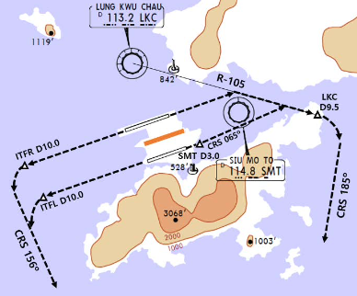
VHHH(HKG) 28ft | RKSI(ICN) 23ft
HAS FLT Disp 131.6 DCL 20분전 5분 차이시 CTC Comm | KE ICN 131.5
PA
HKG : SID + Terminal Tx RTE Chart TA 9000 NADP2 : 1000 SPD INTV (Vzf+10~20kts), 1500 CLB TH (NADP 1/2 for 07L/R)
07L(R) | OCEAN xxE(A) (RASSE xxZ/X) |  |  | 074 |  |  | 074 | 5000 | 074
25R(L) | OCEAN xxB/F |  |  | 254 |  |  | 254 | 5000 | 254
SMT 114.8 |  |  | 07L 111.5 |  | 25R 108.75 |  |  | 07R 110.9 | 25L 110.9
HUD |  | 07R/L(27’/23’) |  |  |  | 12467’ |  | 25L/R(27’/23’)
E. O |  | 07L(R) : LKC R105(SMT /3), LKC105/9.5 R185 25R(L) : ITFR(ITFL)254/10, R156
SID – Tx RTE Chart Many SPD Restriction
HKG DEP 123.8 – RDR 118.925
TPE 129.1 – 126.7 – 123.6 – 125.5
FUK 127.5 - ICN 125.725(124.52)
ICN - 120.72 – 126.17
APP – 119.75
China
ICN : STAR
ILS 33/34 | OLMEN xE | ENPIL | OLMEN 180
ILS 15/16 | OLMEN xH | MUNAN | OLMEN 180
HUD | 33L/R 34L(23’) | 12303’ | 15L/R 16R(23’)
 | 34R(23’) | 13123’ | 16L(23’)
FIX | RWY /8, /5 , YJU R271
33R : C4(7529’), C5(8513’), 33L : B4(7563’), B5(8513‘) 15L : C2(7522’), C1(8536’), 15R : B3(7454‘), B2(8641‘)
34L : P7(5600’), P8(6578’), 34R : N4(6876’), N5(8507‘) 16R : P6(5597’), P5(6574’), 16L : N3(7043‘), N2(8444‘)
8NM 180kts, 5NM 160kts, Parr TAXI 10kts이상, HIRO

Slide 94
RKSI(ICN) 23ft | VVCR(CXR) 46ft
KE ICN 131.5 DCL -10분 TOBT 5분 차이시 CTC Comm | None No D-ATIS
PA
ICN : SID (33/34 NADP 1, 15/16 NADP 2)
33L/R | BOPTA xA |  | 333 |  | 333 |  | ATC |  | 333
34L/R | BOPTA xY |  | 333 |  | 333 |  | ATC |  | 333
15L/R | BOPTA xC |  | 153 |  | 153 |  | 5000 |  | 153
16L/R | BOPTA xH |  | 153 |  | 153 |  | 5000 |  | 153
NCN 113.8 |  | 33L 109.3 |  | 33R 108.9 |  | 15L 111.9 |  | 15R 109.1
WNG 112.9 |  | 34L 109.95 |  | 34R 108.1 |  | 16L 110.35 |  | 16R 108.55
33L/R : NC05L/R, R242 YJU R271 |  |  |  | 34L/R : WNG333/4.6, R242 YJU R271
HUD | 33L/R 34L(23’) |  |  | 12303’ |  | 15L/R 16R(23’)
 | 34R (23’) |  |  | 13123’ |  | 16L (23’)
Parallel TWY 10KTS 이상(R17 MAX 15kts)
FUK 127.5 – TPE 125.5 – 127.9 – 129.1 – MNL 119.3
MNL RDO 8942(5655) – HCM 120.7
132.35 – 134.05 – CXR APP 127.9
SE Asia
CXR : STAR (Wx, Using RWY from HoChiMinh CTL) RWY20 Max Tail Wind 15kts, chk condition CAAV STAR, APP not Authorized
20L/R | COTUN, BANKE, HUNTA, NHATA xx | CR xxx | ILS Y 20L RNP 20R
02R/L |  |  | ILS X/Z 02L/R
HUD | 02R(15’) 3.5도 | 10000’ |  | 20L(34’)
 | 02L(20’) 3.5도 | 10010’ |  | 20R(46’)
20L : G3(6735’), G1(9603’), 02R : G5(6528’), G7(9662’) 20R : W4(5971’), W3(7680’),02L : W5(5606’), W6(7345’)
FollowMe Car Service, Sensitie VDGS Caution!!

Slide 95
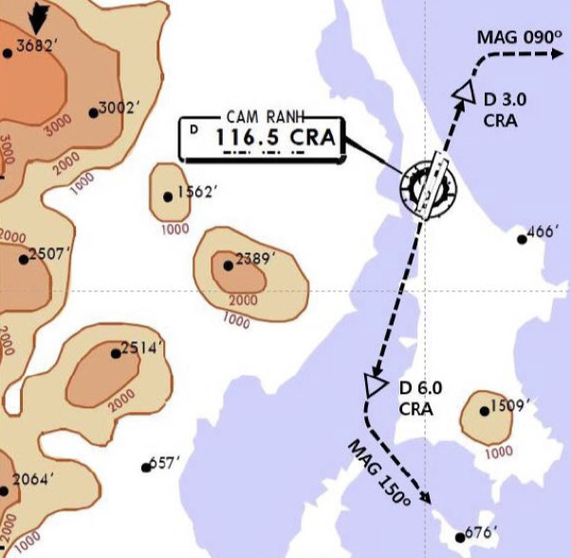
VVCR(CXR) 46ft | RKSI(ICN) 23ft
None TWR 118.2 By Voice | KE ICN 131.5
PA
CNX : RNP SID (NADP 1) Follow Restrictions due to Military Traffic
02L/R | NIHOA xxA |  | 020 |  | 020 | ATC/FL100 | 3000 900m | 020
20R/L | NIHOA xxB |  | 200 |  | 200 | ATC/FL100 | 3000 900m | 200
CRA 116.5 |  | 02R 111.9 |  | 02L 110.7 |  |  | 20L 110.3 | 19 108.9
02 : CRA 020/2, R090 20 : CRA 200/6, R150
HUD | 02L(20’) 3.5도 |  |  | 10010’ |  |  | 20R(46’)
 | 02R(15’) 3.5도 |  |  | 10000’ |  |  | 20L(34’)
TWY Y5 only below wingspan 36m/118ft
DEP 127.9 – HCM 134.05
DAD 123.3 – SNY 122.6(-5min)
HKG 132.15 – 127.1 – TPE 129.1
125.5 – FUK 127.5(SENKA /20)
SE Asia
ICN : STAR
ILS 33/34 | OLMEN xE | ENPIL | OLMEN 180
ILS 15/16 | OLMEN xH | MUNAN | OLMEN 180
HUD | 33L/R 34L(23’) | 12303’ | 15L/R 16R(23’)
 | 34R(23’) | 13123’ | 16L(23’)
FIX | RWY /8, /5 , YJU R271
33R : C4(7529’), C5(8513’), 33L : B4(7563’), B5(8513‘) 15L : C2(7522’), C1(8536’), 15R : B3(7454‘), B2(8641‘)
34L : P7(5600’), P8(6578’), 34R : N4(6876’), N5(8507‘) 16R : P6(5597’), P5(6574’), 16L : N3(7043‘), N2(8444‘)
8NM 180kts, 5NM 160kts, Parr TAXI 10kts이상, HIRO

Slide 96
RKSI(ICN) 23ft | VVTS(SGN) 33ft
KE ICN 131.5 DCL -10분 TOBT 5분 차이시 CTC Comm | None No D-ATIS
PA
ICN : SID (33/34 NADP 1, 15/16 NADP 2)
33L/R | BOPTA xA |  | 333 |  | 333 |  | ATC |  | 333
34L/R | BOPTA xY |  | 333 |  | 333 |  | ATC |  | 333
15L/R | BOPTA xC |  | 153 |  | 153 |  | 5000 |  | 153
16L/R | BOPTA xH |  | 153 |  | 153 |  | 5000 |  | 153
NCN 113.8 |  | 33L 109.3 |  | 33R 108.9 |  | 15L 111.9 |  | 15R 109.1
WNG 112.9 |  | 34L 109.95 |  | 34R 108.1 |  | 16L 110.35 |  | 16R 108.55
33L/R : NC05L/R, R242 YJU R271 |  |  |  | 34L/R : WNG333/4.6, R242 YJU R271
HUD | 33L/R 34L(23’) |  |  | 12303’ |  | 15L/R 16R(23’)
 | 34R (23’) |  |  | 13123’ |  | 16L (23’)
Parallel TWY 10KTS 이상(R17 MAX 15kts)
FUK 127.5(SENKA /20) – TPE 125.5 – 127.9 – 129.1
MNL 119.3 - MNL RDO 8942(5655) – HCM 120.7
132.35 – SGN APP 125.5
SE Asia
SGN : STAR (CPDLC : VVHM) TL 190
25R(L) | DALAP xxH | SOKAN | SOKAN | ILS W 25R/L
07R(L) | DALAP xxG | SAMDU | SAMDU | ILS W 07R, VOR 07L
HUD | 25R(33’) 10007’ 07L(20’) |  | 10007’
 | 25L(32’) 12559’ |  | 10036’ (DISP TH) 07R(24’)
25R:P4(6158’), P5(6991’),07R:S6(4412’),S5(6574’,110도) B737 P4, P5, S6, S5 Unable Tell ATC 25L : S7(6824’), S8(9671’), 07L : P3(6266’), P2(8907’)
FollowMe Car Service in Ramp (Caution STOPBAR L/T) Sensitie VDGS!!! (0.5m이내, 2m STOP시 바로 정지)

Slide 97
VVTS(SGN) 33ft | RKSI(ICN) 23ft
None -15min, DEL 121.8 By Voice | KE ICN 131.5
PA
SGN : RNP SID (NADP 1) TA 18000’ Request RWY due to Performance
25L(R) | KADUM xxD |  | 250 |  | 250 | 11000 | 3000 900m | 250
07L(R) | KADUM xxE/A |  | 070 |  | 070 | ATC | 3000 900m | 070
TSH 116.8 |  | 25R 110.5 |  | 07R 111.7 |  |  | 25L 108.3 | 19 108.9
HUD | 25R(33’) 10007’ 07L(20’) |  |  | 10010’ |  |  | 20R(46’)
 | 25L(32’) 12559’ 07R(24’) |  |  | 10000’ |  |  | 20L(34’)
Caution TSAT +- 5min ATC CLR, RWY CHG After TAXI Caution STOPBAR L/T, Follow Car Service
APP 125.5 – HCM 120.1 - 134.05
HNI 123.3 – SNY 122.6(-5min)
HKG 132.15 – 127.1 – TPE 129.1 – 127.9
126.7 – 123.6 - FUK 127.5(SENKA /20)
SE Asia
ICN : STAR
ILS 33/34 | OLMEN xE | ENPIL | OLMEN 180
ILS 15/16 | OLMEN xH | MUNAN | OLMEN 180
HUD | 33L/R 34L(23’) | 12303’ | 15L/R 16R(23’)
 | 34R(23’) | 13123’ | 16L(23’)
FIX | RWY /8, /5 , YJU R271
33R : C4(7529’), C5(8513’), 33L : B4(7563’), B5(8513‘) 15L : C2(7522’), C1(8536’), 15R : B3(7454‘), B2(8641‘)
34L : P7(5600’), P8(6578’), 34R : N4(6876’), N5(8507‘) 16R : P6(5597’), P5(6574’), 16L : N3(7043‘), N2(8444‘)
8NM 180kts, 5NM 160kts, Parr TAXI 10kts이상, HIRO

Slide 98
RKSI(ICN) 23ft | VDPP(PNH) 40ft
KE ICN 131.5 DCL -10분 TOBT 5분 차이시 CTC Comm | PNH DIS 129.0
PA
ICN : SID (33/34 NADP 1, 15/16 NADP 2)
33L/R | BOPTA xA |  | 333 |  | 333 |  | ATC |  | 333
34L/R | BOPTA xY |  | 333 |  | 333 |  | ATC |  | 333
15L/R | BOPTA xC |  | 153 |  | 153 |  | 5000 |  | 153
16L/R | BOPTA xH |  | 153 |  | 153 |  | 5000 |  | 153
NCN 113.8 |  | 33L 109.3 |  | 33R 108.9 |  | 15L 111.9 |  | 15R 109.1
WNG 112.9 |  | 34L 109.95 |  | 34R 108.1 |  | 16L 110.35 |  | 16R 108.55
33L/R : NC05L/R, R242 YJU R271 |  |  |  | 34L/R : WNG333/4.6, R242 YJU R271
HUD | 33L/R 34L(23’) |  |  | 12303’ |  | 15L/R 16R(23’)
 | 34R (23’) |  |  | 13123’ |  | 16L (23’)
Parallel TWY 10KTS 이상(R17 MAX 15kts)
FUK 127.5(SENKA /20) – TPE 125.5 – 127.9 – 129.1
MNL 119.3 - MNL RDO 8942(5655)
HCM 120.7(MIGUG) - PNH 127.5
APP 123.8
SE Asia
PNH : RNAV STAR (TL ATC, ATIS) Caution CLR Limit GONLY, Do not Confuse ANAT, ANAB
05 | NANXY xxB | BOSET | SOKAN | RNP 05
23 | DETMA xxA | KOSDA Del Holding Data | SAMDU | ILS 23
HUD | 05(40’) 9843’ |  | 9350’ (DISP TH) 23(37’)
05 : E(6240’), H(7148’), 23 : C(7004’), 180 Back No Centerline L/T, No Vacate Lead L/T(Only Edge L/T)
APU Off after 5min after parking Stand xx Yellow Lead-in Marking(xx A,B Blue Line!!)

Slide 99
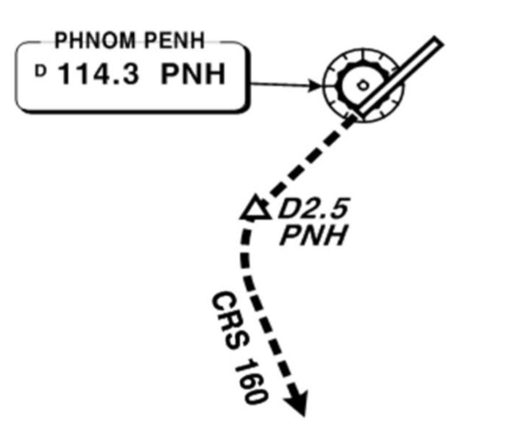
VDPP(PNH) 40ft | RKSI(ICN) 23ft
PNH DIS 129.0 READY! TWR 118.0 By Voice | KE ICN 131.5
PA
PNH : RNAV SID (NADP 1) TA 10000’ RWY 23 SEYHA Watch Over Bank
05 | NANXY xx (SEYHA xx) | 046 |  | 046 | ATC (5000) | 046
23 | KADUM xxE/A | 226 |  | 226 | ATC | 226
PNH 114.3 |  |  | 23 109.7 |  |  | 19 108.9
HUD | 05(40’) 9843’ 23(37’) |  | 10010’
E.O | PNH 226/2.5, R160
APU Start 10min Before DEP Line up 180 Back follow Yellow Guide Line
APP 123.8 – PNH 127.5
HCM 134.05 – 120.7
MNL RDO 8942/5655(ARESI)
MNL 119.3(AKOTA)
TPE 127.9 – 125.5
FUK 127.5(SENKA /20)
SE Asia
ICN : STAR
ILS 33/34 | OLMEN xE | ENPIL | OLMEN 180
ILS 15/16 | OLMEN xH | MUNAN | OLMEN 180
HUD | 33L/R 34L(23’) | 12303’ | 15L/R 16R(23’)
 | 34R(23’) | 13123’ | 16L(23’)
FIX | RWY /8, /5 , YJU R271
33R : C4(7529’), C5(8513’), 33L : B4(7563’), B5(8513‘) 15L : C2(7522’), C1(8536’), 15R : B3(7454‘), B2(8641‘)
34L : P7(5600’), P8(6578’), 34R : N4(6876’), N5(8507‘) 16R : P6(5597’), P5(6574’), 16L : N3(7043‘), N2(8444‘)
8NM 180kts, 5NM 160kts, Parr TAXI 10kts이상, HIRO

Slide 100
RKSI(ICN) 23ft | RPLL(MNL) 75ft
KE ICN 131.5 DCL -10분 TOBT 5분 차이시 CTC Comm | PAGSS Oper 131.0 No D-ATIS
PA
ICN : SID (33/34 NADP 1, 15/16 NADP 2)
33L/R | BOPTA xA |  | 333 |  | 333 |  | ATC |  | 333
34L/R | BOPTA xY |  | 333 |  | 333 |  | ATC |  | 333
15L/R | BOPTA xC |  | 153 |  | 153 |  | 5000 |  | 153
16L/R | BOPTA xH |  | 153 |  | 153 |  | 5000 |  | 153
NCN 113.8 |  | 33L 109.3 |  | 33R 108.9 |  | 15L 111.9 |  | 15R 109.1
WNG 112.9 |  | 34L 109.95 |  | 34R 108.1 |  | 16L 110.35 |  | 16R 108.55
33L/R : NC05L/R, R242 YJU R271 |  |  |  | 34L/R : WNG333/4.6, R242 YJU R271
HUD | 33L/R 34L(23’) |  |  | 12303’ |  | 15L/R 16R(23’)
 | 34R (23’) |  |  | 13123’ |  | 16L (23’)
Parallel TWY 10KTS 이상(R17 MAX 15kts)
FUK 133.6 – 127.5 – 132.3 – 123.9(BISIG ETA)
MNL RDO 8903(13300)
MNL 128.7(BEDIP) – APP 121.1
SE Asia
MNL : RNP STAR with RNP APP (CPDLC : RPHI) TL 130 3 STAR Difference Track Mile & IAF
06 | POLIO, NABAL xxR/P DCT MIA RDR Vec (TMA 250, 20NM 210) | DAGAT (GONDO) | RNP 06 ILS 06
24 | DALAP xxG | MEDAM (MUTAN) | RNP 24 ILS 24
HUD | 06 (16’) 11188’ 24 (75’)
06 : R2(6223’), R1(8221’), 24 : R4(6095’), R5(7746’) Unable advise ATC, Do not confuse R2, E2, RWY31
CTC Ramp before Entering apron, Report Chockin Time Caution HotSpot RWY31

Slide 101
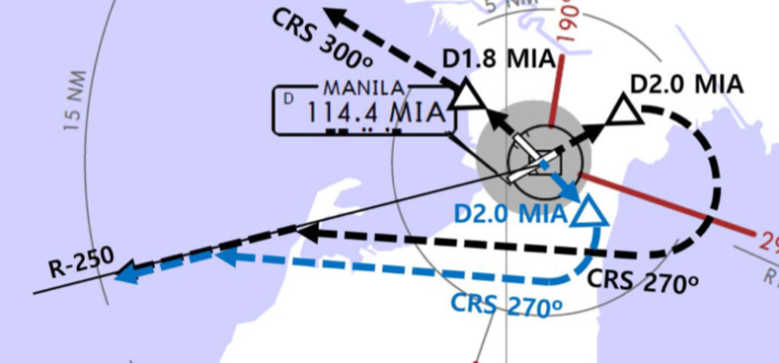
RPLL(MNL) 75ft | RKSI(ICN) 23ft
PAGSS Oper 131.0 -5min, CLR 125.1 By Voice Aircraft Type, Proposing ALT | KE ICN 131.5
PA
MNL : RDR Vector to CAB (NADP 1) TA 11000’ Main RWY H/D Climb 7000ft, CLR for T/O
06 | CAB xx R/A (Cabanatuan) |  | 061 | 061 | 12000ATC | 061
24 | CAB xx P/B (Cabanatuan) |  | 241 | 241 | 9000 ATC | 241
MIA 114.4 |  | 06 109.1 |  |  | 24 109.9 | 19 108.9
E.O | 06 : MIA /2, R250
HUD | 06(16’) 11188’ 24(75’)
Req ENG Startup to GND -> Req Pushback to Ramp
DEP 121.1(124.4)
MNL 120.5 – 119.3(LEBIX ETA)
FUK 123.9 – 127.5 - 133.6
ICN 124.52
SE Asia
ICN : STAR
ILS 33/34 | OLMEN xE | ENPIL | OLMEN 180
ILS 15/16 | OLMEN xH | MUNAN | OLMEN 180
HUD | 33L/R 34L(23’) | 12303’ | 15L/R 16R(23’)
 | 34R(23’) | 13123’ | 16L(23’)
FIX | RWY /8, /5 , YJU R271
33R : C4(7529’), C5(8513’), 33L : B4(7563’), B5(8513‘) 15L : C2(7522’), C1(8536’), 15R : B3(7454‘), B2(8641‘)
34L : P7(5600’), P8(6578’), 34R : N4(6876’), N5(8507‘) 16R : P6(5597’), P5(6574’), 16L : N3(7043‘), N2(8444‘)
8NM 180kts, 5NM 160kts, Parr TAXI 10kts이상, HIRO

Slide 102
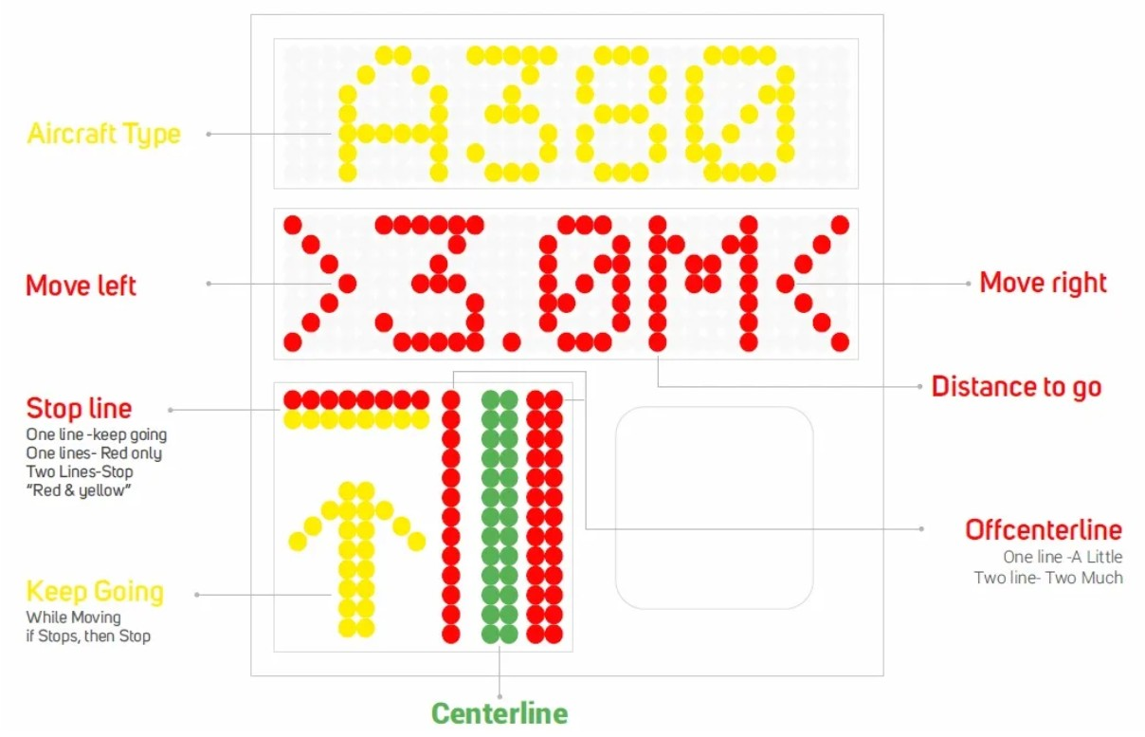
RKSI(ICN) 23ft | RCTP(TPE)108ft
KE ICN 131.5 DCL -10분 TOBT 5분 차이시 CTC Comm | Dynasty Operation 131.3
PA
ICN : SID (33/34 NADP 1, 15/16 NADP 2)
33L/R | BOPTA xA |  | 333 |  | 333 |  | ATC |  | 333
34L/R | BOPTA xY |  | 333 |  | 333 |  | ATC |  | 333
15L/R | BOPTA xC |  | 153 |  | 153 |  | 5000 |  | 153
16L/R | BOPTA xH |  | 153 |  | 153 |  | 5000 |  | 153
NCN 113.8 |  | 33L 109.3 |  | 33R 108.9 |  | 15L 111.9 |  | 15R 109.1
WNG 112.9 |  | 34L 109.95 |  | 34R 108.1 |  | 16L 110.35 |  | 16R 108.55
33L/R : NC05L/R, R242 YJU R271 |  |  |  | 34L/R : WNG333/4.6, R242 YJU R271
HUD | 33L/R 34L(23’) |  |  | 12303’ |  | 15L/R 16R(23’)
 | 34R (23’) |  |  | 13123’ |  | 16L (23’)
Parallel TWY 10KTS 이상(R17 MAX 15kts)
FUK 127.5(SENKA /20)
TPE 125.5
APP 128.5
125.6
SE Asia
TPE : STAR TL130 COPRA FL200 (FL250-130 : 280kts, FL130-10000ft : Max 280kts, APP Chart Text)
05L/R | BAKER xx A | JAMMY |  | ILS 05L/R
23R/L | BAKER xx B | AUGUR |  | ILS 23R/L
HUD | 05L(74’) | 12008’ |  |  | 23R(63’)
 | 05R(107’) DIS 12139’ | 12467’ | 23L(96’) DIS 11319’ |  | 23L(96’)
05L : N7(5787’), N6(6738’), 23R : N6(4468’), N4(6656’) 05R : S6(5419’), S7(7244’), 23L : S5(5442’), S4(7470’)
No VOR at TPE, A-VDGS see above

Slide 103
RCTP(TPE)108ft | RKSI(ICN) 23ft
Dynasty Operation 131.3 DCL, Voice -5min | KE ICN 131.5
PA
TPE : RNAV SID (NADP 1) TA 11000 Be Ready Intersection T/O, A030 -> 3000ft
05R/L | PIANO xxA/C |  | 054 | 054 | ATC | 054
23L/R | PIANO xxD/B |  | 234 | 234 | ATC | 234
05L 111.1 |  | 23R 109.3 | 05R 110.7 |  | 23L 111.9 | 19 108.9
HUD | 05L(74’) |  | 12008’ |  | 23R(63’)
 | 05R(107’) |  | 12467’ |  | 23L(96’)
“DCT PIANO then L3 RNAV Transition”
DEP 128.5
TPE 125.5
FUK 127.5 (SENKA /20)
SE Asia
ICN : STAR
ILS 33/34 | OLMEN xE | ENPIL | OLMEN 180
ILS 15/16 | OLMEN xH | MUNAN | OLMEN 180
HUD | 33L/R 34L(23’) | 12303’ | 15L/R 16R(23’)
 | 34R(23’) | 13123’ | 16L(23’)
FIX | RWY /8, /5 , YJU R271
33R : C4(7529’), C5(8513’), 33L : B4(7563’), B5(8513‘) 15L : C2(7522’), C1(8536’), 15R : B3(7454‘), B2(8641‘)
34L : P7(5600’), P8(6578’), 34R : N4(6876’), N5(8507‘) 16R : P6(5597’), P5(6574’), 16L : N3(7043‘), N2(8444‘)
8NM 180kts, 5NM 160kts, Parr TAXI 10kts이상, HIRO

Slide 104
RKSI(ICN) 23ft | PGUM(GUM) 305ft
KE ICN 131.5 DCL -10분 TOBT 5분 차이시 CTC Comm | Menzies Operations 129.4 No DATIS
PA
ICN : SID (33/34 NADP 1, 15/16 NADP 2)
33L/R | OSPOT xE/A |  | 333 |  | 333 |  | 5500/ATC |  | 333
34L/R | OSPOT xY |  | 333 |  | 333 |  | ATC |  | 333
15L/R | OSPOT xC |  | 153 |  | 153 |  | 5000 |  | 153
16L/R | OSPOT xH |  | 153 |  | 153 |  | 5000 |  | 153
NCN 113.8 |  | 33L 109.3 |  | 33R 108.9 |  | 15L 111.9 |  | 15R 109.1
WNG 112.9 |  | 34L 109.95 |  | 34R 108.1 |  | 16L 110.35 |  | 16R 108.55
33L/R : NC05L/R, R242 YJU R271 |  |  |  | 34L/R : WNG333/4.6, R242 YJU R271
HUD | 33L/R 34L(23’) |  |  | 12303’ |  | 15L/R 16R(23’)
 | 34R (23’) |  |  | 13123’ |  | 16L (23’)
Parallel TWY 10KTS 이상(R17 MAX 15kts)
FUK 133.15 – 135.3 – 132.3
TKO RDO (BIXAK) 17904/8870
SFO RDO (PAKDO) 4666/8903
GUM (NATSS) 118.7
SE Asia
GUM : no STAR (UTC + 10, TL 180) CPDLC BIXAK to NATSS : RJJJ to KZAK CTC GUM CERAP 118.7 (SQ2100) Before 250NM
06L/R | UNZ/-15,OBALE(MEMKE) | ILS 6L/R (Upslope)
24L/R | UNZ/-15,CIBOL(WABOX) | RNAV Y 24L/R (Downslope)
HUD | 6L(256’) 11014’ DIS TH 6R(258’) 10014’ | 24R(305’) 12014’ 24L(293’) 8710’ DIS TH | 24R(305’) 12014’ 24L(293’) 8710’ DIS TH
FIX | UNZ /250 (UNZ VOR out of 3.3NM A/P) | 18 : KMH R283, R280
06L : E(6473’), F(6975’), 24R : D(6282’), C(8264’) 06R : E(6502’), G(7808’) , 24L : B(8254’)
Prepare GS OUT, Vacate RWY CTC Ramp CTL

Slide 105
EDTO Procedure APU Remain ON
PREFLIGHT Apply Alternate Airport IFR Wx Minima for Planning (Ops Pecs C055) RVSM CHK : CAPT/FO 50ft, PILOT/FE 75ft FUEL CROSS FEED V/V CHK : On -> Off, V/V L/T CHK NAV DATA Input : EEP, ETP1, ETP2, EXP HF SELCAL CHK : Jeppesen - ENT DATA Pacific SEOUL RADIO : 8903(3004,6532,13300,13303,17904)
AFTER START APU Remain ON Until Passing EXP
AFTER LEVEL OFF (CRZ CHK) RVSM CHK : CAPT/FO 200ft
BEFORE EEP (Entry Point) 60min 기준 : B737-900 398NM, Others 408NM APU Fail Before EEP : Reroute, Turnback, Divert FIX 1 : EEP, FIX 2 : ETP1 FMS ALT A/P SET : ALTN Page EDTO C/L : Fuel, A/C, MSA, ALT Wx & NOTAM Review Contingency Procedure
EDTO Segment APU Fail After EEP : Continue Apply Actual Wx for Actual Divert
ETP (Equal Time Point) FIX, ALTN Page SET EDTO C/L : Fuel, A/C, MSA, ALT Wx & NOTAM
EXP (Exit Point) APU - OFF
1 HR Before TOD FUEL CROSS FEED V/V CHK : On -> Off, V/V L/T CHK

Slide 106
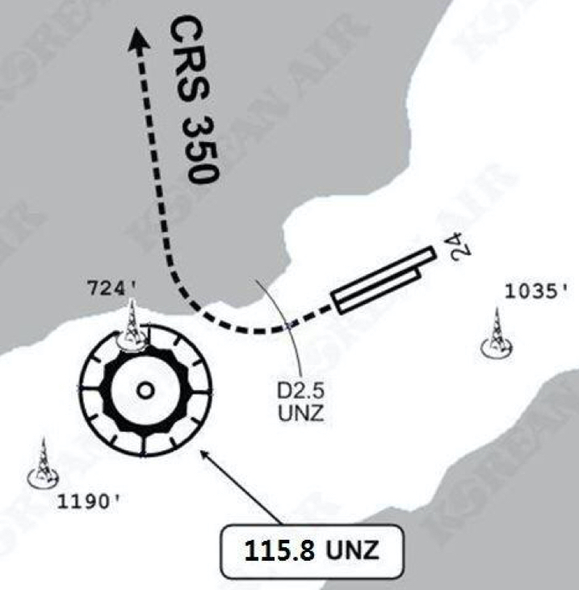
PGUM(GUM) 305ft | RKSI(ICN) 23ft
Menzies Operations 129.4 By Voice, No DATIS | KE ICN 131.5
PA
PUS : no SID (RWY 06 LNAV not Arming on GND)
06L/R | RWY H/D |  | 063 | 063 | ATC (9000) |  | 063
24L/R | RWY H/D |  | 243 | 243 | ATC (9000) |  | 243
UNZ 115.8 |  |  |  | 06L 110.3 |  | 06R 110.9
24 : UNZ /2.5 (UNZ VOR out of 3.3NM A/P)
HUD |  | 06L(256’) 12014’ 24R(305’) 06R(258’) 10014’ 24L(293’) |  |  | 24R(305’) 8530’ 24L(293’) 8999’
RWY, Ramp Area have lots of Slope, Be Caution 06 Upslope, 24 Downslope
DEP 118.7
SFO RDO (NATSS) 8870/6532
TKO RDO (PAKDO) 3455/8903
FUK 132.3 (HIDEK)
KOB 133.85 – 118.9
TAE 125.37
SE Asia
ICN : STAR
ILS 33/34 | GUKDO xE | ENPIL | GUKDO 180
ILS 15/16 | GUKDO xH | MUNAN | GUKDO 180
HUD | 33L/R 34L(23’) | 12303’ | 15L/R 16R(23’)
 | 34R(23’) | 13123’ | 16L(23’)
FIX | RWY /8, /5 , YJU R271
33R : C4(7529’), C5(8513’), 33L : B4(7463’), B5(8513‘) 15L : C2(7522’), C1(8536’), 15R : B3(7454‘), B2(8641‘)
34L : P7(5600’), P8(6578’), 34R : N4(6876’), N5(8507‘) 16R : P6(5597’), P5(6574’), 16L : N3(7043‘), N2(8444‘)
8NM 180kts, 5NM 160kts, Parr TAXI 10kts이상, HIRO

Slide 107
RKPK(PUS) 13ft | RCTP(TPE)108ft
KE Gimhae 129.2 DCL -5분 | Dynasty Operation 131.3
PA
PUS : SID (Mod NADP CLB2 1000, 14000 MAX)
36 | SOORO x TOPAX tx |  |  | 306 |  | 280 |  | ATC |  | 279
18 | BULIM x ENGOT tx |  |  | 182 |  | 182 |  | 5000 |  | 182
KMH 113.8 |  |  | PSN 114.0 |  | 36L 108.5 |  |  |  | 36R 109.5
36 : KMH R091, R271, R185
HUD |  | 36L(13’) 10499’ 36R(8’) 8999’ |  |  |  |  | 18R(13’) 8530’ 18L(13’) 8999’
RWY36 400ft Man L/H turn, Max Taxi SPD 20KTS
DEP 125.5 – TGU 128.17 – 124.52(125.72)
FUK 127.5(SENKA /20)
TPE 125.5
APP 128.5
125.6
SE Asia
TPE : STAR TL130 COPRA FL200 (FL250-130 : 280kts, FL130-10000ft : Max 280kts, APP Chart Text)
05L/R | BAKER xx A | JAMMY |  | ILS 05L/R
23R/L | BAKER xx B | AUGUR |  | ILS 23R/L
HUD | 05L(74’) | 12008’ |  |  | 23R(63’)
 | 05R(107’) DIS 12139’ | 12467’ | 23L(96’) DIS 11319’ |  | 23L(96’)
05L : N7(5787’), N6(6738’), 23R : N6(4468’), N4(6656’) 05R : S6(5419’), S7(7244’), 23L : S5(5442’), S4(7470’)
No VOR at TPE, A-VDGS see above

Slide 108
RCTP(TPE)108ft | RKPK(PUS) 13ft
Dynasty Operation 131.3 DCL, Voice -5min | KE Gimhae 129.2
PA
TPE : RNAV SID (NADP 1) TA 11000 Be Ready Intersection T/O, A030 -> 3000ft
05R/L | PIANO xxA/C |  | 054 | 054 | ATC | 054
23L/R | PIANO xxD/B |  | 234 | 234 | ATC | 234
05L 111.1 |  | 23R 109.3 | 05R 110.7 |  | 23L 111.9 | 19 108.9
HUD | 05L(74’) |  | 12008’ |  | 23R(63’)
 | 05R(107’) |  | 12467’ |  | 23L(96’)
“DCT PIANO then L3 RNAV Transition”
DEP 128.5
TPE 125.5
FUK 127.5 (SENKA /20)
ICN 125.725(124.52) – 128.17
APP – 125.5
SE Asia
PUS : STAR (Tail Wind 36R 136000lbs F40)
ILS 36 | KEVOX x | ANROD | 9DME LG, 8DME FLAP
VOR 18 | GAYHA x | ANROD | 18 Circling Click!!
HUD | 36L(13’) 10499’ 36R(8’) 8999’ |  | 18R(13’) 8530’ 18L(13’) 8999’
FIX | 36 : IKMA/IKHE /9, /8 |  | 18 : KMH R283, R280
36L : C4 (6299’), C2(7795’) / 36R : E3(5866’), E2(7339’) 18R : C6(5770’), C7 (6824’) / 18L : E4(5882’), E5(8792’)
Vacate C3,C4 by ATC only. Max Taxi SPD 20KTS C2 HOLD SHORT 가까움(Vacate TaxiSPD)

Slide 109
CRZ FUEL Penalty (Approximation)
ISA+10℃ : 1% increase trip fuel 2000ft above/below OPT ALT : 1~2% increase trip fuel
NG 4000ft below OPT ALT : 3~5% increase trip fuel 8000ft below OPT ALT : 8~14% increase trip fuel
-8 4000ft below OPT ALT : 2% increase in trip fuel 8000ft below OPT ALT : 7% increase in trip fuel 0.01M above LRC : 1~2% increase in trip fuel
FUEL Consumption
APU GND : 270LBS/hr IN FLT : 180LBS/hr
TAXI 2 ENG, no APU : 1500LBS/hr (400LBS 16분 연료)
CRZ 1시간당 750ft 상승가능
Holding 분당 100LBS (4000LBS는 40분 Holding가능) Missed App & Landing 1200LBS (과거 EDTO자료) 1500LBS이상 적용
FUEL Loading
Center Tank 1000LBS 이상시 Main Tank FULL FUEL Overfill : 1000LBS 기준 - 8 : CTR fuel 1000~2000LBS T/O시 Low Press L/T ON -> CTR Fuel 필요시 2000LBS이상으로 Dispatch
Home

Slide 110
NO ENGINE BLEED TAKEOFF AFTER START (APU ON)
Consideration - Max Taxi Weight Check (MTOW+500lbs) - Improved T/O < No Bleed T/O < Improved T/O + No Bleed T/O - OPT TOW Blank -> MTOW Check - ELEC : ENG GEN, BLEED : APU BLEED (Max 17000ft)
Anti-ice 필요시 이륙전 수행, 불필요시 시동후 수행 BLUE(S/W CHG), BLACK(S/W NO CHG)
Stabilized - AFTER START Flow GENs on BUS, Prob Heats ON 이후 수행 Right PACK switch . . . . . . . . . . . . . AUTO ISOLATION VALVE switch . . . . . . CLOSE Left PACK switch . . . . . . . . . . . . . . AUTO Engine No. 1 BLEED air switch . . . . . OFF APU BLEED air switch . . . . . . . . . . . . . ON Engine No. 2 BLEED air switch . . . . . OFF Trim Air Switch . . . . . . . . . . . . . . . . . . ON WING ANTI-ICE switch . . . . . . . . . . . OFF (ENG BLEED ON & ISOL V/V AUTO까지 OFF) Bleed Air DUCT PRESS indicator . Check Ensure that eng bleed air supplies the packs. APU Remain – ON (OFF 주의) RECALL CHK AFTER START CHECK LIST
Home
Continue
Next Page

Slide 111
NO ENGINE BLEED AFTERTAKEOFF
ENG Fail시 FE+1500ft or Obstacle CLR후 수행하라.
N1, Climb Thrust (APU Bleed MAX 17000ft) Engine No. 2 BLEED air switch . . . . . . ON APU BLEED air switch. . . . . . . . . . . . OFF CABIN rate of CLIMB indicator 안정되면 Engine No. 1 BLEED air switch . . . . . . ON ISOLATION VALVE switch . . . . . . . AUTO APU switch . . . . . . OFF (or ON for EDTO) For EDTO flights, APU EXP까지 ON 유지하라 Bleed Air DUCT PRESS indicator . .Check Ensure that eng bleed air supplies the packs.
NO ENGINE BLEED LANDING
GA Thrust 추가 필요시 10000ft 이하에서 수행
FL200 or TOD 이하 APU switch . . . . START
When below 10,000 ft: WING ANTI-ICE switch . . . . . . . . . . . OFF Right PACK switch . . . . . . . . . . . . . AUTO ISOLATION VALVE switch . . . .. . CLOSE Left PACK switch . . . . . . . . . . . . . . AUTO Engine No. 1 BLEED air switch . . . . . OFF APU BLEED air switch . . . . . . . . . . . . . ON Engine No. 2 BLEED air switch . . . . . OFF Bleed Air DUCT PRESS indicator . .Check Ensure that APU bleed air supplies the packs.
Home

Slide 112
GND CONDITIONED AIR USE
공항 요구로 APU OFF후 기내 온도 조절을 위한 방법 Air Cart와는 다르며 단순 에어컨 기능만 함.
GPU Connect – GPU ONBUS – APU OFF Ground conditioned air 연결 전 PACK switches . . . . . . . . . . . . . . . . . . OFF Packs의 damage를 방지하기 위함.
APU Start – APU ONBUS – GPU, GND Air 제거 PACK switches . . . . . . . . . . . . .As needed
GND AIR CART USE
APU 부작동시 AIR CART로 PACK과 시동을 위해 사용 AIR CART는 외부 BLEED AIR의 역할을 함.
APU BLEED air switch . . . . . . . . . . . . OFF ISOLATION VALVE switch . . . . . . . OPEN RECIRC FAN switches . . . . . . . . . . AUTO Trim Air Switch . . . . . . . . . . . . . . . . . . . ON PACK switches . . . . . . . . . AUTO or HIGH Cabin temperature selectors . . . . . AUTO Set for desired temperature. Duct pressure . . . . . . . . . 20 psi minimum
20 psi이하고 APU 사용가능시 ISOLATION VALVE switch . . . . . . . AUTO APU BLEED air switch. . . . . . . . . . . . . ON APU - left pack, external air - right pack.
Home
ENG START
Next Page

Slide 113
STARTING with GND AIR SOURCE
#1 ENG 먼저 (우측에 AIR CART, GPU 연결됨) “Req Engine Start up Present Positon~~~”
Engine No. 1 must be started first. When cleared to start: -> Before Start CHKLIST APU BLEED air switch . . . . . . . . . . . . OFF Engine No. 1 start . . . . . . . . . .Accomplish Use normal start procedures. -> PACKS – OFF… Generator No. 1 switch . . . . . . . . . . . . ON Disconnect Air Cart & GPU “Request Pushback” (if needed) #2 시동전 Air Cart 제거 반드시 확인!!
ENG CROSSBLEED START
#1 ENGBLEED 로 #2 ENG START
PushBack 완료, #2 ENG Area CLR Parking brake . . . . . . . . . . . . . . . . . . . SET Engine BLEED air switches . . . . . . . . .ON APU BLEED air switch . . . . . . . . . . . . OFF PACK switches . . . . . . . . . . . . . . . . . . OFF ISOLATION VALVE switch . . . . . . . AUTO ENG Bleed air 들어오는지 확인하라. #1 thrust lever . . . . Advance thrust lever Duct Press 30PSI까지 TH 증가(-8 : IDLE) Starting ENG #2 Stabilized - #1 ENG IDLE – After START Flow AFTER START CHKLIST
Home

Slide 114
COLD TEMP CORRECTION General 5도 간격은 보수적으로 보간법 적용됨
Min 은 반드시 수정 (중간 고도 CORRECTION은 PIC 결정) Missed App 고도는 ATC 협조 필요
반드시 고도 – FE 후의 고도를 보정해야함. Ex) FE 200ft 공항 : 5000ft는 4800ft만 보정해야함.
Height Above FE (Feet) 200-800ft
TEMP | 200 | 300 | 400 | 500 | 600 | 700 | 800
0 | 20 | 20 | 30 | 30 | 40 | 40 | 50
-5 | 20 | 30 | 40 | 40 | 50 | 60 | 70
-10 | 20 | 30 | 40 | 50 | 60 | 70 | 80
-15 | 30 | 40 | 50 | 60 | 80 | 90 | 100
-20 | 30 | 50 | 60 | 70 | 90 | 100 | 120
Height Above FE (Feet) 900-5000ft
TEMP | 900 | 1000 | 1500 | 2000 | 3000 | 4000 | 5000
0 | 50 | 60 | 90 | 120 | 170 | 230 | 280
-5 | 70 | 80 | 120 | 160 | 230 | 310 | 390
-10 | 90 | 100 | 150 | 200 | 290 | 390 | 490
-15 | 110 | 120 | 180 | 240 | 360 | 480 | 600
-20 | 130 | 140 | 210 | 280 | 420 | 570 | 710
Domestic
Japan
China
GMP, CJU, CJJ next page
Home

Slide 115
COLD TEMP CORRECTION 1/2
Min 은 반드시 수정 (중간 고도 CORRECTION은 PIC 결정) Missed App 고도는 ATC 협조 필요
GMP 32L (261’) / 32R (262’) / 14R (254’)
32L/R | 8000 | 5500 | 5300 | 4000 | 2800 | 2300 | 2000
0 | 8450 | 5810 | 5600 | 4230 | 2970 | 2440 | 2120
-5 | 8620 | 5930 | 5710 | 4310 | 3030 | 2490 | 2160
-10 | 8780 | 6040 | 5820 | 4390 | 3080 | 2530 | 2200
R14 | 4000 | 2800 | 1400 |  | 4000
0 | 4230 | 2970 | 1490 |  | 4230
-5 | 4310 | 3030 | 1520 |  | 4310
-10 | 4390 | 3080 | 1540 |  | 4390
CJU 07 (307’) / 25 (296’)
 | 4000 | 2900 | 1800 | 07 | 8000 | 25 | 6000
0 | 4220 | 3070 | 1900 |  | 8450 |  | 6340
-5 | 4300 | 3130 | 1940 |  | 8620 |  | 6460
-10 | 4380 | 3180 | 1970 |  | 8780 |  | 6590
CJJ 06L (387’) / 24R (296’)
06L | 4400 | 3900 | 3000 | 2100 |  | 7000
0 | 4650 | 4110 | 3170 | 2210 |  | 7390
-5 | 4740 | 4200 | 3230 | 2270 |  | 7540
-10 | 4810 | 4260 | 3280 | 2290 |  | 7670
24R | 6000 | 3700 | 2500 | 2100 |  | 6000
0 | 6330 | 3900 | 2640 | 2210 |  | 6330
-5 | 6460 | 3980 | 2700 | 2270 |  | 6460
-10 | 6570 | 4040 | 2730 | 2290 |  | 6570
ICN, KWJ, PUS next page
Home

Slide 116
COLD TEMP CORRECTION 2/2
ICN ALL RWY (243’)
33/34 | 7000 | 6000 | 5000 | 3600 | 2600 | 1600
0 | 7400 | 6340 | 5290 | 3810 | 2760 | 1700
-5 | 7520 | 6460 | 5390 | 3880 | 2810 | 1730
-10 | 7680 | 6580 | 5490 | 3950 | 2860 | 1760
15/16 | 3000 | 2600 | 1600 |  | 4000 |  | 3000
0 | 3170 | 2760 | 1700 |  | 4230 |  | 3170
-5 | 3230 | 2810 | 1730 |  | 4310 |  | 3230
-10 | 3290 | 2860 | 1760 |  | 4390 |  | 3290
KWJ 04R(266’),04L(610’) / 22L(610’)
04L/R | 4000 | 3000 | 2000 |  |  |  | 7000
0 | 4230 | 3170 | 2120 |  |  |  | 7500
-5 | 4310 | 3230 | 2160 |  |  |  | 7590
-10 | 4390 | 3290 | 2200 |  |  |  | 7680
22L | 5000 | 4100 | 3500 | 2900 | 2200 |  | 4000
0 | 4230 | 3170 | 2120 | 3070 | 2340 |  | 4230
-5 | 4310 | 3230 | 2160 | 3130 | 2430 |  | 4310
-10 | 4390 | 3290 | 2200 | 3190 | 2420 |  | 4390
Home
PUS 36L(233’),36R(228’) / 18L/R (see below)
36L/R | 6000 | 5000 | 3300 | 2100 |  | 6000
0 | 6340 | 5290 | 3490 | 2210 |  | 6340
-5 | 6460 | 5390 | 3560 | 2250 |  | 6460
-10 | 6580 | 5490 | 3620 | 2290 |  | 6580
18L/R | 6000 | 5000 | 4000 | 2600 | 1700 |  | 6000
0 | 6340 | 5290 | 4230 | 2760 | 1800 |  | 6340
-5 | 6460 | 5390 | 4310 | 2810 | 1830 |  | 6460
-10 | 6580 | 5490 | 4390 | 2860 | 1870 |  | 6580

Slide 117
COLD Wx Operation 1/2
OAT (GND) / TAT (TAT) is 10°C (50°F) or below : • visible moisture (clouds, fog with VIS 1SM (1600 m) or rain, snow, sleet, ice crystals...) • ice, snow, slush and standing water is present on the ramps, taxiways, or runways.
PREFLIGHT PROBE HEAT switches ------------------------- ON
ENGINE START NG : OAT -35°C TH변경전 2분간 IDLE, Min Oil Press 까지 IDLE 수분간 유지, Oil Temp Nor 후 Oil Press High시 ShutDown
ENGINE ANTI-ICE ENGINE START switches ------------------- CONT ENGINE ANTI-ICE switches ------------------- ON COWL V/V OPEN 지속 Bright : APU Bleed OFF - ISO V/V AUTO - TH 서서히 증가 (Max 30%)
WING ANTI-ICE WING ANTI-ICE switch ---------------------------- ON Type II or IV로 Deicing 안할 거면 사용하라
AFTER START GENERATOR 1 and 2 switches ---------------- ON IDG 1분이내 안정, 늦어도 5분이내 안정된다. FLIGHT controls -------------------------------- Check Deicing 할거면 Deicing 하고 한다. FLAPS ---------------------------------------------- Check Full Travel UP – 40 – UP (Deicing시 하고 실시) FLAP UP Taxi 고려
TAXI OUT OAT 3°C 이하 RUN UP, Ice Shedding - RUNUP : Behind CLR, Min 70% 30초, 30분간격 (-8 : 50%-IDLE, 60분 간격) - Ice Shedding (FZRA, FZDZ, FZFG, +SN) : Min 70%, 1초, 10분간격 (-8 : 없음) TWY 상태 고려 허용되는 만큼 N1 사용
Home

Slide 118
COLD Wx Operation 2/2
BEFORE T/O (Takeoff Signal - FLAPS 5) FLAPS ------------------------------------------------ SET -8 : Oil Temp 31°C 이상 확인
Standing TAKEOFF THRUST with EAI -------------- 70%, -8 : 50%5초 RUNUP(OAT 3°C이하) NG 70%30초, -8 : 50% 5초
ENGINE ANTI-ICE ENGINE START switches -------------------- CONT ENGINE ANTI-ICE switches -------------------- ON SAT -41°C 부터 OFF 가능 COWL V/V OPEN 지속 Bright : APU Bleed OFF, ISO V/V AUTO, TH 서서히 증가 (Max 30%)
FAN ICE REMOVAL one ENG at a time Moderate Severe Icing 가능하면 회피하라. FAN ICE로 Vibration 발생 또는 예방을 위한 절차 ENGINE START switches (both) ------------- FLT Autothrottle (if engaged) ------------- Disengage THRUST ------ Increase(min 80%, 1초) & Adjust 15초이내 Vib 4.0이하 안정화(15분 간격 반복가능) Autothrottle (if needed) ------------------- Engage 4.0보다 크면 Engine High Vibration Check List
WING ANTI-ICE Icing 보이면 Deicer로 사용(Anti-icer도 사용가능) FL350이상 사용금지 -> Emer Descend Icing 지역 Holding – Flap 사용금지 WING ANTI-ICE switch --------------------------- ON
APPROACH L/D FLAP 15 사용 조건일 경우만 VREF ICE 사용
AFTER L/D, SHUTDOWN TAXI RUNUP, ICE SHEDDING 절차적용 FLAPS ---------------------------------------- 15 까지만 ENG ANTI-ICE ----------- ENG ShutDown전 OFF Stabilizer trim --------------------------- Set 5 units ENGINE ------------------------------------ ShutDown
Home

Slide 119
ENG ON Deicing in ICN TOBT- 40min CTC KE ICN (사전신청, 결과확인)
ICN Deicing ”Deicing Required ENG On Deicing” ICN Apron “Req Pushback Deicing Zone xxx” SQ2000 Pad Control Arrange Deicing Pad No. Ice Man Manage Deicing Process
PARKING BRAKE ------------------------- SET Report Parking Brake SET - > Ice Man B737-8 BROADBAND s/w -------------- OFF FLAPS ----------------------------------------- UP THRUST LEVERS ------------------------ IDLE ENGINE BLEED AIR SWITCHES ----- OFF APU BLEED air switch ------------------ OFF Report Ready for Deicing - > Ice Man
START DE/ANTI-ICING REQ DCL(CTC DEL) 항공기이동 및 Configuration 변경 금지
AFTER DE/ANTI-ICING IS COMPLETED (TIME CHECK 1분) 용액과 마지막 용액 뿌린 시간 받고 적는다. Holdover Time 결정!!!
TIME CHECK 1분후 APU BLEED air switch ---------- As needed Engine BLEED air switches ------------- ON B737-8 BROADBAND s/w ---------------- ON FLAP LEVER --------- Set for takeoff or UP ice, snow, slush or standing water, 강수 지속시 – FLAP UP고려 (FLAP full travel check 고려) Flight controls ----------- Check, as needed After Start Cheklist
TAXI, BEFORE T/O, T/O Procedure
DECISION TREE next page
Cold Wx
Home

Slide 120
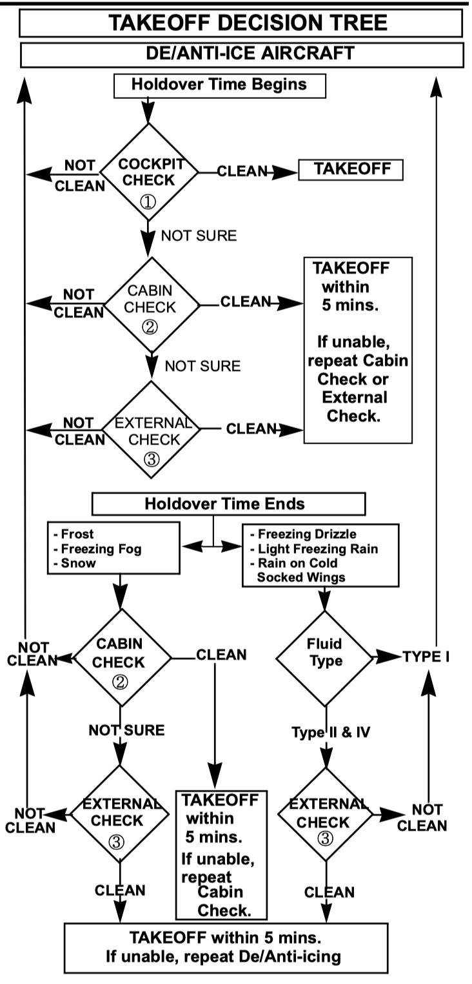
Home

Slide 121
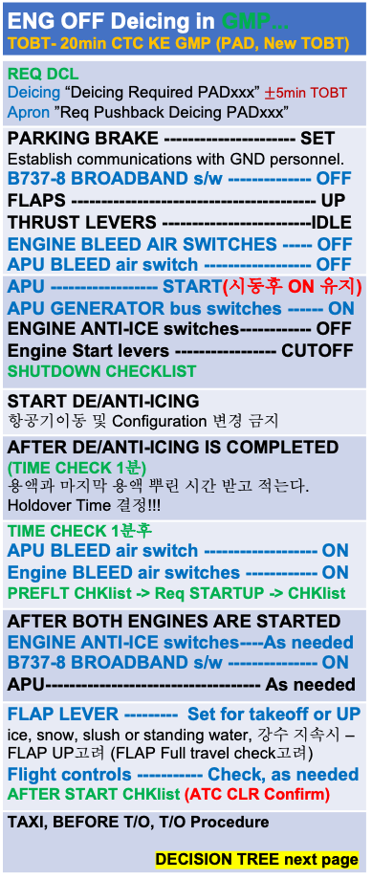
ENG OFF Deicing in GMP... TOBT- 20min CTC KE GMP (PAD, New TOBT)
REQ DCL Deicing “Deicing Required PADxxx” $±$5min TOBT Apron ”Req Pushback Deicing PADxxx”
PARKING BRAKE ---------------------- SET Establish communications with GND personnel. B737-8 BROADBAND s/w -------------- OFF FLAPS ----------------------------------------- UP THRUST LEVERS -------------------------IDLE ENGINE BLEED AIR SWITCHES ----- OFF APU BLEED air switch ------------------ OFF
APU ------------------ START(시동후 ON 유지) APU GENERATOR bus switches ------ ON ENGINE ANTI-ICE switches------------ OFF Engine Start levers ----------------- CUTOFF SHUTDOWN CHECKLIST
START DE/ANTI-ICING 항공기이동 및 Configuration 변경 금지
AFTER DE/ANTI-ICING IS COMPLETED (TIME CHECK 1분) 용액과 마지막 용액 뿌린 시간 받고 적는다. Holdover Time 결정!!!
TIME CHECK 1분후 APU BLEED air switch ------------------- ON Engine BLEED air switches ------------ ON PREFLT CHKlist -> Req STARTUP -> CHKlist
AFTER BOTH ENGINES ARE STARTED ENGINE ANTI-ICE switches----As needed B737-8 BROADBAND s/w --------------- ON APU------------------------------------ As needed
FLAP LEVER --------- Set for takeoff or UP ice, snow, slush or standing water, 강수 지속시 – FLAP UP고려 (FLAP Full travel check고려) Flight controls ----------- Check, as needed AFTER START CHKlist (ATC CLR Confirm)
TAXI, BEFORE T/O, T/O Procedure DECISION TREE next page
Home
Cold Wx

Slide 122
Home

Slide 123
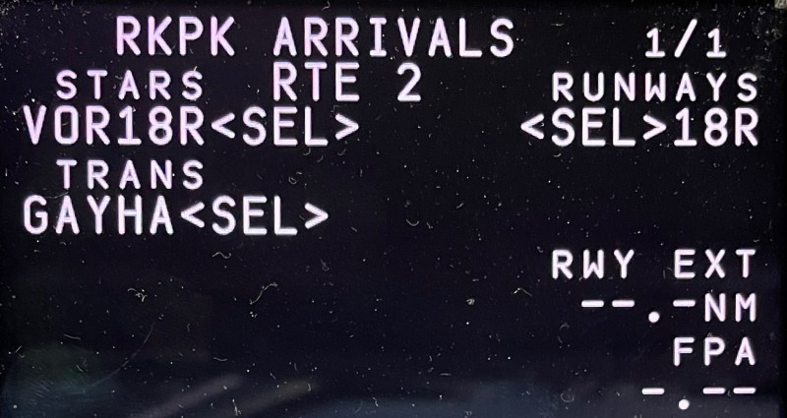
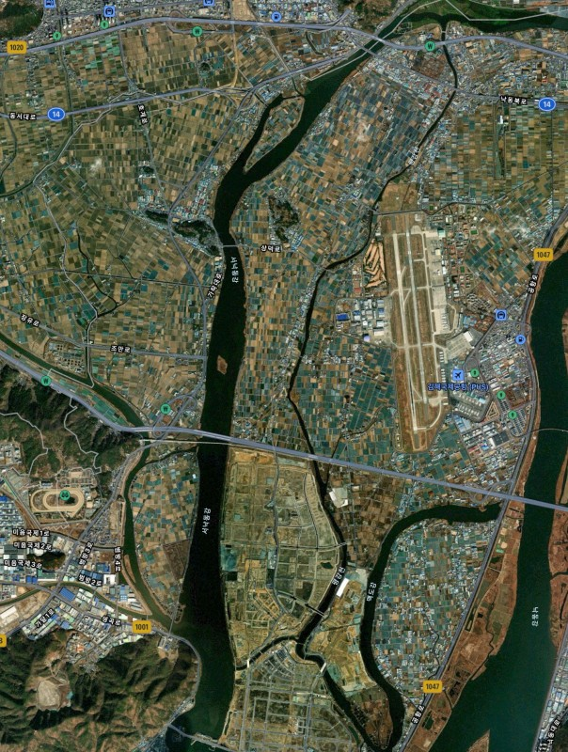
PUS VOR 18L/R
 | STARS RUNWAYS VOR18L/R 18L/R TRANS. KMH22 Vref+wind GAYHA (Modify Required)
FIX : KMH 280(Base Turn), 284(Missed App)
KMH32
KMH35
(18L)
KMH34
(18R)
KMH R280
Start Turn
H/D 182
090-1000ft
(900ft)
500’전
A/P Off
FD Off -
On
KMH30
H/D110
KMH30-1NM
Start Des
KMH22
(MA046)
1700ft L/O 6000ft SET
CRS 284
FAF
(FF046)
Before L/D CHK Complete
NEXT 1700ft
Missed App
Base Turn 이전 : L/H Turn KMH 284 OUTBD (SEL HDG SEL – INT H/D - VOR/LOC Engage)
Base Turn 이후 : Continue R/H Turn KMH 284 OUTBD (SEL HDG SEL – INT H/D - VOR/LOC Engage)
Domestic
LOC 36 Circling
Next Page

Slide 124
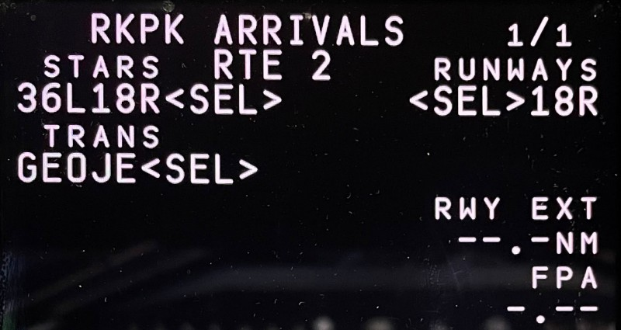
PUS LOC 36L/R Circling 18L/R
 | STARS RUNWAYS 36L18L/R 18L/R TRANS. KMH22 Vref+wind GEOJE (Modify Required)
CI36L(CF36R) 3500 FI36L(FF36R) 2100
FIX : KMH 280(Base Turn), 310(Missed App)
KMH32
KMH35
(18L)
KMH34
(18R)
KMH R280
Start Turn
H/D 182
090-1000ft
(900ft)
500’전
A/P Off
FD Off -
On
KMH30
H/D110
KMH30-1NM
Start Des
KMH22
VOR SET CRS 310
L/D FLAP
Before L/D CHK Complete
KMH18
Before FAF L/G DN FLAP15
1700ft L/O
6000ft SET
Missed App
Base Turn 이전 : L/H Turn KMH 310 OUTBD (SEL HDG SEL – INT H/D - VOR/LOC Engage)
Base Turn 이후 : Continue R/H Turn KMH 310 OUTBD (SEL HDG SEL – INT H/D - VOR/LOC Engage)
Domestic

Slide 125
GS KTS | KM | MILES
300 310 320 330 340 350 | 560 570 590 610 630 650 | 350 360 370 380 390 400
360 370 380 390 400 | 670 690 710 720 740 | 410 430 440 450 460
410 420 430 440 450 | 760 780 800 820 830 | 470 480 500 510 520
460 470 480 490 500 | 850 870 890 910 930 | 530 540 550 560 580
510 520 530 540 550 | 950 960 980 1000 1020 | 590 600 610 620 630
560 570 580 590 600 | 1040 1060 1070 1090 1110 | 650 660 670 680 690
610 620 630 640 650 | 1130 1150 1170 1190 1200 | 700 710 730 740 750
660 670 680 690 700 | 1220 1240 1260 1280 1300 | 760 770 780 800 810
Home

